Slide 1
The future of truck parking
Notes:
Thank you for the opportunity to talk with you the MAASTO Regional Truck Parking Information Management System.
TPIMS is an innovative program for making freight movements on our major highway corridors safer and more efficient.
TPIMS is a joint project of eight partner states that belong to MAASTO – the Mid America Association of State Transportation Officials.
This project was made possible by a $25 million TIGER grant awarded in 2015. And before I go into more detail about it, I’d like to show you a short video we made to summarize the project and its benefits.

Slide 2
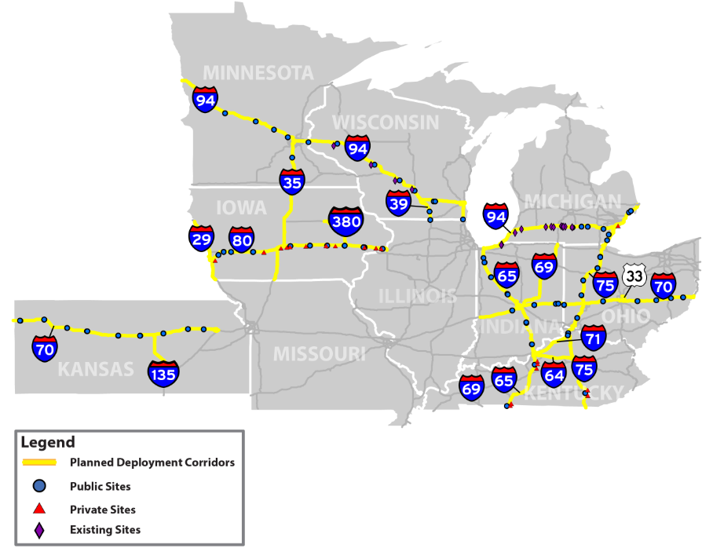
TPIMS at a glance
Focus on key Midwest freight corridors
Monitor 132 public and private sites
Collect real-time parking availability
Aggregate and analyze data
Communicate parking availability to drivers
Measure impact on truck parking and safety
Notes:
So as you just saw, TPIMS reflects a belief that existing parking on important regional corridors can be used more efficiently, benefitting all of us in terms of safety and economic activity.
To achieve that, however, requires better communication of parking availability. And when TPIMS is completed, that’s what will happen along these freight corridors. They include: I-35; I-64; I-65; I-70; I-71; I-75; I-80; I-94; and I-135; and a small portion of US 33 in Ohio
When fully operational, TPIMS will empower the trucking community to make better, more informed parking decisions.

Slide 3
How does TPIMS help?
Give parking information to drivers in route
Rely initially on dynamic messaging signs
Locate signs at routing decision points
Provide drivers with multiple parking options
Make system seamless for users
Notes:
TPIMS will provide real-time information about available parking to drivers through a variety of means.
Signs at travel decision points are one of the most important tools they want.
Truck drivers want to get information about parking availability when they can still react and make routing changes. And they also want confirmation as they approach exits that parking is still open there.
That’s why drivers rank dynamic messaging signs as one of the most favored communication methods for reaching them. There are other forms we’ll discuss later.
TPIMS also provides them with the kind of seamless system they want. Truckers told us loud and clear in the early stages of this project that they wanted the system to look and operate the same regardless of what state they were in.

Slide 4
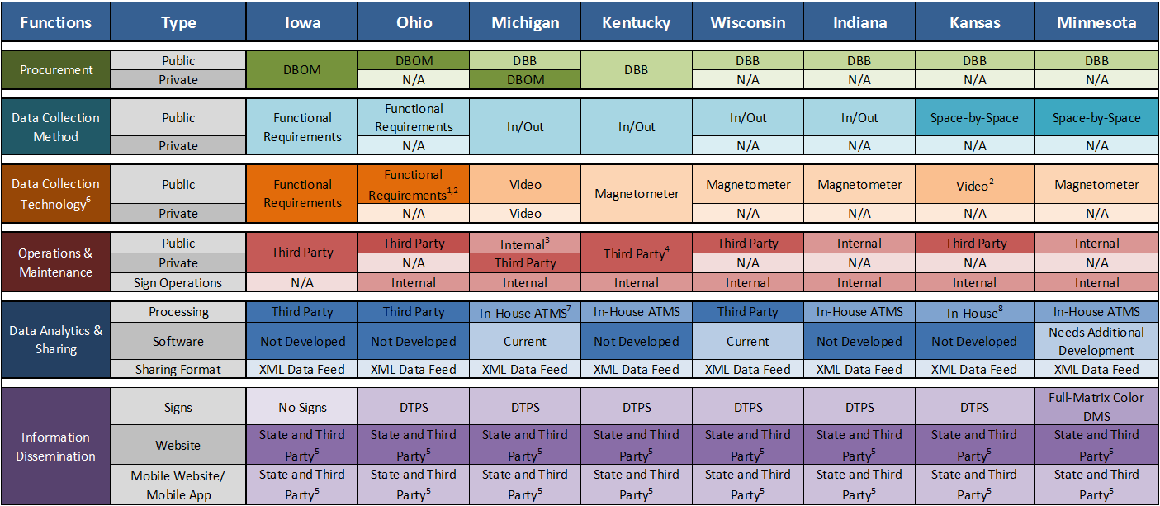
Seamless system challenge
Notes:
A seamless system is a lot harder to create than it might seem.
That’s especially true because the TPIMS partners decided early on that the system had to reflect reality. And the reality is that each state had different technology, procurement and operational requirements.
Luckily, in many ways, this complex “eco-system” really boiled down to four key decisions by the Partnership states.

Slide 5
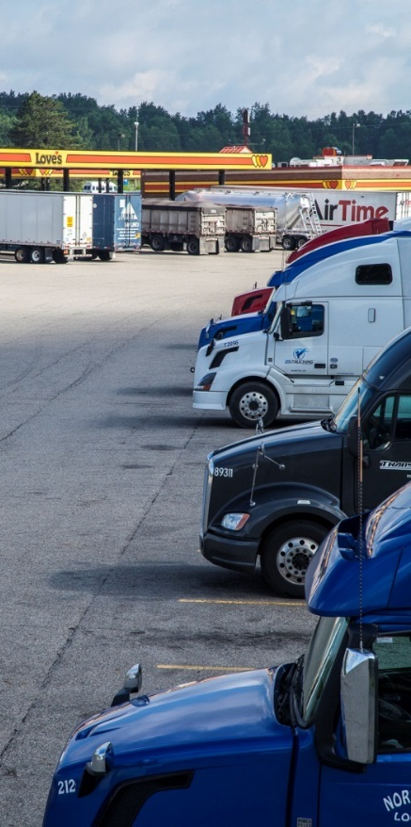
Key TPIMS decisions
Public vs. private sites
Data Collection
Entrance and exit or individual space counts
Data Aggregation
Integrated with ATMS or separate
Local or cloud
Data Communication
Notes:
There are four core operational concepts for the TPIMS deployment: public vs private sites, data collection, data aggregation and data communication. The next series of slides overviews them in more detail.
Each of these core concepts were evaluated through a series of workshops and stakeholder engagement activities during the 30% design phase to arrive at the regional concepts.

Slide 6
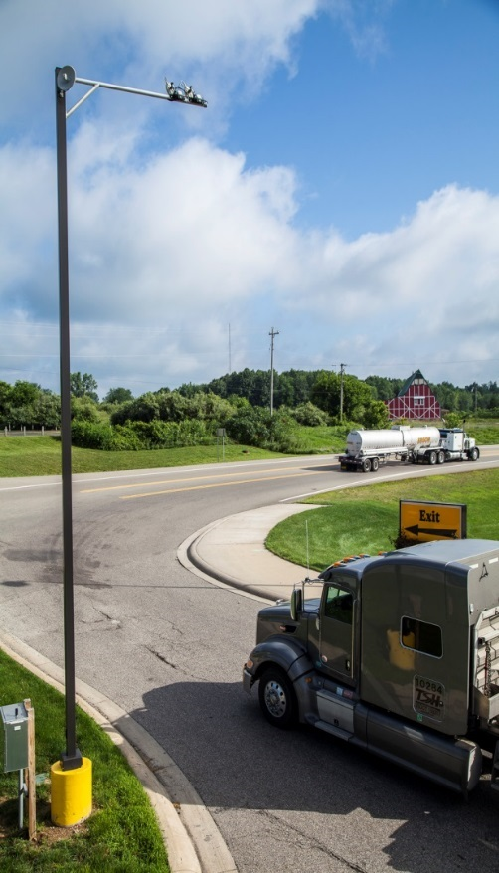
Public vs. private sites
Public sites
Owned, maintained and operated by state agencies
Rest areas, weigh stations
Direct access
Limited parking slots, simpler designs
Greater control over data collection and distribution
Public Sites
Owned, maintained and operated by private sector
Truck stops
Indirect access
Greatest number of parking slots
Shift some costs to private sector
Notes:
One of the first questions each state has had to ask itself is whether or not it was going to include private sites.
If you confine yourself to public sites only, there are some immediate advantages. Public sites have limited parking for trucks typically. This lends itself to more straightforward system concepts, operations and monitoring. It also provides greater control to the states regarding how information can be collected and displayed. Most of the states are focused only on public sites.
Private lots, on the other hand, typically have varying and complex geometries. These do not lend themselves to more straightforward design concepts, operations and monitoring. And coordinating with the private sector can add decision-making complexities.
However, most available parking spaces are in private lots. And partnering with the private sector also offers opportunities to:
Free up grant budget for expanded site deployment;
Eliminate ongoing O & M costs;
Shift all costs for periodic technology upgrades and evolving user needs to third party vendors; and
Ease expansion to other states in the future.
Four states in MAASTO initiative (KY, IA, OH and MI) are doing private site deployments.

Slide 7
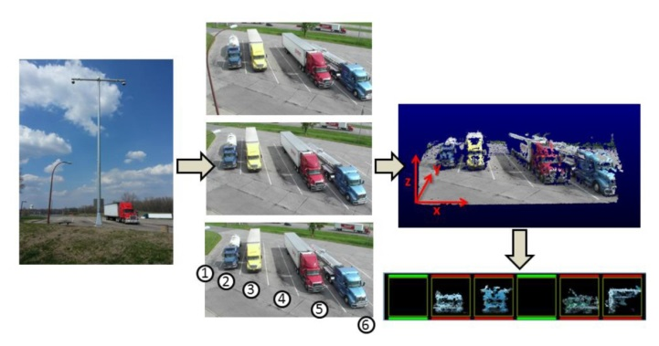
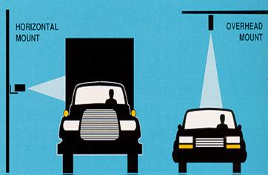
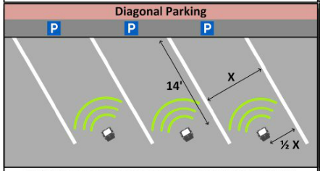
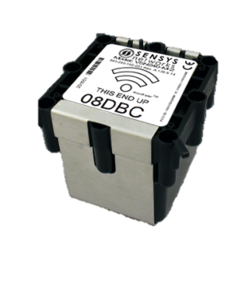
Data collection
Entrance and Exit Counts
In-pavement magnetometer
Video cameras
Laser technology
Space Occupancy Counts
Infrared/magnetometers
Microwave/magnetometers
Video cameras
Radar
Notes:
The next key decision relates to how you’re going to collect parking data.
There are many different systems out there for counting open parking slots.
But generally speaking, every system uses one of two methodologies:
Entrance and exit counts or
Space occupancy counts
Each has advantages or drawbacks based on the specific technology used to implement it. Ultimately, each state had to weigh how those based on their own DOT’s preferences.

Slide 8
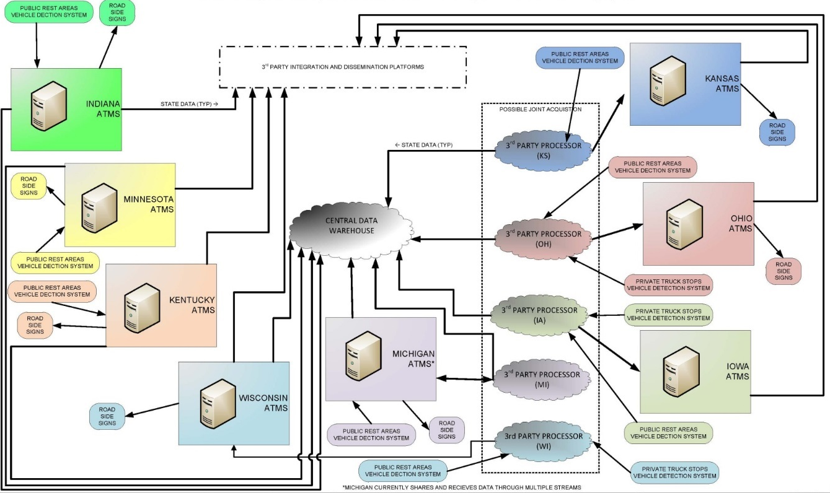
Data aggregation
Notes:
The third decision involves how parking data will be aggregated and analyzed before being disseminated to truckers.
This was important for many reasons, including that it was a key step in creating a system that appeared seamless to drivers.
After looking at various set-ups, ultimately the partnership settled on creating a central warehouse for receiving and storing system data. The warehouse approach means that:
There is a consolidated database of truck parking availability data for all states;
Outages do not impact all state data feeds; and
Operations and maintenance cost less.

Slide 9
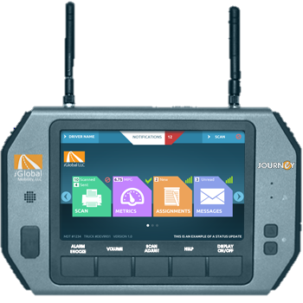
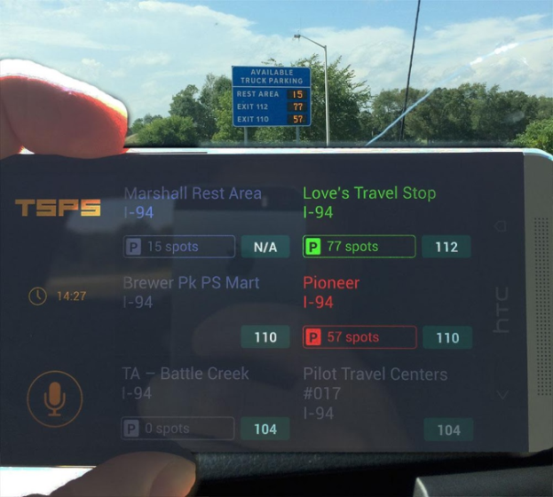
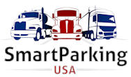
Data communication
Notes:
Finally, each state had to decide how it would provide the parking information.
For many reasons, not every partner state wanted to rely on digital messaging signs.
But every state did want to have the ability to potentially distribute information through 5-1-1 state traveler information sites, in-cab communication systems or private-vendor services such as Waze or Drivewyze.
To accommodate those differing preferences, the partnership created a common XML data feed that would accommodate virtually any kind of digital communication.
This particularly was important to delivering the kind of seamless system that users wanted.

Slide 10
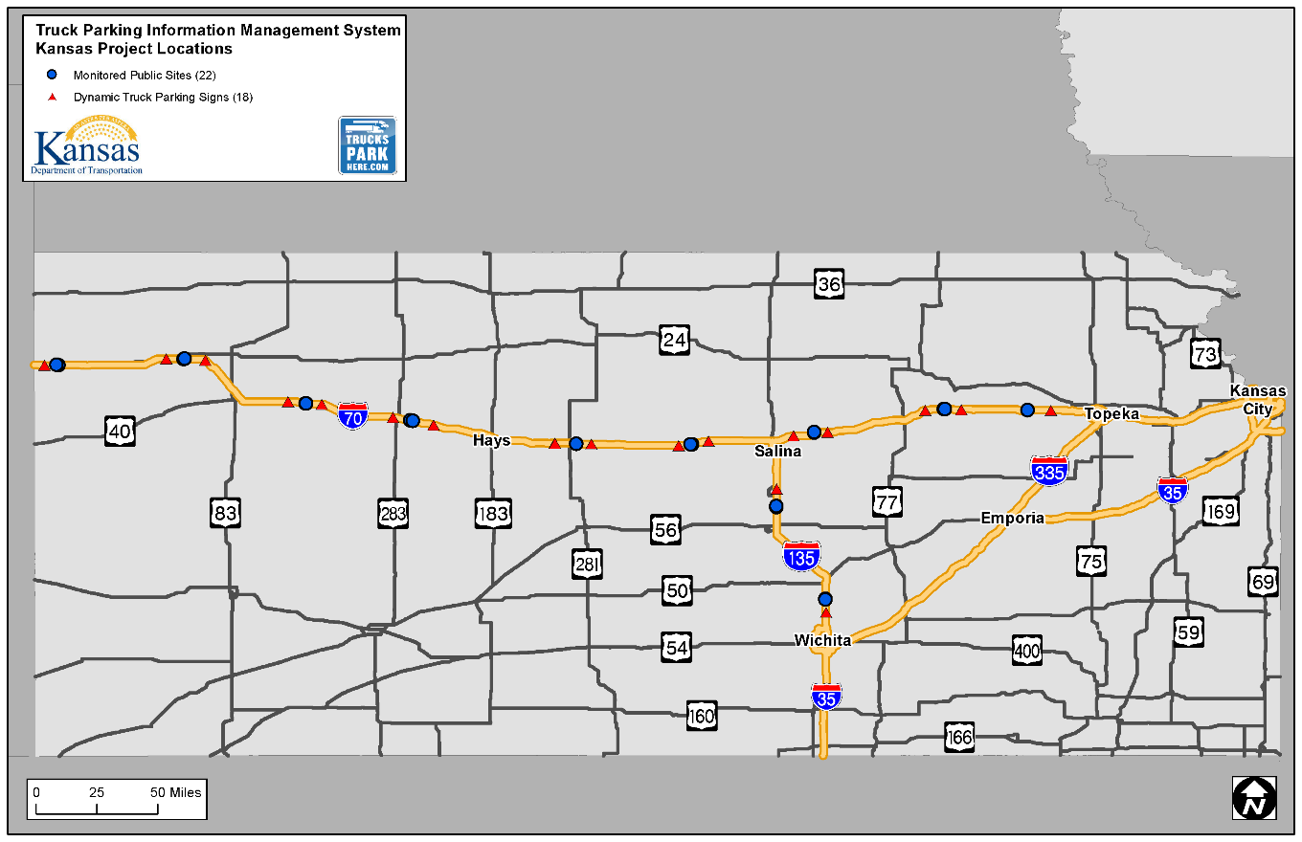
The Kansas TPIMS system
Focus on I-70/I-135
Site locations being finalized
22 public sites
18 dynamic messaging signs

Slide 11
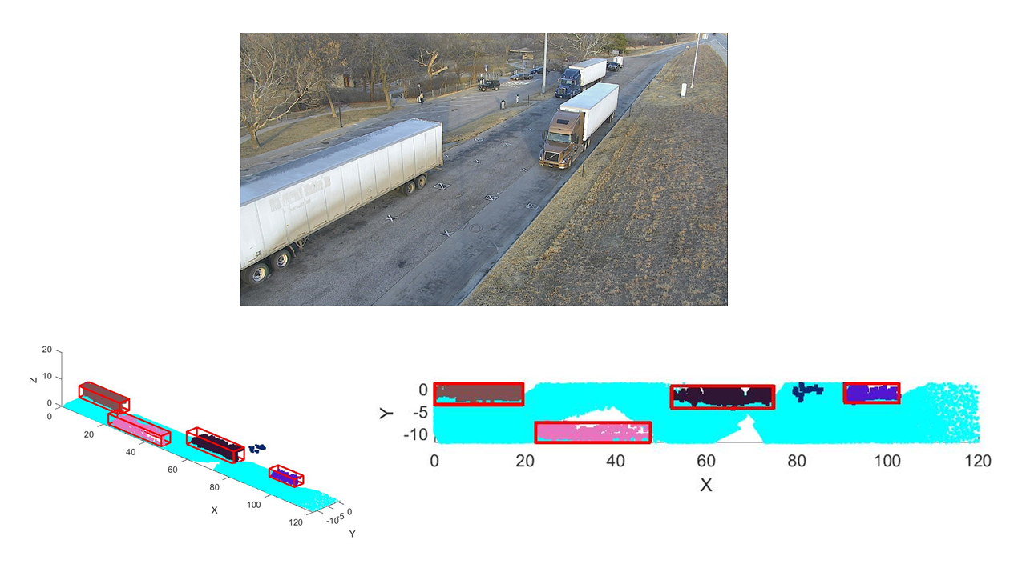
How the Kansas TPIMS works
Uses a 3-camera system
Build a 3D representation of the parking area
Requires less calibration and monitoring than radar or magnetic detection
More accurate than other detection systems

Slide 12
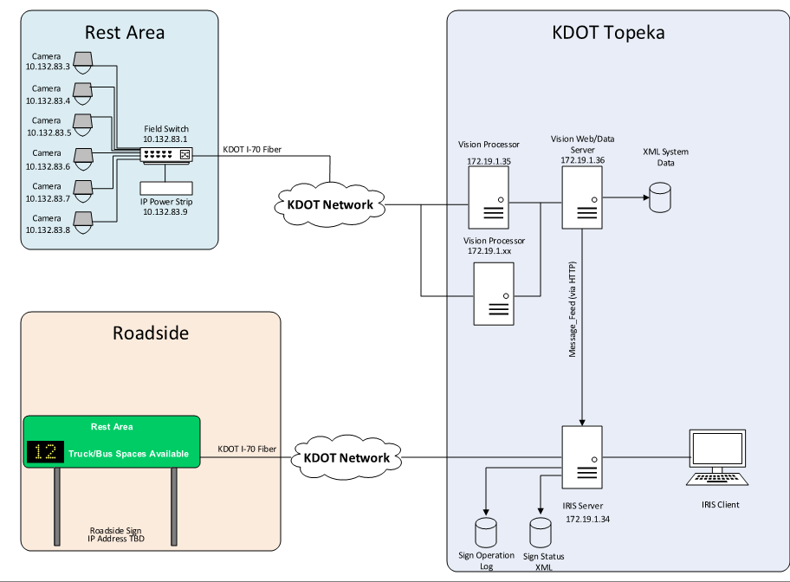
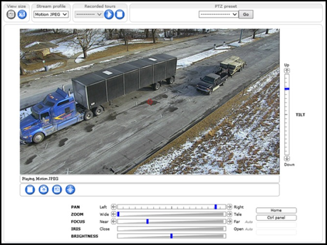
After the data is collected

Slide 13
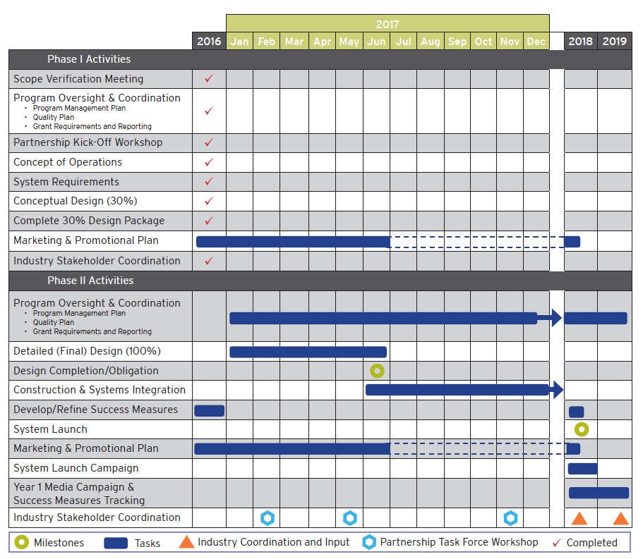
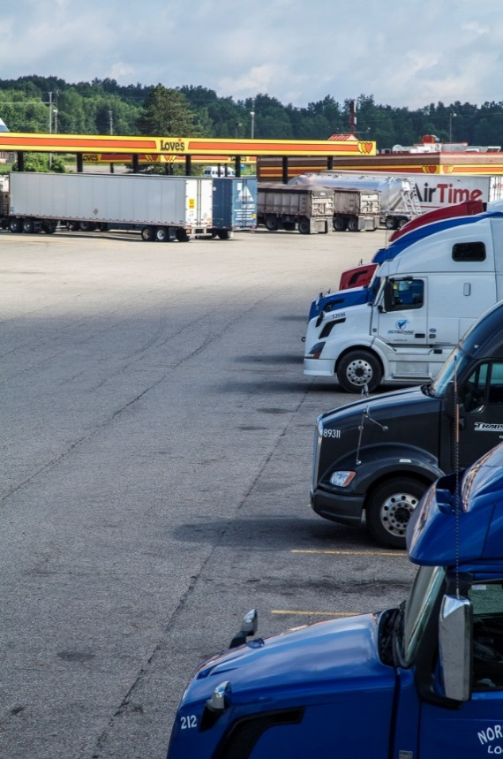
The TPIMS schedule
Notes:
So let’s talk about what we’ve accomplished since we started in early 2016 – and where we’re going between now and our 2018 launch.

Slide 14
Phase 1 – completed
Partnership governance and protocols
Proof of concept
Conceptual design (30%) plans
Online map & geodatabase
System architecture
TPIMS marketing and communication
Notes:
Phase 1 is complete. And we accomplished quite a lot in the last three quarters of 2016 along the way.
The most significant completed task was development of the 30 percent plans.

Slide 15
100% design – completed
Statewide block diagram
Sign memo and locations
Refined engineer’s opinion of costs
Design requirements
Typical site layouts and block diagrams
Regional and statewide ITS architecture conformance
User needs
System requirements
Traceability matrices
Final tech memo
Final grant tracking system
Environmental clearance
Notes:
Thirty percent design rally put in place the operational framework for the system.
And again, in terms of creating a seamless regional system, this was the key to making sure that every state delivered in a way that produced a unified TPIMS system.

Slide 16
Phase 2 – underway
Software Integration
Construction
Grant reporting
System testing
Vendor/Developer Outreach
Performance measure data collection and analysis
Notes:
Phase two is now underway. As we move towards procurement, each state is designing its individual portion of the system.
Some states are using design-build to accelerate completion. One of them, Ohio, already is in procurement and will soon be followed by Iowa and Michigan.
And we’ve put in place the measurement and reporting systems that will help us document the impact of TPIMS on the regional and national freight system.

Slide 17
Performance measures
Parking Utilization
Are drivers utilizing TPIMS to inform their parking decisions?
Have driver-perceived parking shortages declined?
Safety and Security
Are truck parking facilities more safe and secure?
Is there a reduction in illegal or informal parking?
Is there a reduction in fatigue-related crashes?
System Reliability
Is there a decline in the average time spent looking for parking?
Is the system meeting its performance requirements for accuracy?
Notes:
These performance measures are critically important to proving that TPIMS is a success, one that can serve as a national model for a freight parking system. We will be collecting and analyzing data annually on:
Parking utilization and demand This measures driver perceptions of how full MAASTO truck stops are and how often. We’ll collect this data through system statistics and a yearly driver survey. The survey will be conducted by the American Transportation Research Institute (ATRI).
Corridor safety We’ll measure fatigue-related crashes on TPIMS corridors. Corridor safety data - including fatigue-related truck crash rates, types and patterns - will be analyzed and reported by the Mid-America Freight Coalition (MAFC).
System reliability This shows how well the system is operating. System reliability will be measured by total system downtime, number of user complaints and the difference in the number of spots that the system says are open and that are available.

Slide 18
TPIMS questions?
www.TrucksParkHere.com
info@TrucksParkHere.com
TPIMS Project Manager
Davonna C. Moore
MAASTO TPIMS Project Manager
Assistant Bureau Chief-Transportation Planning
Kansas Department of Transportation
(785) 296-0346
davonna.moore@ks.gov
Notes:
This has been a very quick overview of TPIMS, what it is, where we’re at and where we’re going.
If you want to learn more about the project, please visit our project website, email us your questions or call.
Thank you for your time and interest regarding TPIMS. I’m available for the next few minutes to take questions about the project as well.

