Slide 1
FREIGHT PLANNING & EMERGING TECHNOLOGIES
MAFC
OHIO CONFERENCE on FREIGHT
AUGUST 3, 2017

Slide 2
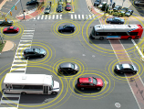
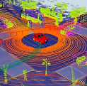

BENEFITS
Technology convergence will revolutionize transportation, dramatically improving safety and mobility while
reducing costs and environmental impacts
Connected Vehicles
Benefits
Order of magnitude safety improvements
Reduced congestion
Reduced emissions and use of fossil fuels
Improved access to jobs and services
Reduced transportation costs for gov’t and users
Improved accessibility and mobility
Vehicle Automation
Internet of Things
Machine Learning
Big Data
Mobility on Demand

Slide 3

PLANNING CONSIDERATIONS
Identify Goals
Determine Strategies
Implement the Plan
Goals
Short
Long
Strategies
Funding
Engagement
Implement
Phasing
Operations

Slide 4
Planning Considerations-Goals
Goals must fit within the overall vision of the agency
Short term Goals
  Timely
  Efficient
  Low Cost (relatively)
Long Terms Goals
  Integration with future projects
  Agency Impacts
  Short
  Long
Goals

Slide 5
Planning Considerations-Strategies
Funding
  Identify sources
  Budget
Engagement
  Connecting the right groups
  Reaching out to end users
  Champion(s)
  Funding
  Engagement
Strategies

Slide 6
Planning Considerations-Implementation
Phasing
  Connecting technologies
  Building Infrastructure
Operations
  Life Cycle Costs
  Responsibility
  Advocacy
  Phasing
  Operations
Implement

Slide 7
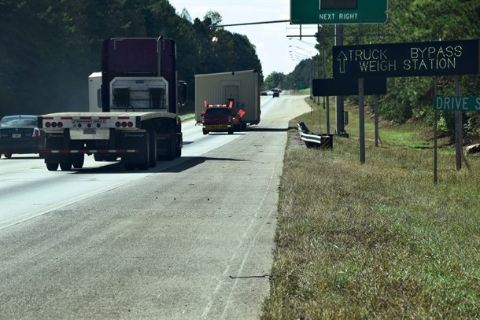
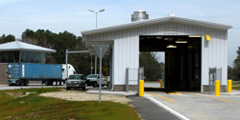
Smart Freight Technologies
Smart Weigh Stations
Automated ramp weigh station facilities
Weigh in Motion
Roadside and scale house electronics
License plate and US DOT number reading
Over-height detection systems
Smart truck inspection systems
Notes:
Smart Roadside
Interoperable technologies and information sharing among in-vehicle, on-the-road, and freight facility systems
Apply advanced technologies to create more efficient and streamlined processes and share data in real-time
Focus Areas:
Electronic screening
Virtual weigh stations/electronic permitting
Wireless roadside inspection program
Truck parking

Slide 8
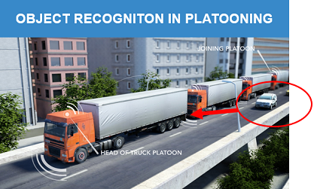
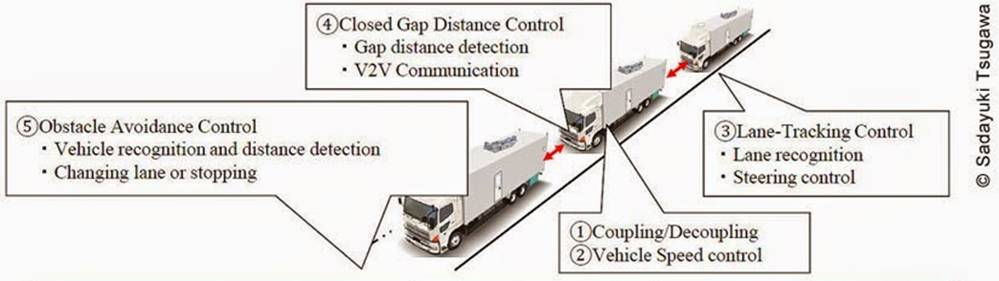
TRUCK PLATOONING
Driver in first vehicle leading driver or driverless trucks
Lead vehicle linked to platoon via wireless communications
Incorporates vehicle detection, anti-collision and lateral control technologies for safety
Requires legislative action

Slide 9

KEY TAKEAWAYS
Expect resistance
Data is multi-faceted
Consider Impacts to others
Stay committed

