Slide 1
Digitization of
Freight and Transport
B I T A . S T U D I O

Slide 2
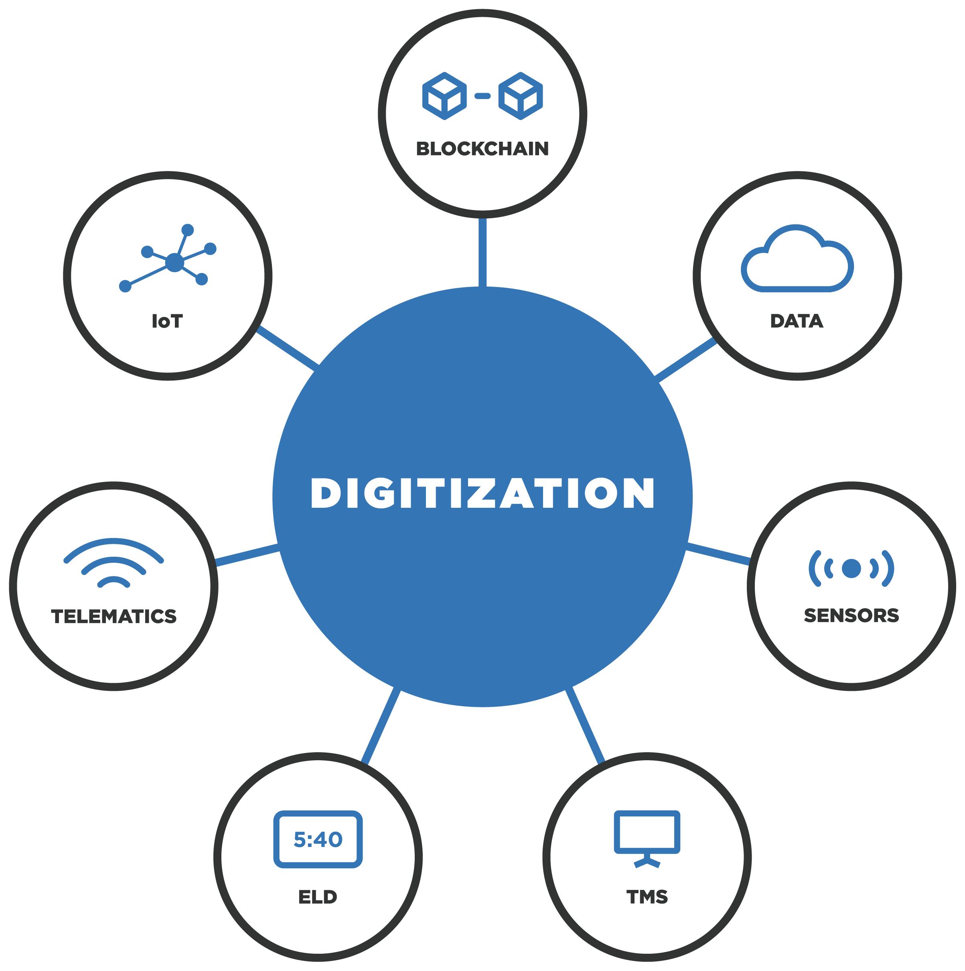
Digitization
To drive the industry forward, BiTA is committed to the digitization of analog and legacy data. Through the process of digitization, industry-wide benefits are created.

Slide 3
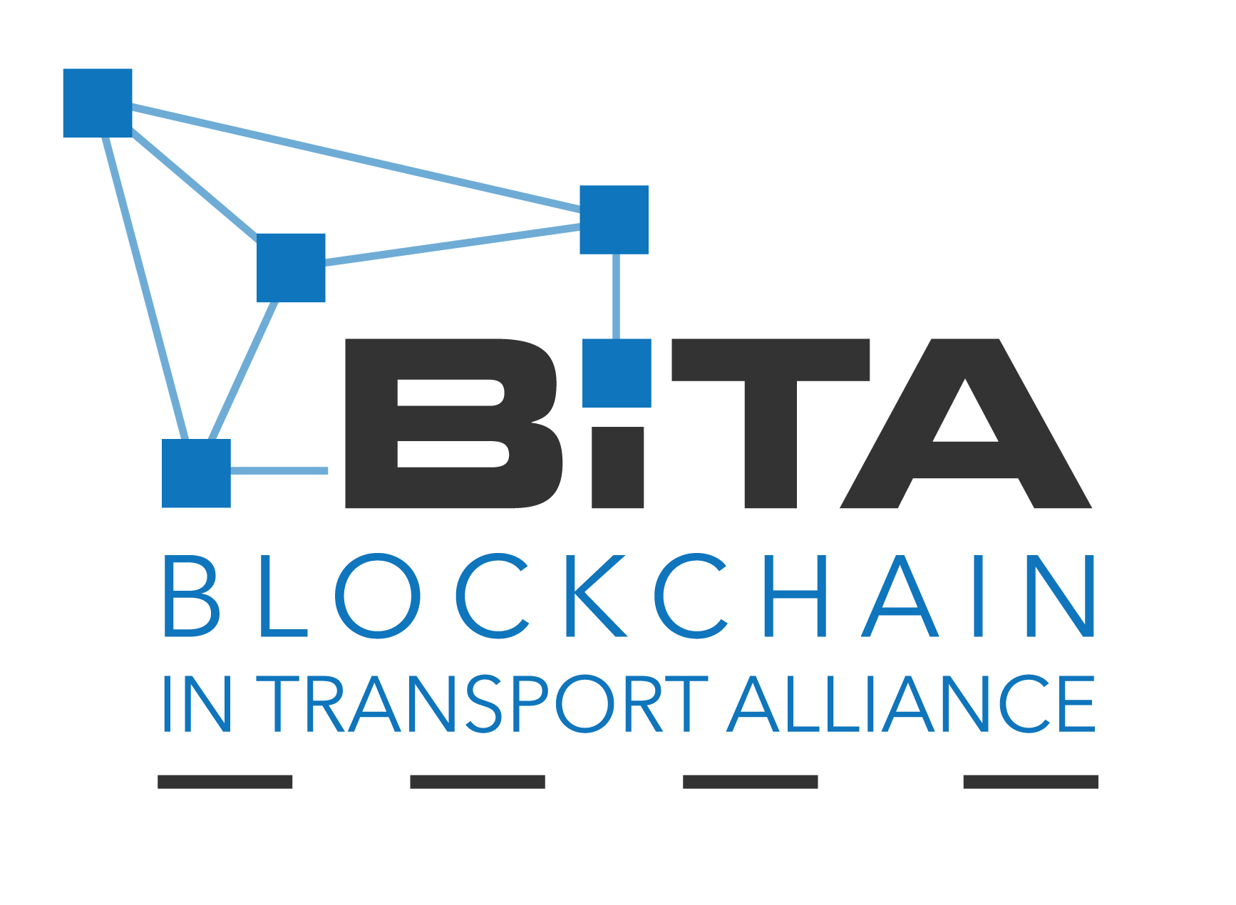
Purpose
Leveraging talent and resources from the world’s most influential companies, BiTA is producing open source and royalty free data standards that will allow for interoperability between participants in the global supply chain.
We’re a member-driven community focused on education, evangelism, networking and commercial outcomes around blockchain and other emerging technologies, and we’re committed to overcoming geographic, language, and cultural hurdles to solve for seamless commerce.

Slide 4
450+ Members

Slide 5
Disruptive Impact
As blockchain digitizes, decentralizes, secures and incentivizes the validation of transactions, it will fundamentally change the industry.

Slide 6
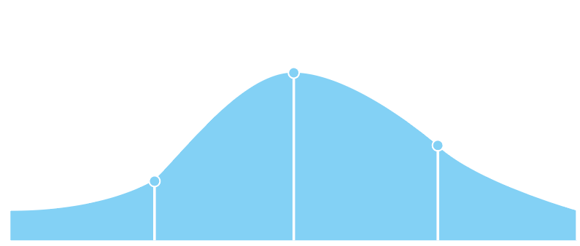
Despite its initial reluctance, the transportation industry anticipates a widespread embrace of blockchain technology by 2020
First wave industries vs. Transportation blockchain adoption
70%
Mass adopters
53%
Followers
32%
Trailblazers
15%
23%
7%
2017
2018
2019
2020
2021
Source: IBM Institute for Business Value analysis
Transportation industry
First wave industries
Notes:
Interestingly, Transportation industry has the highest number of respondents who expect to have a production network in 3 years (77%).
Consistent with Gartner findings too
BiTA started out as trucking, but now wider ecosystem with 1000 members => blockchain solves a social problem for the ecosystem, more than just a technical problem
Blockchain is still very early for this industry, and the curve on the right could be overly ambitious - Most important thing for this industry is how to get the players into a design thinking workshop and get them to understand the tech, its potential, and possible use cases - this way the players own the solution and to make it live
Fast Forward EIU Survey Q21: Time period your org. likely to implement a commercial blockchain solution at scale

Slide 7
Transportation executives’ initial investments in blockchain are focused on improving existing operational processes
Top 2017 blockchain investment areas – all transportation firms
Shipment Status/Tracking
Payment processing
Empty container Management
Shipment Security Management
Transportation executives surveyed, revealed that their initial focus will be on fixing the foundational processes critical to their operations.
These processes are deliberately chosen as a prerequisite to disruption in this manually intensive, coordination heavy industry.
26%
21%
20%
20%
Source: IBM Institute for Business Value analysis
Notes:
For instance, basic processes like shipment status and tracking and payment processing need to be improved and transformed before more ecosystem wide areas like chain of custody verification can be disrupted.
Fast Forward EIU Survey Q27: Plan to invest in Blockchain initiative in

Slide 8
But executives also believe that blockchain disruption opportunities exist across several areas of the transportation value chain
Anticipated disruption across all transportation organizations
Chain of custody verification
Shipment status/tracking
Payment processing
Partner data sharing
Customs/border management
Shipment security management
Empty container management
16%
39%
46%
16%
38%
46%
15%
31%
54%
15%
39%
47%
14%
34%
52%
13%
37%
50%
12%
37%
51%
Moderate - large
Some
None - slight
Source: IBM Institute for Business Value analysis
* Percentages may add up to over 100% due to rounding
Notes:
For an old school industry like Transportation, some of the improvements themselves can be actually transformational - the First Movers see the disruptive potential for blockchain, are investing and working on projects in this area (E.g. shipment status/ tracking today is done on the phone and the 50% not seeing disruptive potential are ok with it)
Fast Forward EIU Survey Q26t: Extent blockchain will disrupt business area​
Shipment status/ tracking – Global E2Esupply chain events (e.g., container stuffed, ETA at terminal, shipment cleared)
Payment processing – Recording shipment deliveries, invoices, and payments
Shipment security management – Securing shipments in transit (en route (sea or land), with customs, in ports and terminals etc.)
Customs/ border management – Clearing shipments across international borders (verifying shipping documents; processing duties etc.)
Empty container management – Delivery to stuffing sites, re-positioning, temporary storage, tracking, and return of empties
Partner data sharing – Sharing data on shipment volumes, status etc., across entire ecosystem (container shipping companies, rail and road freight providers, port operators, terminals, government authorities, and customers
Chain of custody verification – Tracking and verifying possession and ownership of goods throughout the entire transportation system

Slide 9
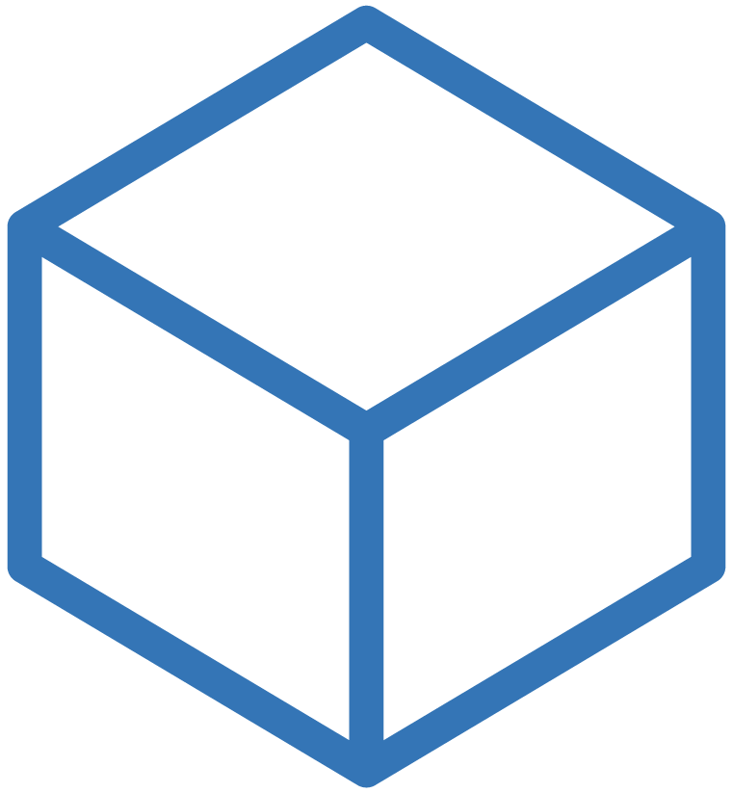
BiTA Timeline
3rd BiTA Symposium
_______________
Public TC & WG Presentations
Technical Committees set, initiate Working Groups
Data Format TC: Tracking Document and Location WG’s issue charter
1st BiTA
Symposium
Proposed specs to Data Format TC
DEC
2017
JULY 2018
SEPT
2018
NOV
2018
JAN
2019
MAY
2019
AUGUST
2017
MAY 2018
AUGUST 2018
OCT
2018
DECEMBER 2018
FEBRUARY 2019
Board Standards
Committee launched
____________
2nd BiTA
Symposium
Working Groups
formed
WG chairs lead BiTA efforts on drafts
IEEE/ISTO engaged for TC & WG expansion
Location Standard & Tracking Data Framework published
________________
Election of 1st BiTA Standards Council Chair
Founded

Slide 10
BiTA Timeline
MAY
2019
BiTA
Spring
Symposium
Patrick Duffy announced President of BiTA
First use of Location Standard in real world product
Party component specification sent to TC for review.

Slide 11
Foundation Profile – Layered Model
Physical | ShipUnit, HandlingUnit, Conveyor
Data link | TrackableEntity, TrackableEvent, Link
Network | Location, Position, Address, Lane, Route
Transport | Trip, Service Offers
Session | Party, ShipOrder, ScheduledOrder, Rates
Presentation | BOL, BUBBA/EMIT
Application | Traceability, Chain of Custody
Source: Ben Kothari, Ampliflex

Slide 12
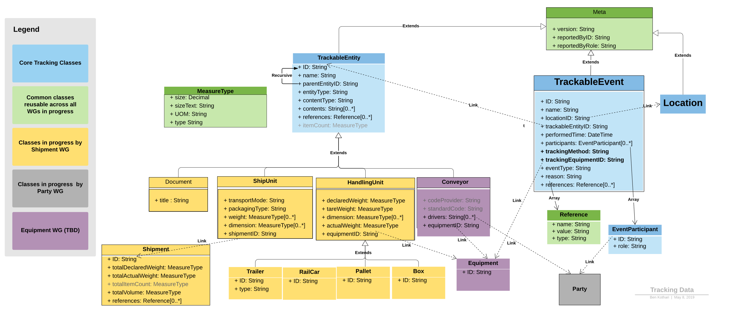
Tracking Foundation Profile
Source: Ben Kothari, Ampliflex

Slide 13
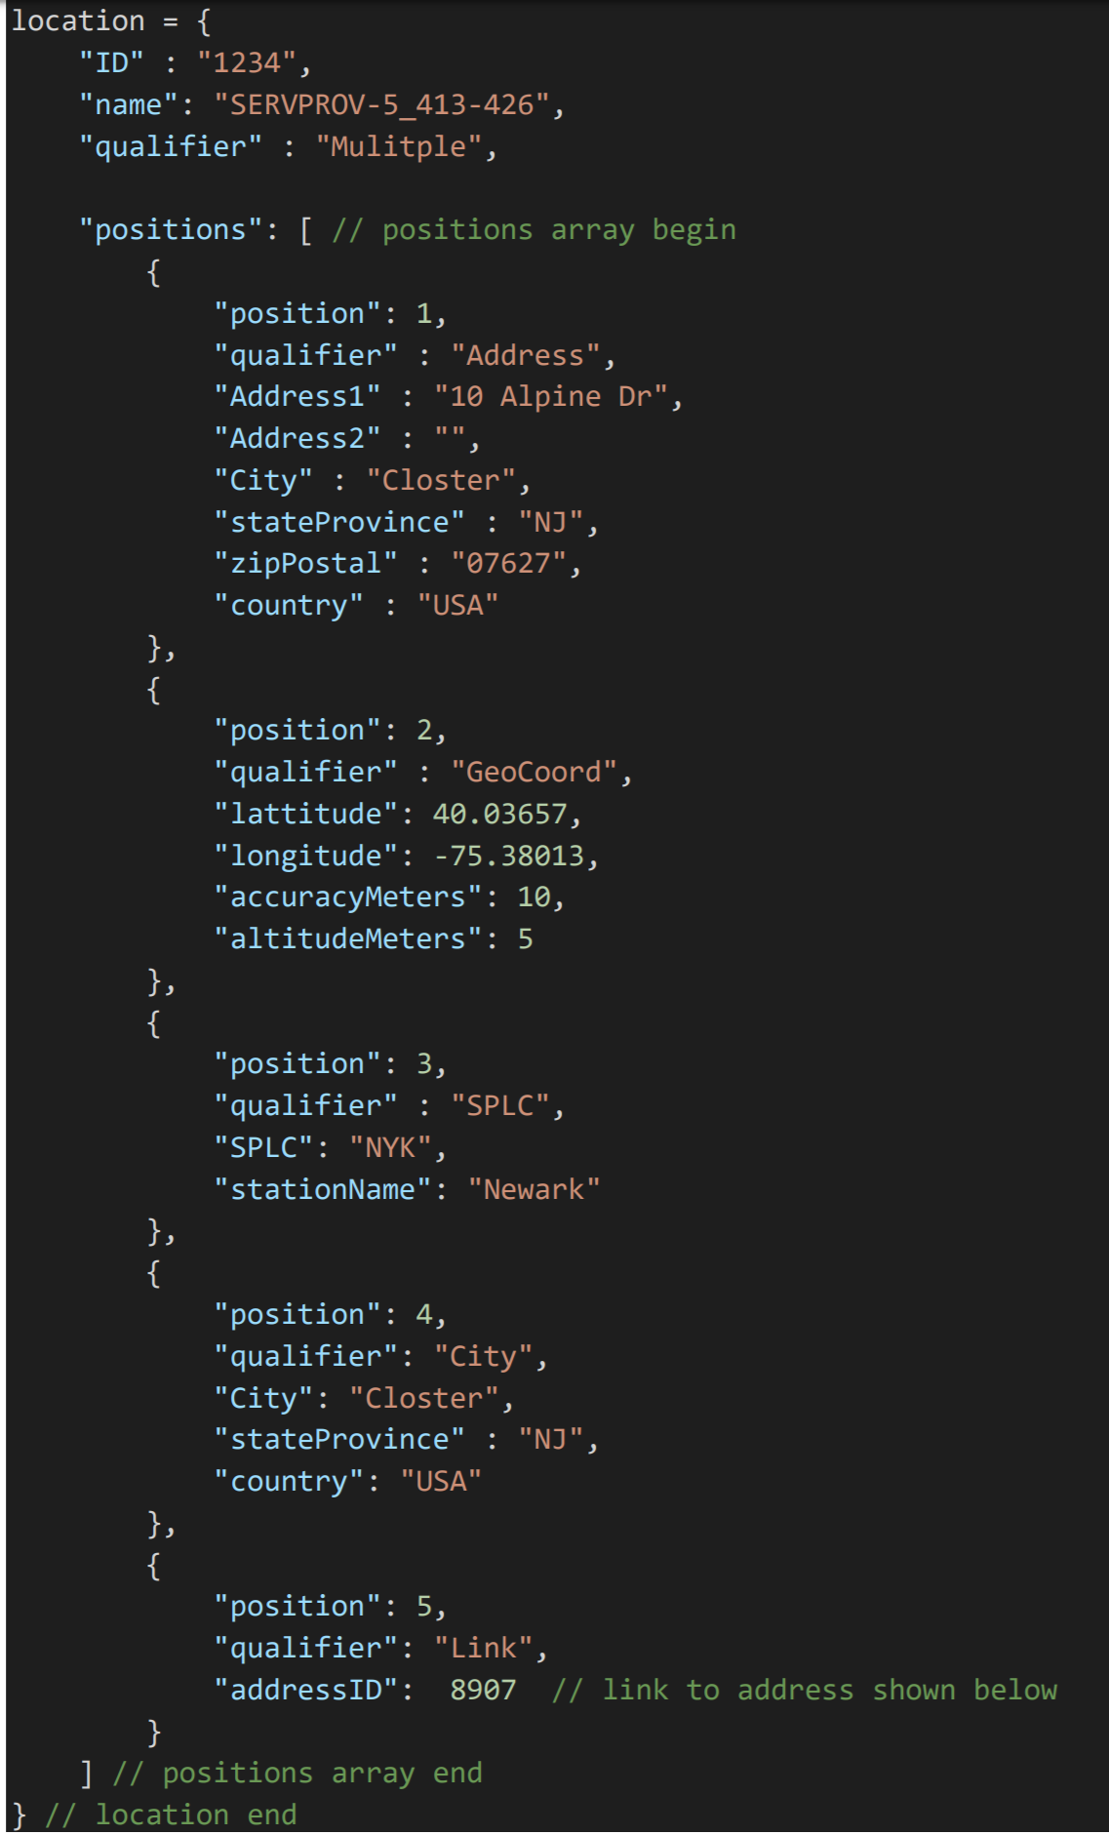
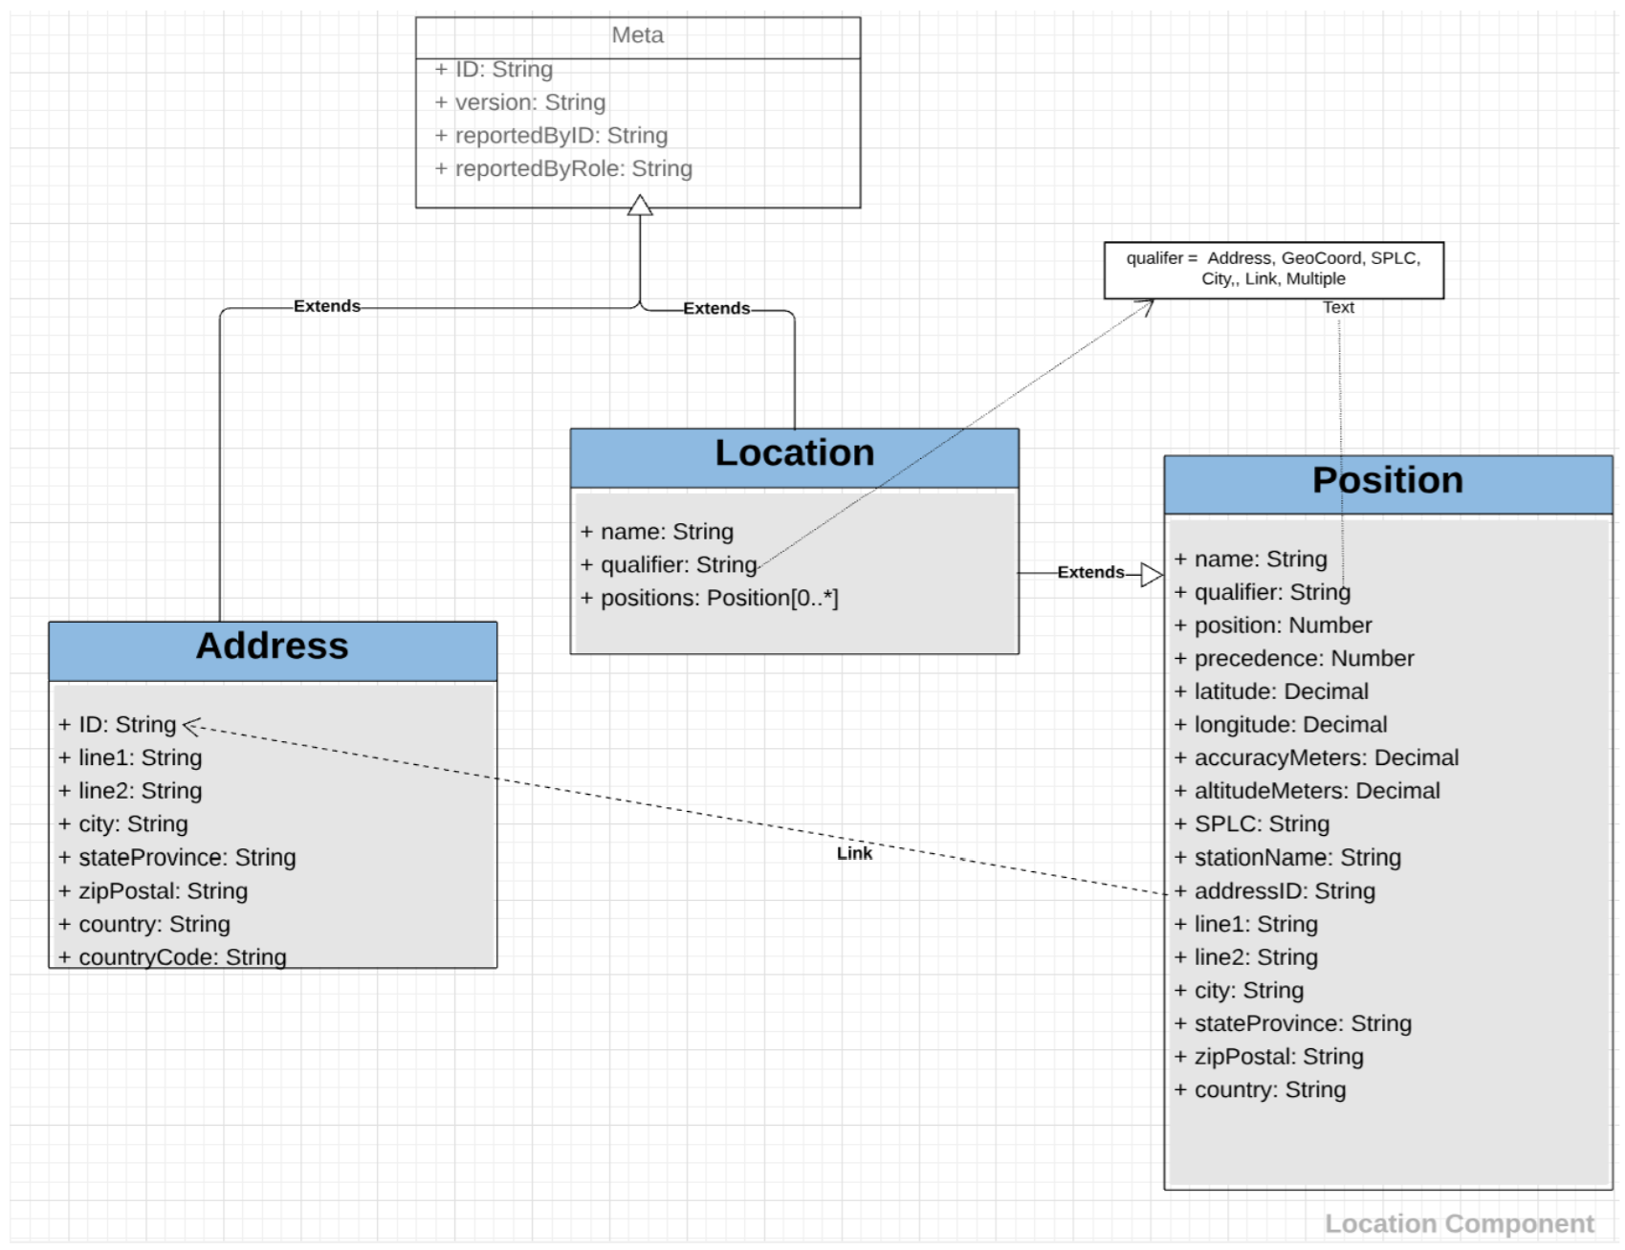
Location
Source: Ben Kothari, Ampliflex

Slide 14
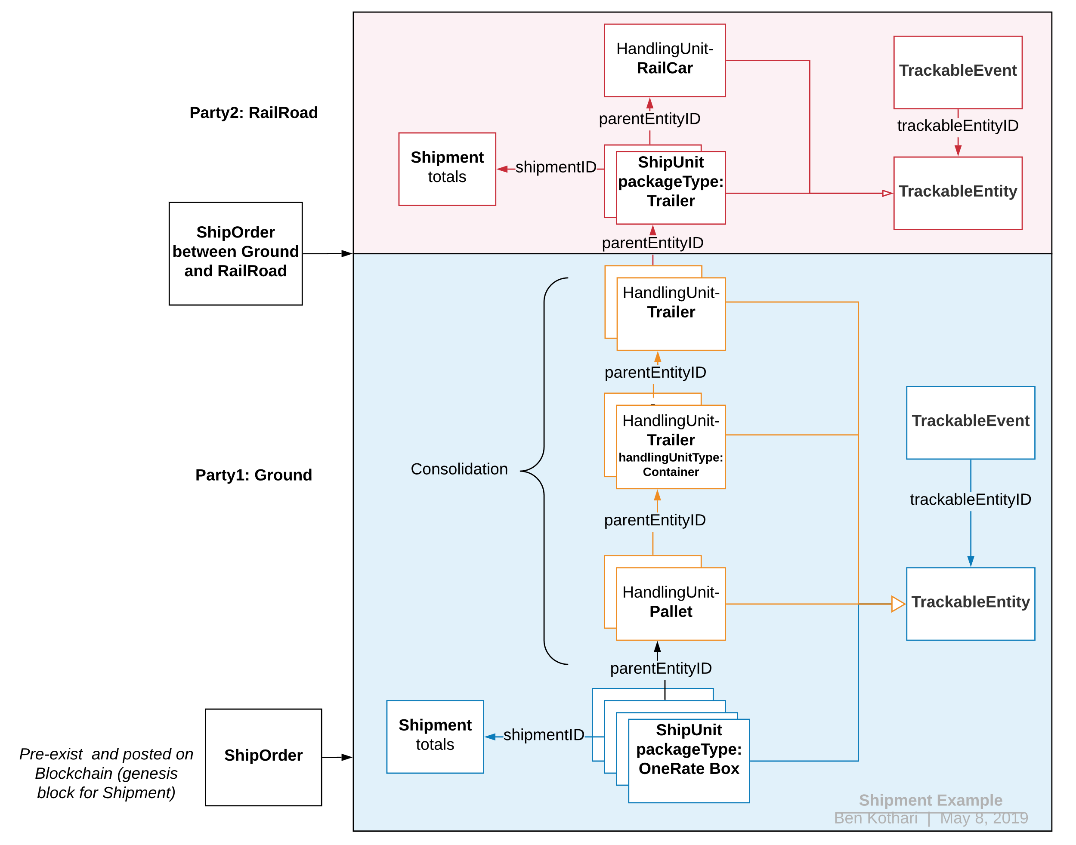
Shipment Example
Passive vehicle resources which are responsible for bearing or storing the load of ShipUnits are collectively referred to as HandlingUnit (HU). HandlingUnit is a recursive/hierarchical representation; Each HU may be tracked separately, or an HU group may contain multiple HUs which may be tracked together as a single entity.
A Shipment is Goods or Products that may be transported under the terms of an Agreement (TBD) authorized by two or more Parties. As a grouping of Ship Units, the shipment is moved at the same time and transported by means of a transportation service offered by the Carrier or any Transportation Service Provider (Party) and requested by the Shipper (Party) who is at one Origin (Location) to one Recipient (Party) who is at one Destination (Location), and with respect to the total number of Ship Units and their respective piece counts, total weight, total cube, pallet counts etc. A shipment is also uniquely identified from among a set of Shipments at any given time, but tracking occurs at the individual Ship Unit level.
Source: Ben Kothari, Ampliflex

Slide 15
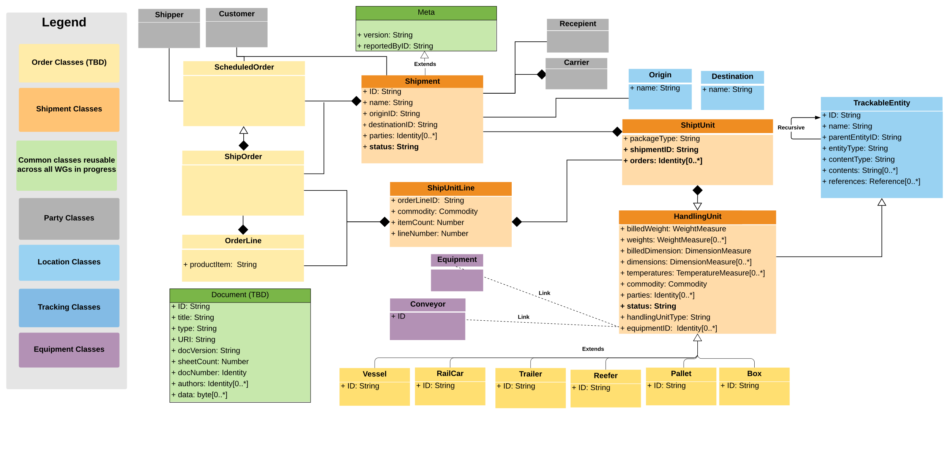
Shipment Model
Source: Ben Kothari, Ampliflex

Slide 16
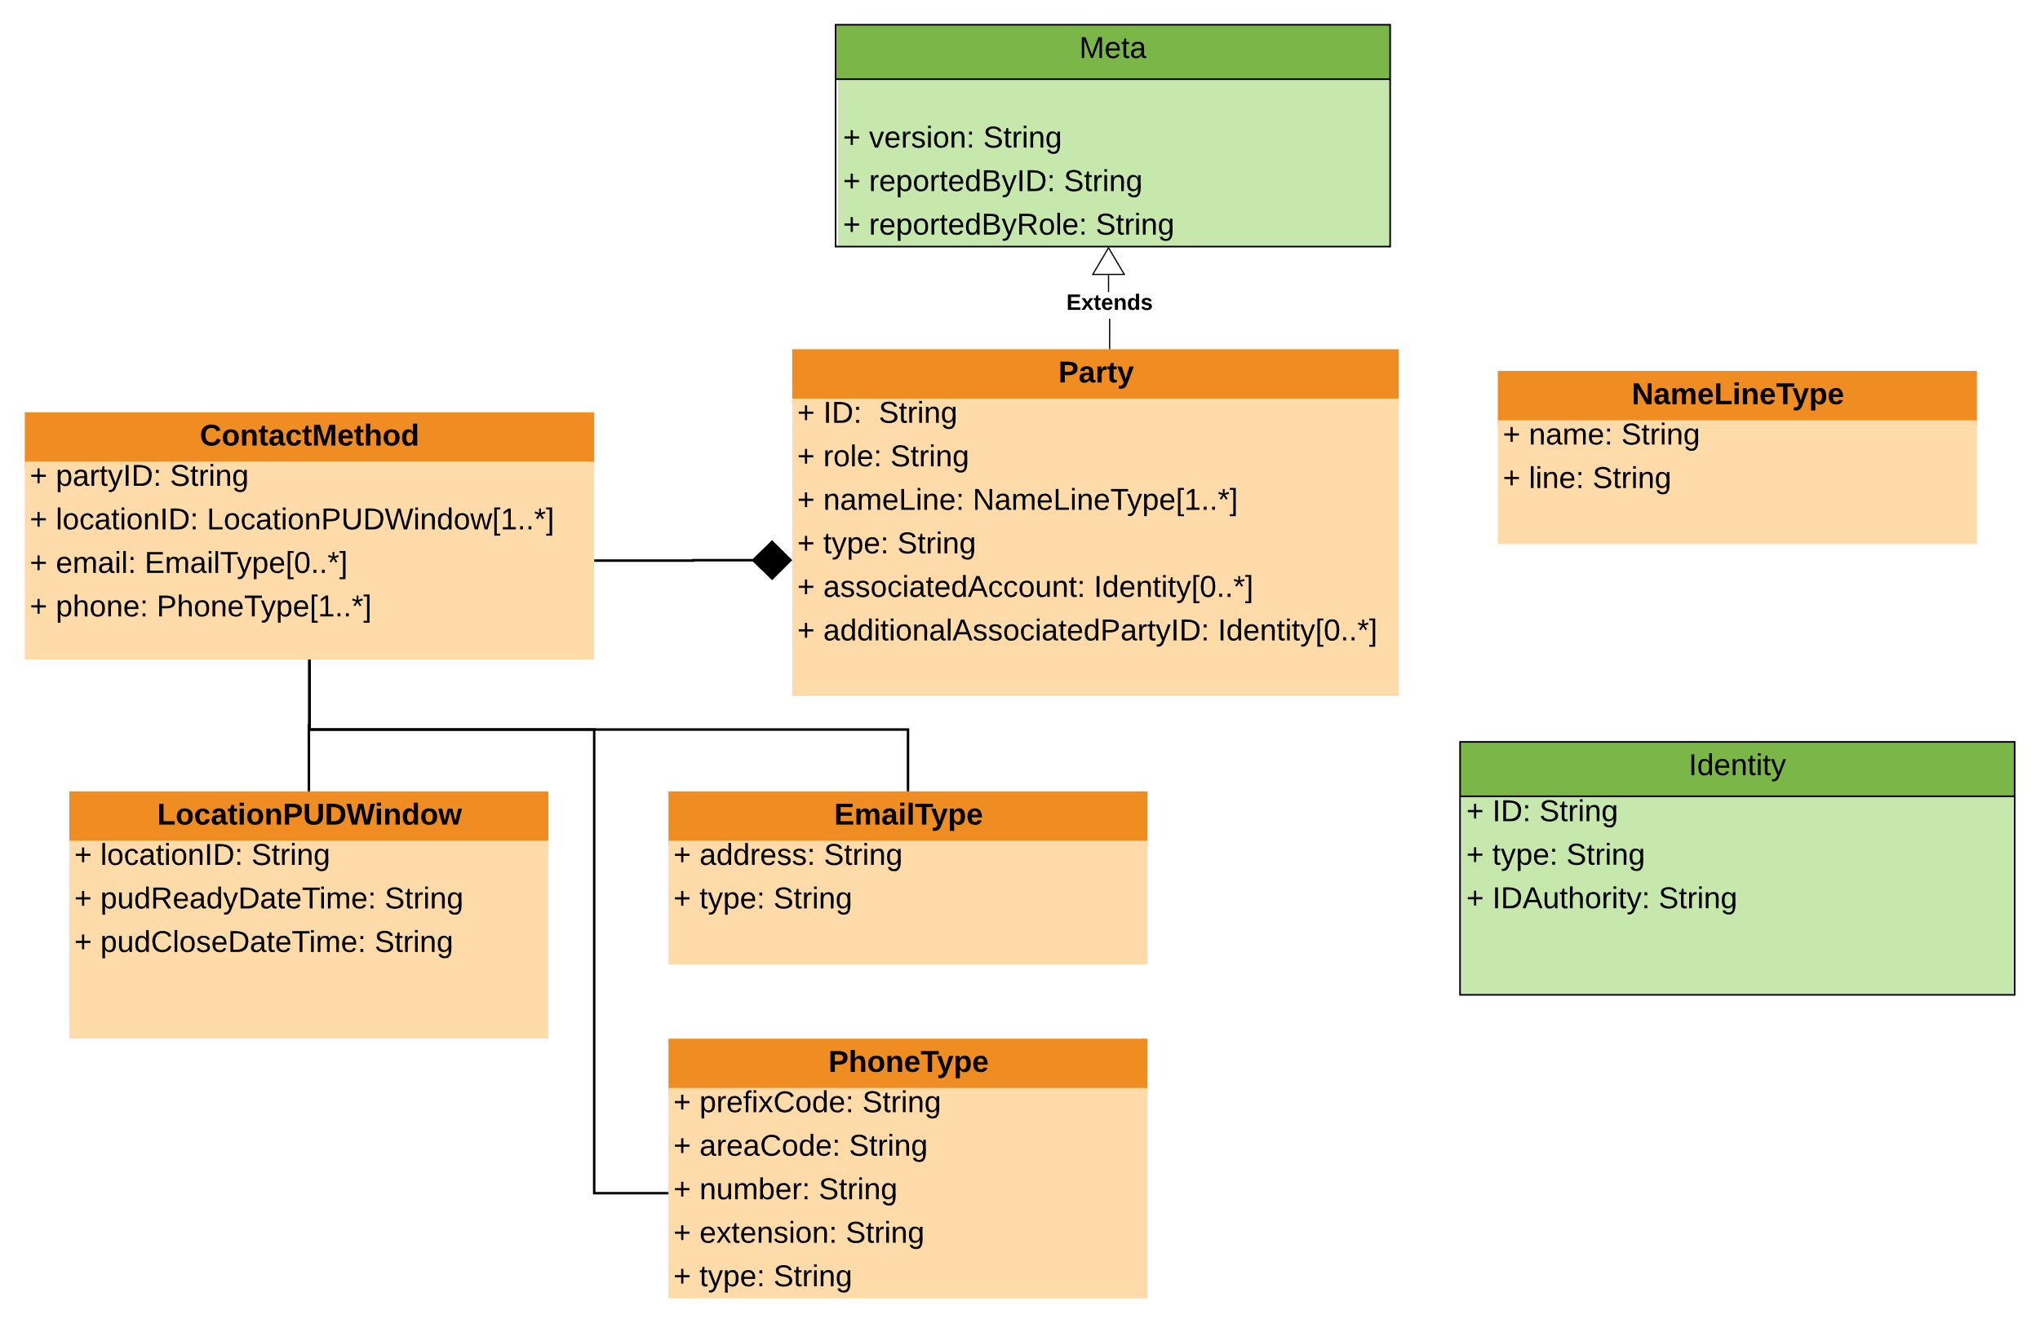
Party Model
Party can be any Enterprise (Company, Corp, LLC, etc.) that participates in or provides products and/or services within the transportation network.
Party may also represent any individual person or organization who participates within the network or fulfils a general role related to the products and/or services offered.
Source: Ben Kothari, Ampliflex

Slide 17
Benefits to Enterprise
Frees up capital
Lowers transaction costs
Speeds up processes
Provides security and trust
Market transparency
Operational efficiency
Carbon friendly
Risk management
Promotes interoperability

Slide 18
Cost of Trust
Processes and procedures for integrity
Duplicate records, audit, investigation, antifraud, penalty structures, etc.
RMIT University Blockchain Innovation Hub
Preliminary study on cost of trust
As high as 35% ($30T)
WTO analysis that smart contracts on blockchain can
Increase world GDP by 5%
Increase world trade volume by 15%
Source: Dean Tribble, Agoric

Slide 19
Use cases build on each other
Driver credential verification (authentication)
Chain of custody transitions (data)
Payment in shipping transactions
Currency conversion
Automated (partial) payment release
Automated A/R loans for completed delivery
Links to associated financial transactions
Source: Dean Tribble, Agoric

Slide 20
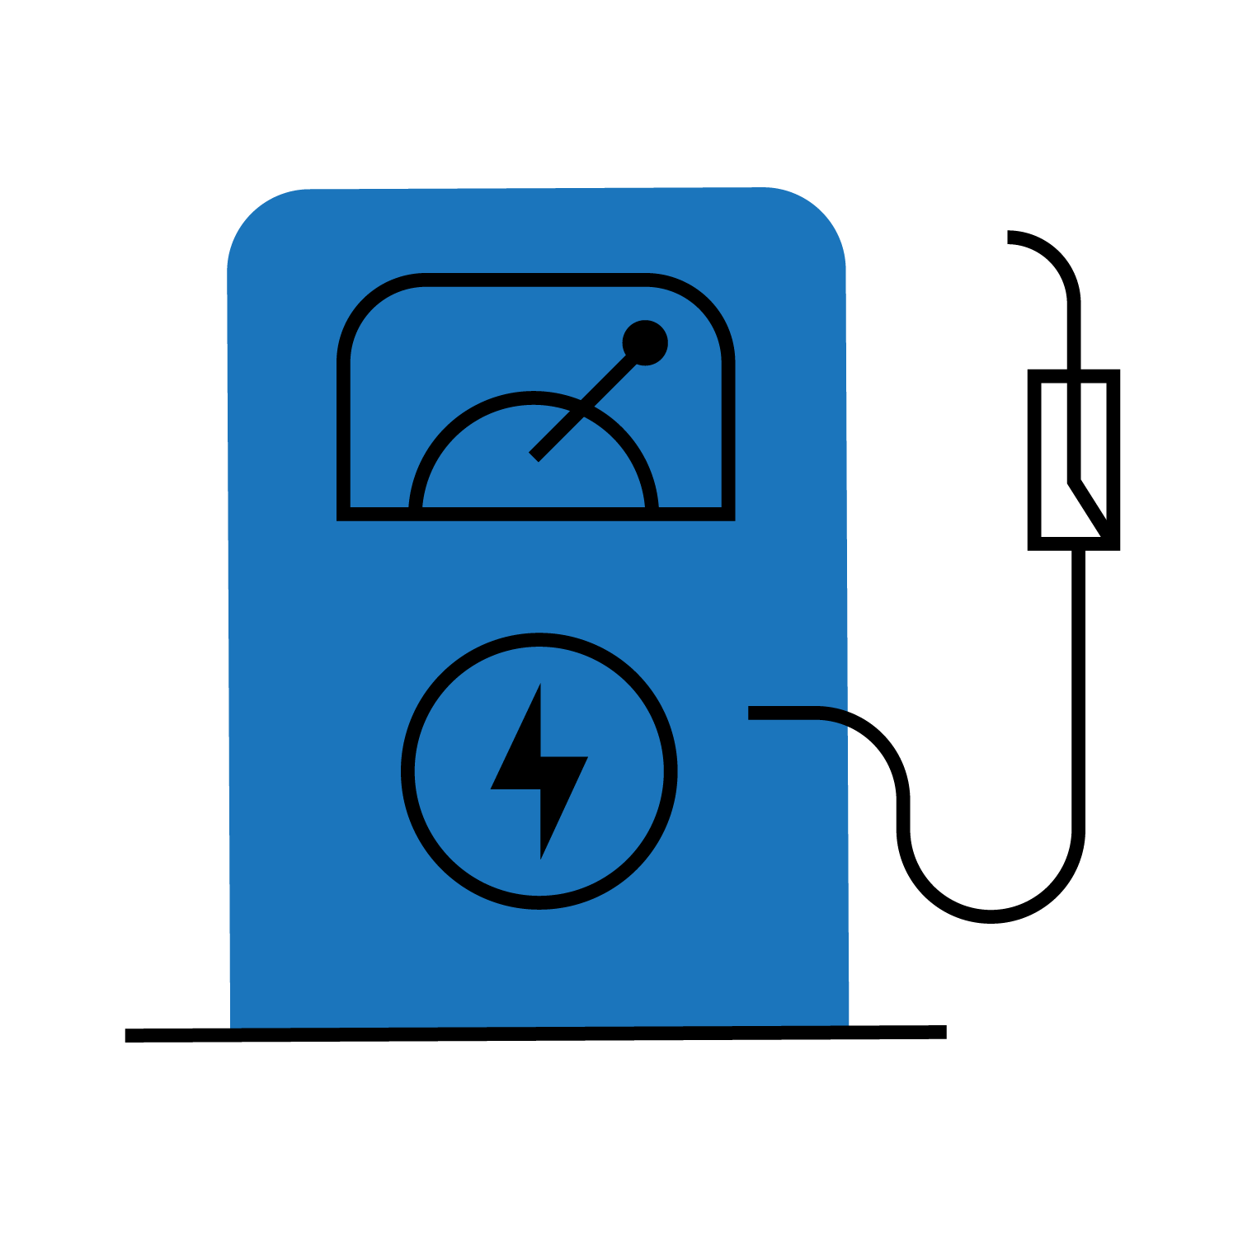
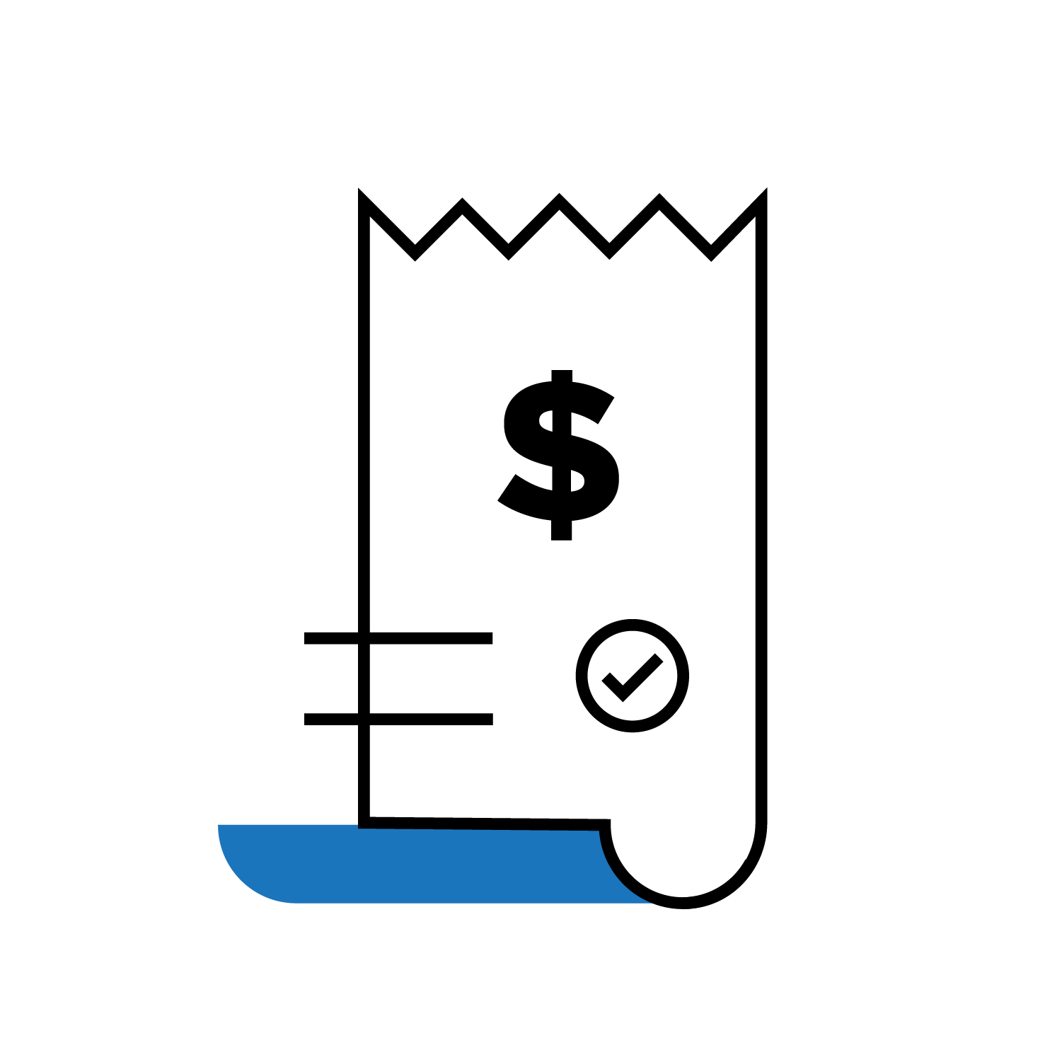
Use Case 1
Fuel Repayments and Repricing Without the Need for a Processor
Immutable record of agreed financial transaction(s)
Payment and Settlement Solutions
EDI Communications

Slide 21
Use Case 2
Self-Executing
Smart Load
Contracts
Proof of Provenance
Proof of Delivery
Contracts executed and arbitrated using blockchain, lowering risks and costs for both carriers and shippers.
Verifiable provenance
with long
supply chains.
Recorded on blockchain, available to relevant
parties.

Slide 22
What is a Smart Contract?
A contract-like arrangement, expressed in code, where the behavior of the program enforces the terms of the contract
Source: Dean Tribble, Agoric

Slide 23
It’s not all or nothing
Hybrid smart contracts
The real arrangement includes both code and prose
Code portions are enforced by the smart contract system
Prose portions are enforced by people
Oracles
Dispute resolution
Exceptions
Source: Dean Tribble, Agoric

Slide 24
BiTA Forecast
2019
2020
2021
2022
2023
2024
2025
2026 & Beyond
EDUCATION, CASE STUDIES,
& EARLY ADOPTION
______________________________________
Industry-wide education on use cases outside of cryptocurrency.
Develop industry-wide standards and apply to case studies.
Early adoption within innovative startups and pilot programs at large corporations with extensive resources (i.e., BP, Daimler, and Salesforce).
Regulatory authorities develop auditing and compliance practices.
GROWTH
__________________________________________________________________________________
Early adopters and standards activity provide greater clarity and minimize uncertainty, driving widespread adoption.
MATURITY
__________________________
Blockchain is widely adopted and considered an integral part of the supply chain ecosystem.

Slide 25
Join us for a happy hour and networking event featuring hors d’oeuvres, drinks, and learning. Meet-ups are open to BiTA members, and non-members seeking to learn more about BiTA. Attendance for BiTA members is free; members can invite up to 3 non-BiTA guests for free as well. Non-BiTA members not accompanied by a member can register for a small fee.
UPCOMING MEET-UPS
Detroit
July 24
Chicago
August 7
Chicago
November 14

Slide 26
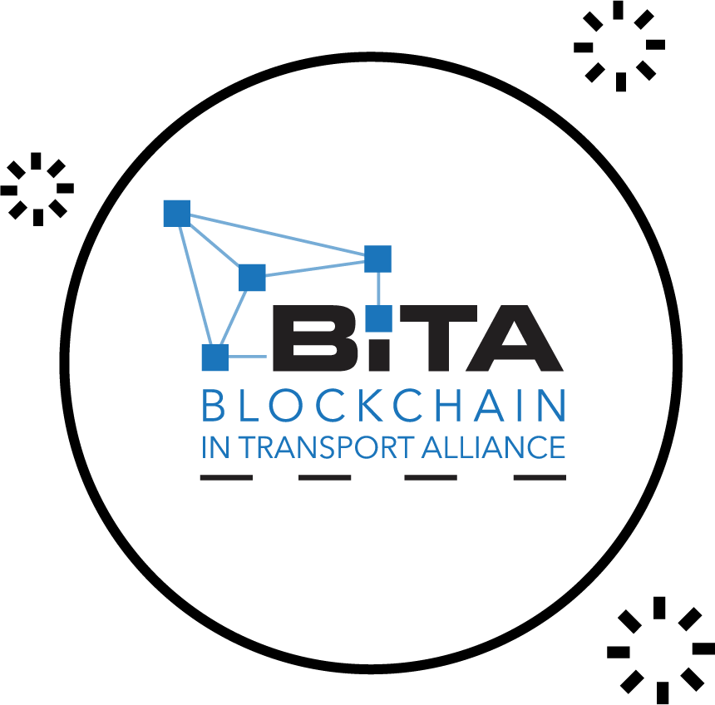
Stay up-to-date
Visit BiTA.studio to join the BiTA Blockchain in Transport Alliance
Notes:
Delete ‘BiTA’ in line 1 of first ‘bullet point.’ Instead, place ‘(BiTA)’ after ‘Alliance’ and before period
Change ‘on-going’ to ‘ongoing’

Slide 27
CONCLUDING THOUGHT
It’s not just a tech play,
it’s a business model change. Oliver Bussmann
Source: Hilary Carter, Blockchain Research Institute

Slide 28
B I T A . S T U D I O

