Slide 1
2019 MAASTO Annual Conference and
2019 Mid-America Freight Coalition Annual Meeting​
Illinois Marine Transportation System Plan and Economic Impact Analysis Study
Hyatt Regency, Downtown Indianapolis, IN
Wednesday, August 13, 2019

Slide 2
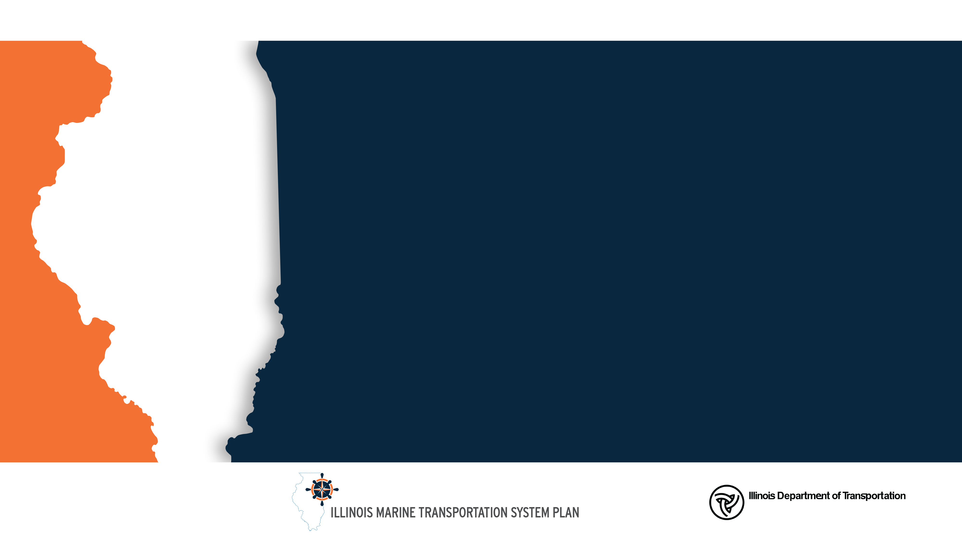
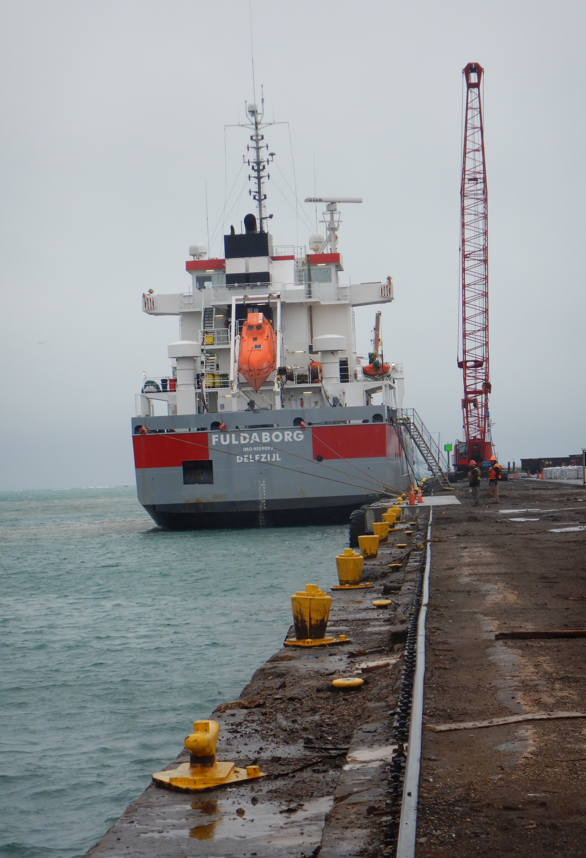
Illinois Marine Transportation System Plan and
Economic Impact Analysis Study
Presentation by:
BJ Murray
Section Chief, Aviation & Marine Transportation Program Planning
Illinois Department of Transportation
Office of Planning & Programming
2300 S. Dirksen Parkway, Rm. 341
Springfield, Illinois 62764
Phone: (217) 782-4118
BJ.Murray@Illinois.gov
www.IDOT.illinois.gov
Clayton Stambaugh, MPA
Program Manager
Illinois Department of Transportation
Office of Planning & Programming
2300 S. Dirksen Parkway, Rm. 341
Springfield, Illinois 62764
Phone: (217) 782-4981
Clayton.Stambaugh@Illinois.gov

Slide 3
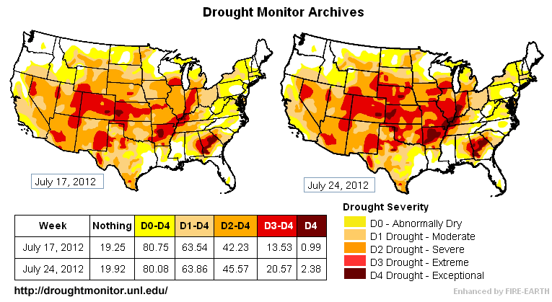
IDOT’s Emergence Into Marine Transportation
Low water events associated with drought of 2012 and subsequent outages due to flooding and lock and dam failures continued to drive reintegration vision
5-day delay at Lock 27
  63 vessels – 455 barges
  Equivalent of 6,100 railcars or 26,400 semi-tractor trailers
As a result of recent high water levels we have seen similar issues on the roads

Slide 4
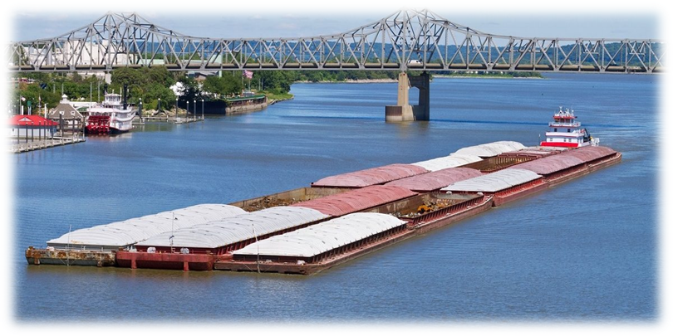
IMTSP Study Contract
  IMTSP Study Utilized IL DOT Bureau of Planning’s Contract for General Planning and Performance Management Services – Prime Contractor is WSP USA Inc.
  Entered into an agreement with WSP USA Inc. on February 14, 2019
  Contract Term is 18 months with an estimated study length of 12 months.

Slide 5
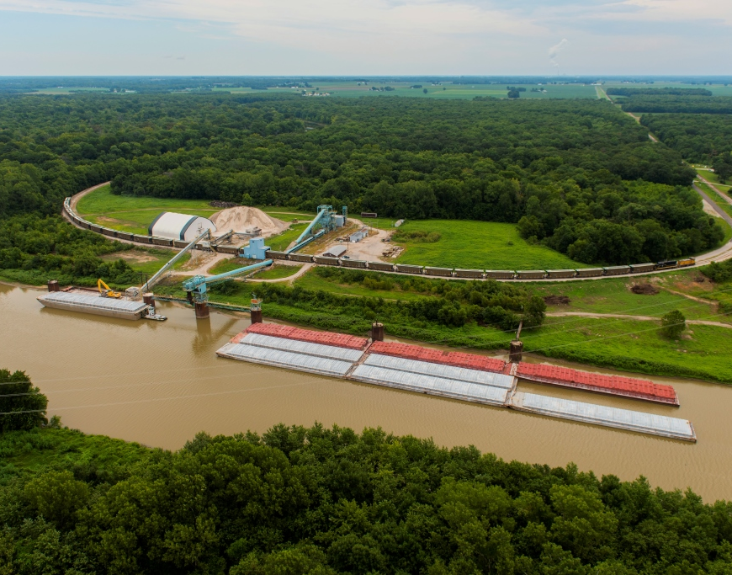
Illinois Marine Transportation System Overview
1,118 miles of navigable inland waterways
19 Public Port Districts
Over 350 private terminals
Ferries, Water Taxis, Lake Cruises, Sea Plane Base
9% of the state’s freight tonnage is moved via the IMTS
2017 Waterborne Freight totaled:
  90.6 million tons

Slide 6
Steering Committee Meeting
  First meeting held July 9th at the Illinois International Port District
  Provided steering committee first look at the topics that will be covered during the study, and provided and update on the plan activities that are underway.
  Presentation can be found on the IDOT website.
  Next Steering Committee Meeting Tentatively Scheduled for September 3rd in Peoria Illinois.

Slide 7
Study Overview
Stakeholder Engagement
  Provide feedback on industry needs and concerns regarding the IMTS
System and Volume Information
  Provide context decision and policy makers to better information decisions on planning, programming, and policy development
User and Operator Information
  Provide insight into current and future industry trends
Needs Assessment and Strategy Development
  Conduct activities that will help guide future decisions, this to include SWOT analysis, critical needs and potential responses analysis, peer state best practices and programmatic recommendations
Benefits of Action
  Provide a benefit-cost analysis based on the near-term and long-range programmatic actions
Economic Impact
  Provide economic impact of the 19 port districts on their associated region and the State of Illinois

Slide 8
Stakeholder Engagement
Federal Agencies
  U.S. Army Corp of Engineers (USACE)
  U.S. DOT Maritime Administration (MARAD)
  U.S. Coast Guard (USCG)
  US Committee on the Marine Transportation System (CMTS)
State Agencies
  IL Department of Natural Resources
  IL Department of Transportation (IDOT)
  IL Environmental Protection Agency (IEPA)
  IL Department of Commerce and Economic Opportunity (DCEO)
  IL Department of Agriculture (IDOA)
Associations
  Inland Rivers, Ports, and Terminals Association (IRPT)
  Great Lakes St. Lawrence Governors and Premiers (GLSLGP)
  Upper Mississippi River Basin Association (UMRBA)
  Waterways Council Inc. and commercial operators
  Regional/metropolitan planning organizations and local units of government
  IL Soy Bean
  IL Corn Growers
  IL Farm Bureau

Slide 9
Stakeholder Engagement
Local
  Public Port Districts
  Public Ports
  Private Terminals
  Shippers
  Carriers
  Grain Elevators
  Railroads
Regional Forums
  Educate public
  Learn about local priorities

Slide 10
System and Volume Information
Overview of History of Illinois Waterway
  Provide a history of IMTS from the pre-Columbian era to modern times
Inventory of Facilities, Conditions, and Connections
  Inventory port facilities
Commodity Flows and Volumes
  Provide information on flows using IMTS and other modes that support the IMTS
Notes:
Overview of History of Illinois Waterway
This section goes over the history of Illinois waterway, it will provide information on how the IMTS became what it is today. Stemming from Native American populations that thrived along the river floodplains and the building of the I & M canal to Navy Pier being used during WW2 to train soldiers.
Inventory of Facilities, Conditions, and Connections
Commodity Flows and Volumes

Slide 11
User and Operator Information
Industry Profiles of Primary MTS Shippers and Receivers
  Provide analysis of facilities and commodity flows within major commodities and industry groups
Inventory of Carriers and Operators
  Identify carriers and operators, and learn about their daily experiences on the IMTS

Slide 12
Economic Value
  IMTS reliant industry effects on State’s economy
Economic Impact Analysis
  Port contribution to regional economy
  Port contribution
  to state economy

Slide 13
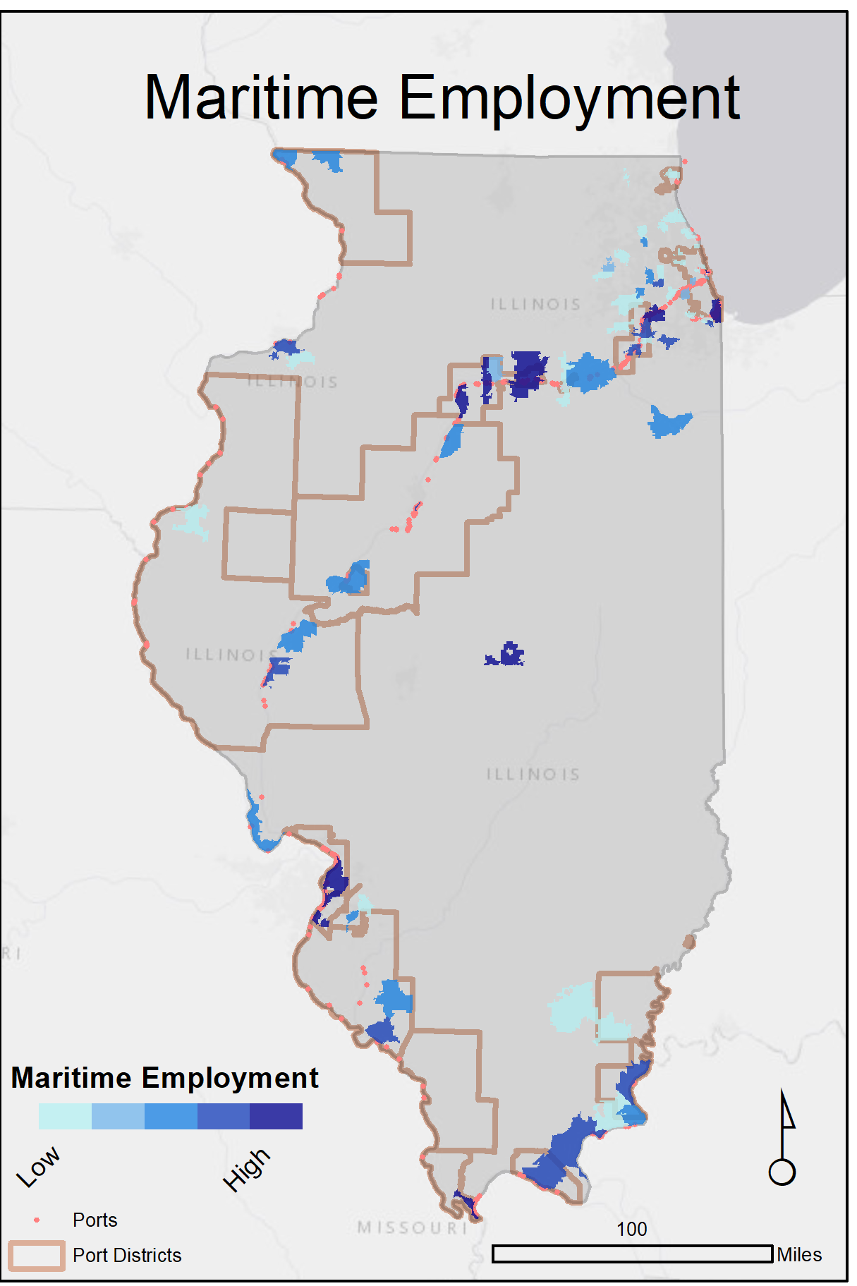
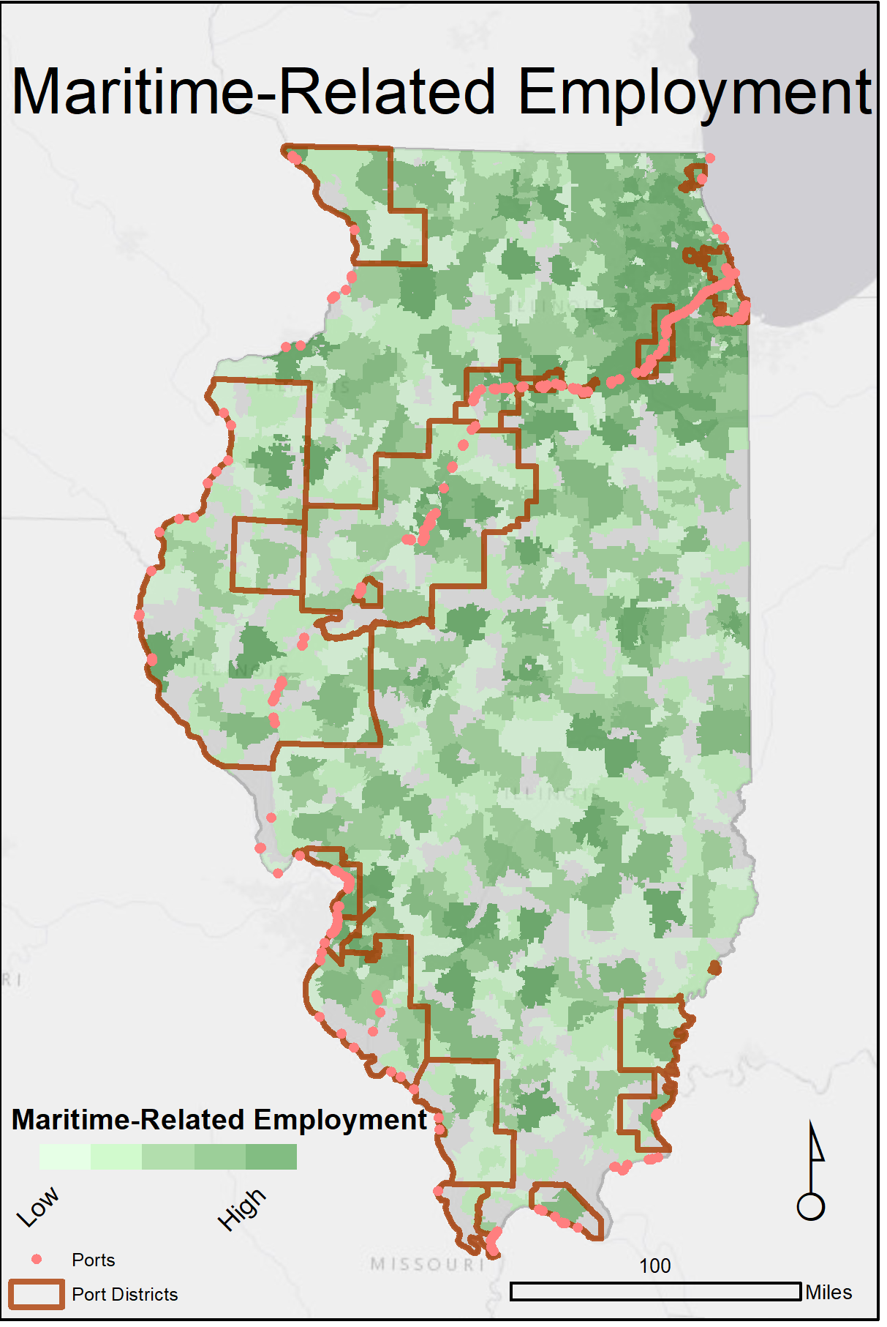
Statewide Maritime Employment

Slide 14
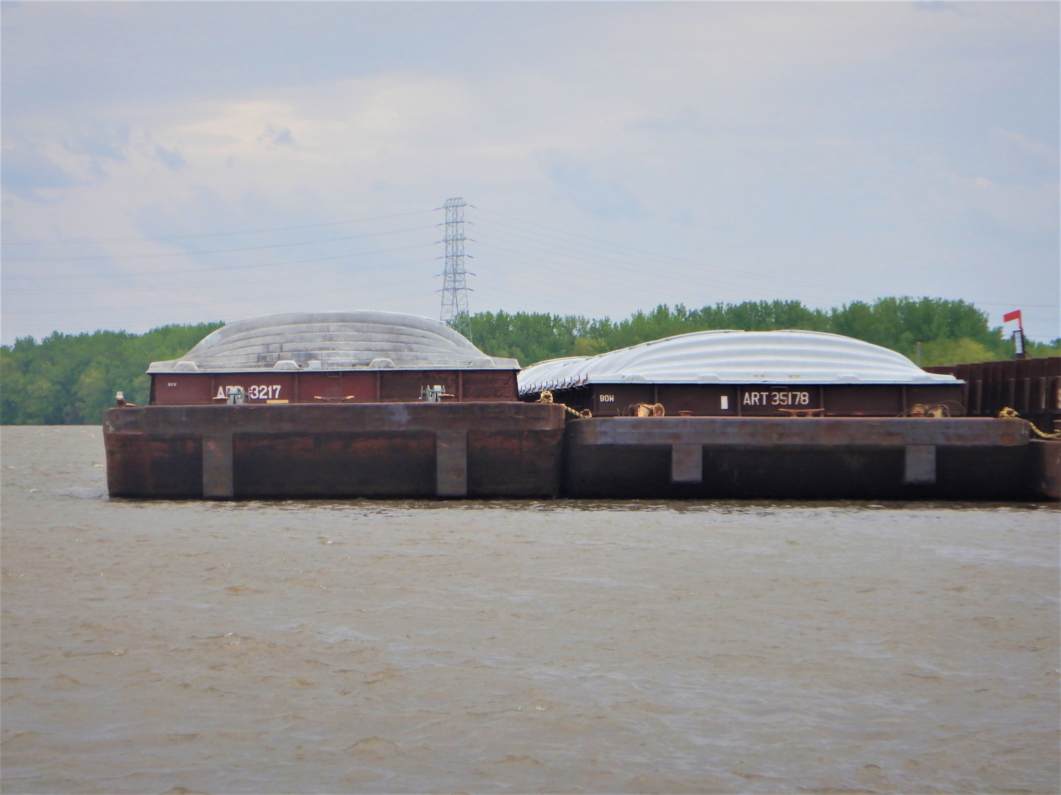
One 15 Barge Tow is Equivalent To
216 Rail Cars and 6 Locomotives
1,050 Large Semi Tractor-Trailers
One Gallon of Fuel Moves 1 Ton of Cargo
647 Miles by Water
477 Miles by Rail
144 Miles by Truck

Slide 15
Needs Assessment and Strategy Development
SWOT
Analysis
(Port, Waterway, and System-Levels)
Critical Needs and Potential Responses
Peer State Programs and Best Practices
Programmatic Action Plan Recommendations and Responsibilities
Funding and Financing
Notes:
SWOT Analysis (Port, Waterway, and System-Levels)
Critical Needs and Potential Responses
Peer State Programs
Review peer states waterway programs and identify best practices that could be used by Illinois
Programmatic Action Plan Recommendations and Responsibilities
Develop near-term and long-range programmatic action plans, these recommendations will address port, regional and state level opportunities.
Funding and Financing
Will identify established sources of funding and financing for ports and waterways
Look at innovative funding options and financing strategies

Slide 16
Benefits of Recommended Action Plans
Benefit-Cost Analysis
  Safety
  State of Good Repair
  Economic Competitiveness
  Environmental Protection
  Livability
Recommended
Programmatic Action Plans
  Develop near-term and long-range programmatic action plan
Notes:
State Long Range Transportation Plan Goals and Objectives

Slide 17
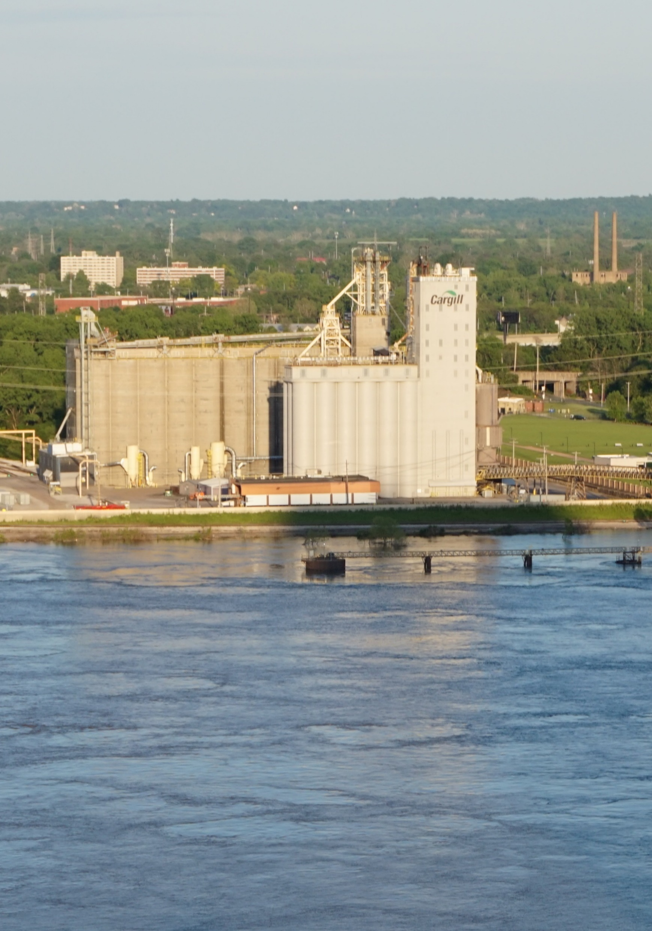
Inventory of Facilities, Conditions, and Connections

Slide 18
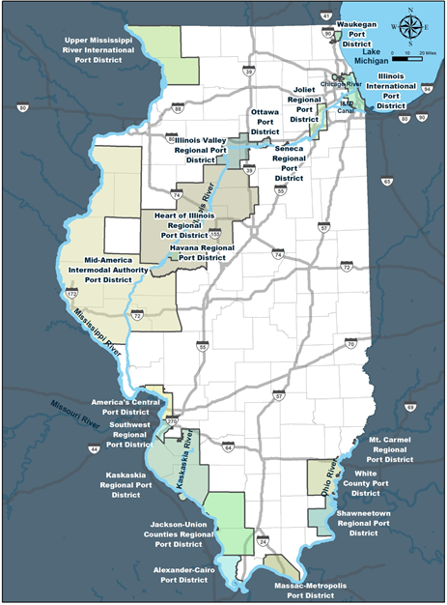
Illinois Port District Map
19 Public Port Districts
Navigable Rivers
  Mississippi
  Ohio
  Illinois
  Kaskaskia
Chicago Area Waterway System (CAWS)
Lake Michigan

Slide 19
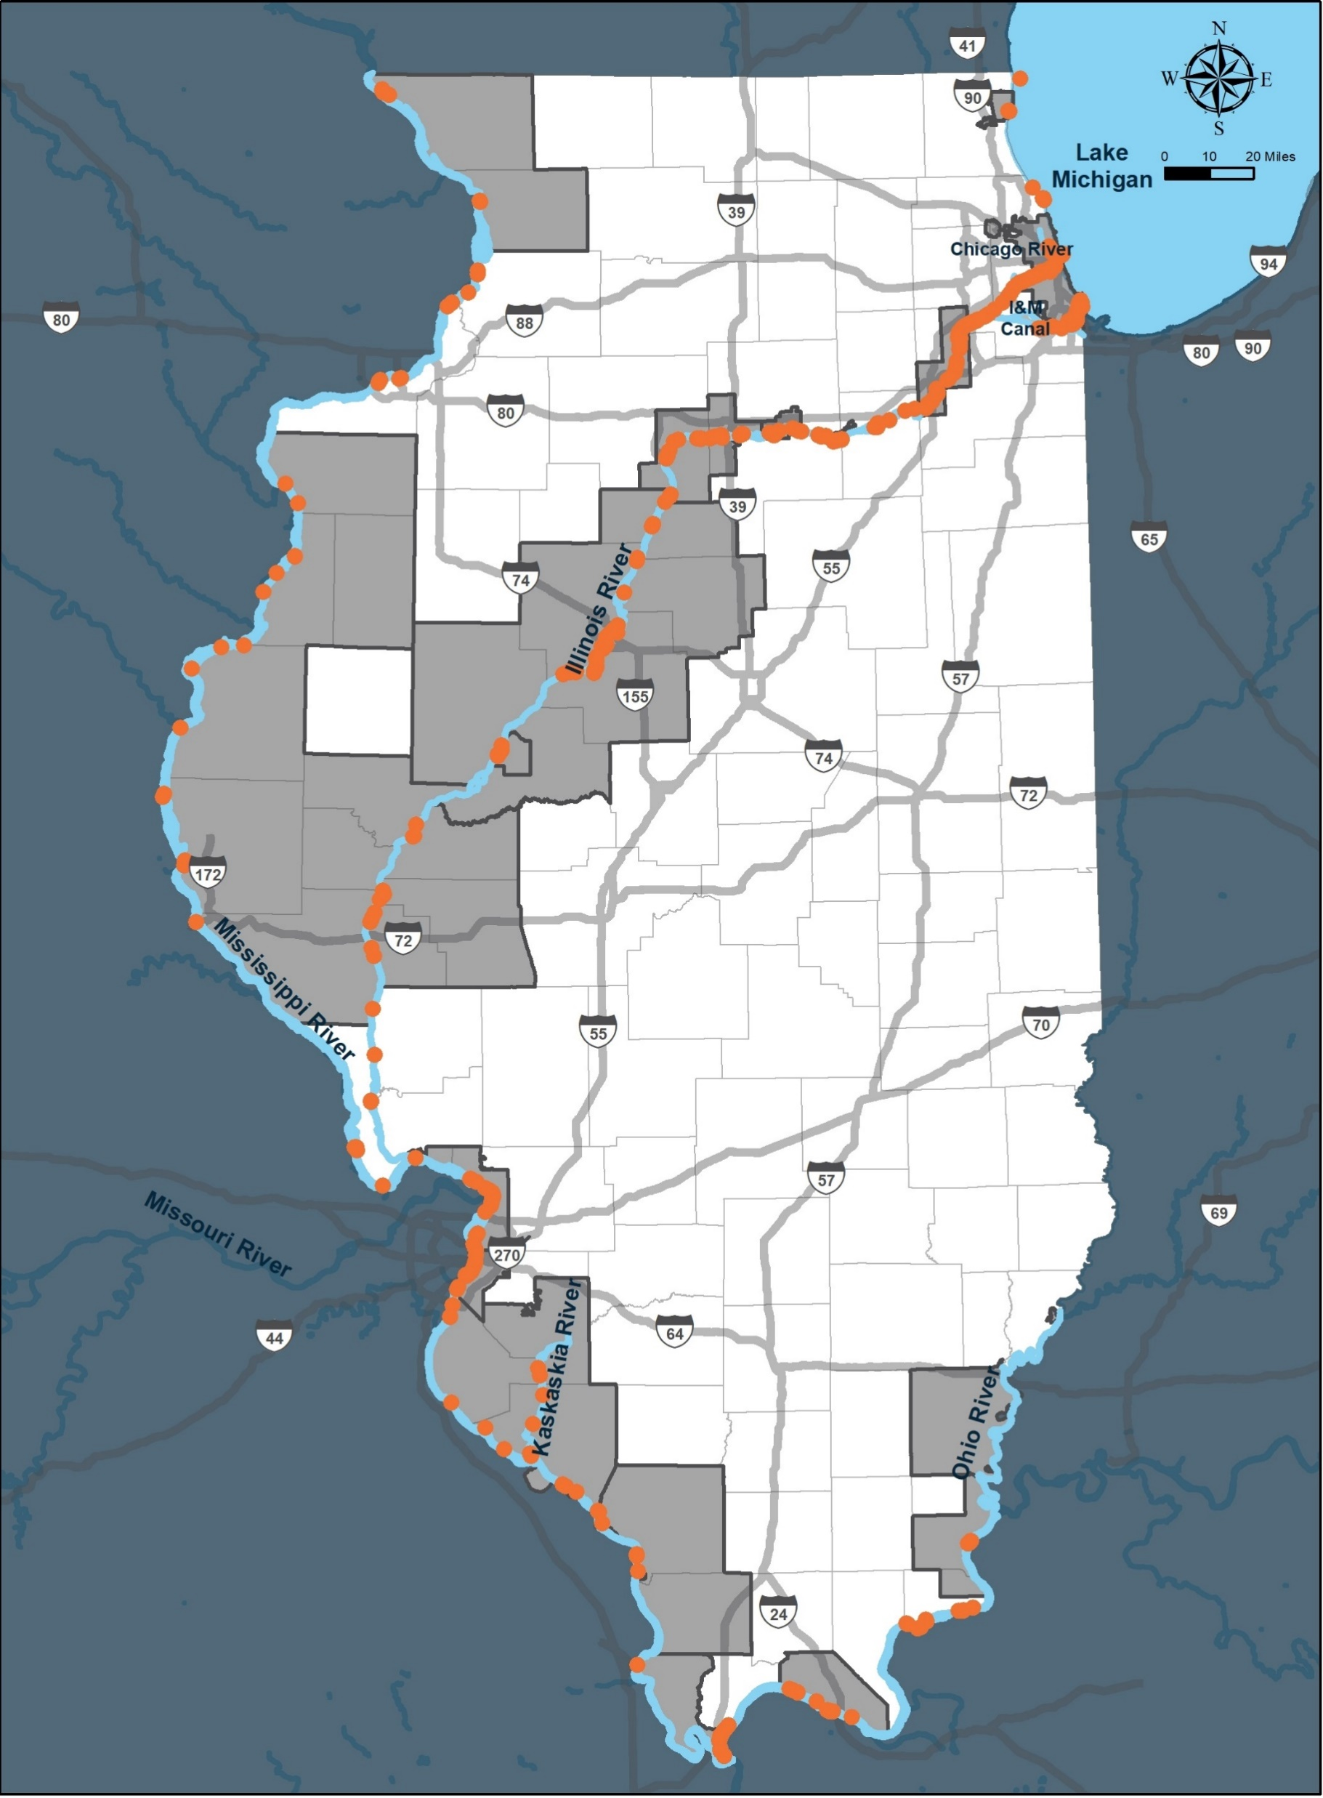
Terminal Locations
Over 350 Terminals
Majority Private
Types of Commodities
  Grain
  Sand
  Gravel
  Chemicals
  Fertilizer
  Fuel

Slide 20
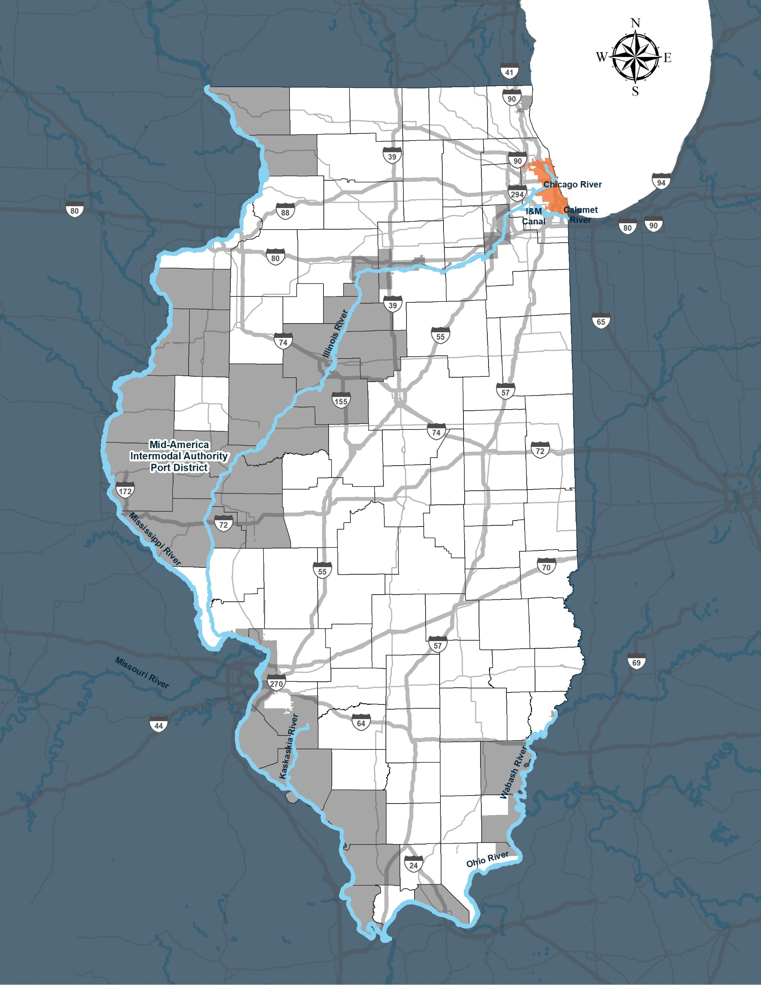
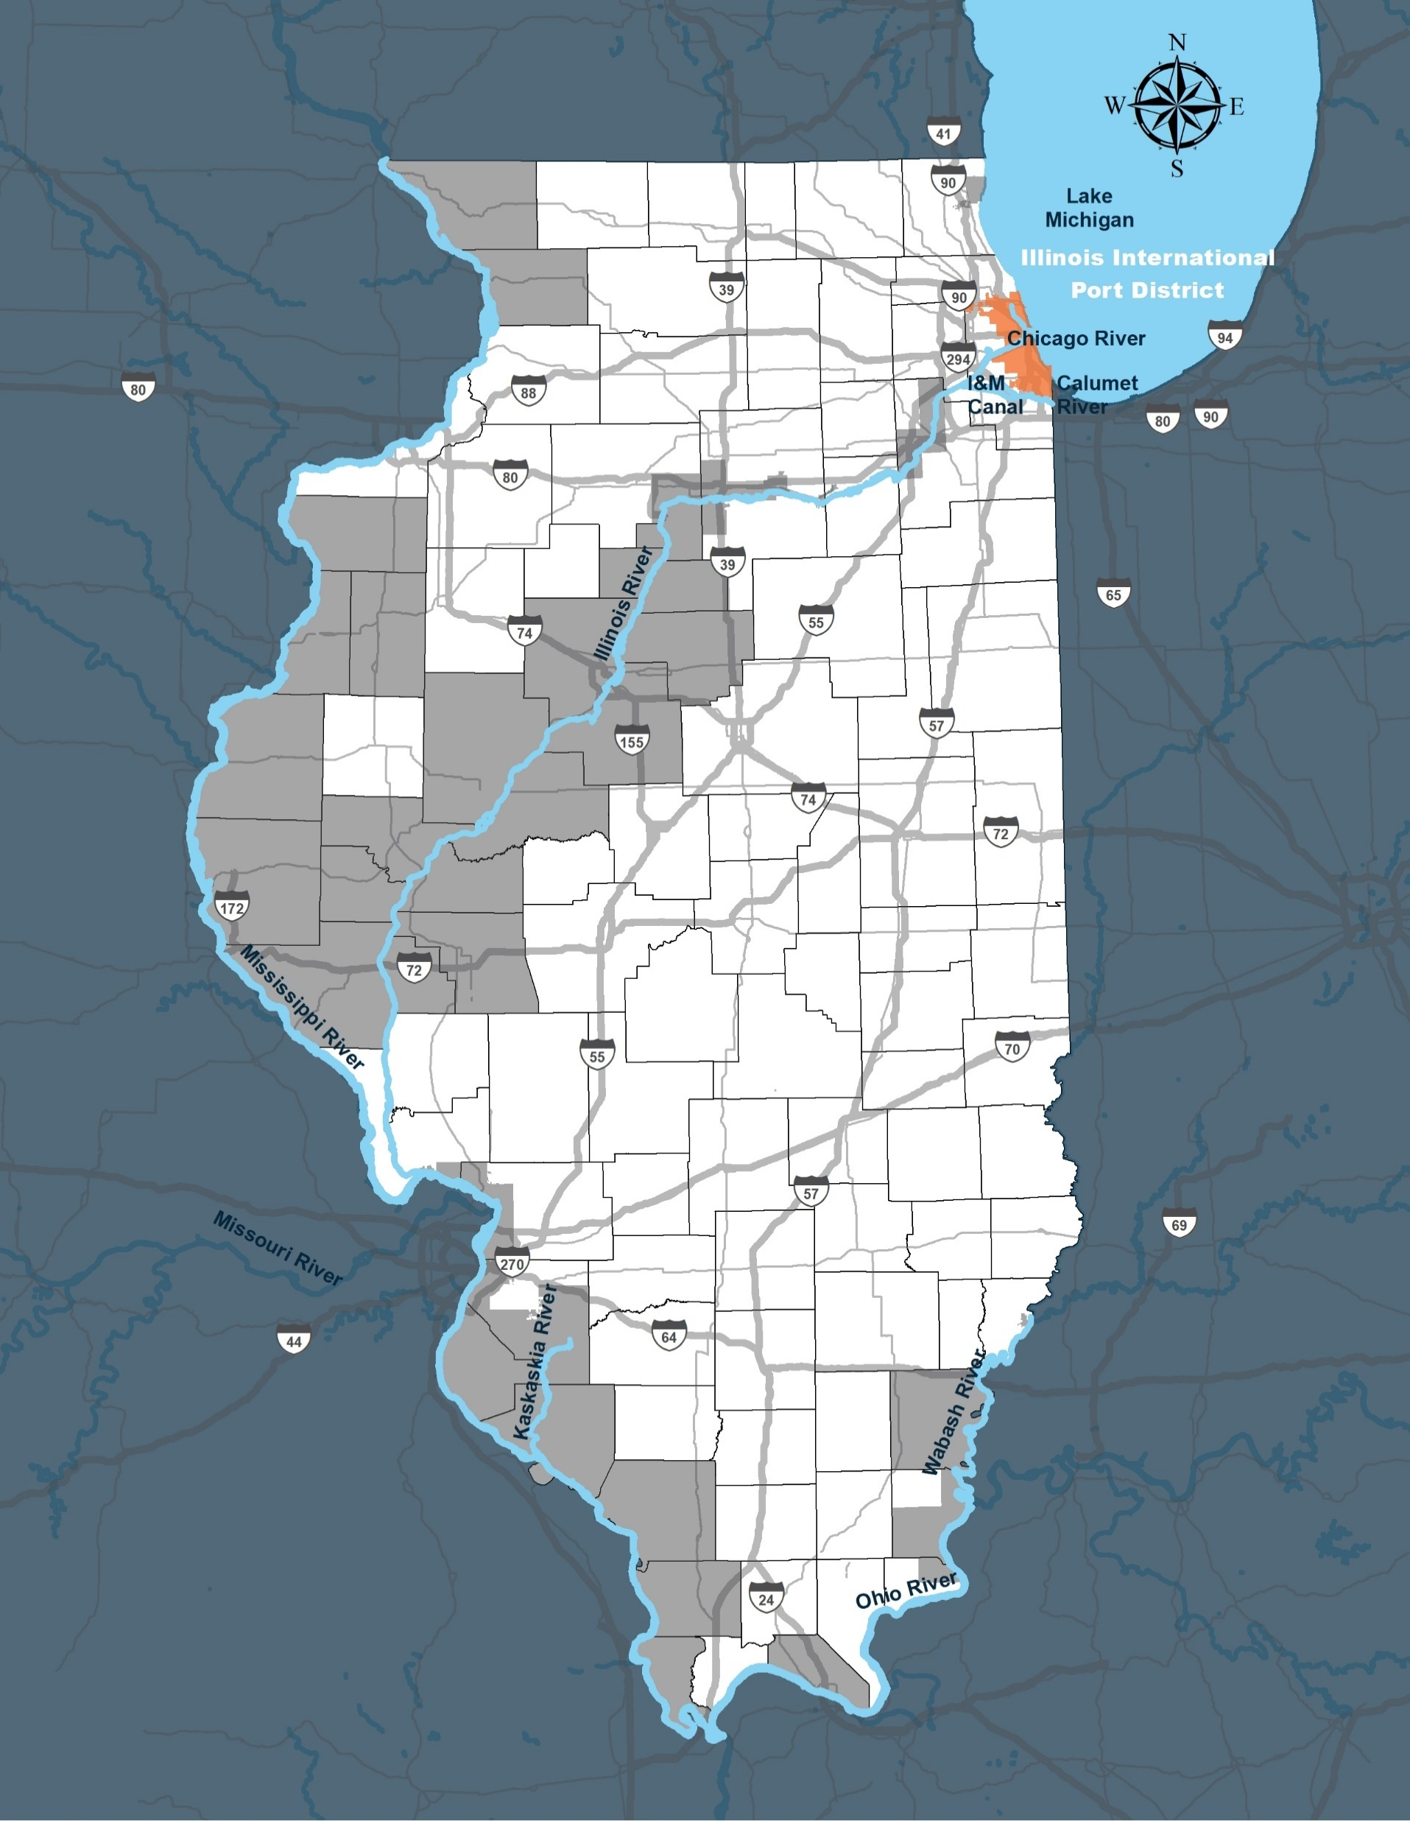
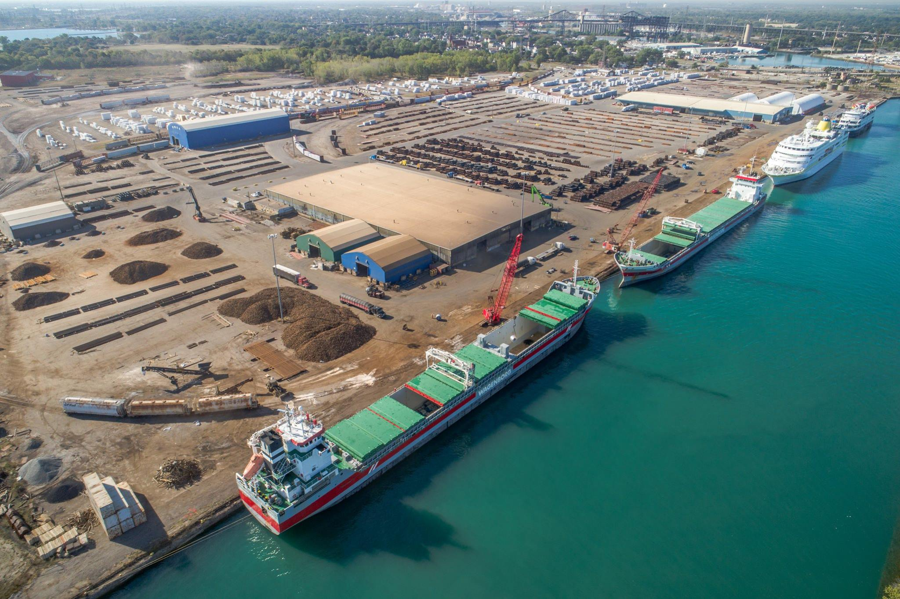
Illinois International Port District (IIPD)

Slide 21
Facility Inventory Example: Illinois International Port District
River Length
  Chicago Sanitary & Ship Canal, and Chicago River 10 Miles
  Chicago River North Branch 6.5 Miles
  Calumet River and Channel 13.5 Miles
Terminals
  77 located within the Port District
Road Connection
  I-294, I-290, I-90, I-94, I-80, I-57, I-55
Rail Connection
  Served by six out of seven Class I Railroads
Major commodities
  Sand and Gravel
  Base Metals
  Fuel Oils

Slide 22
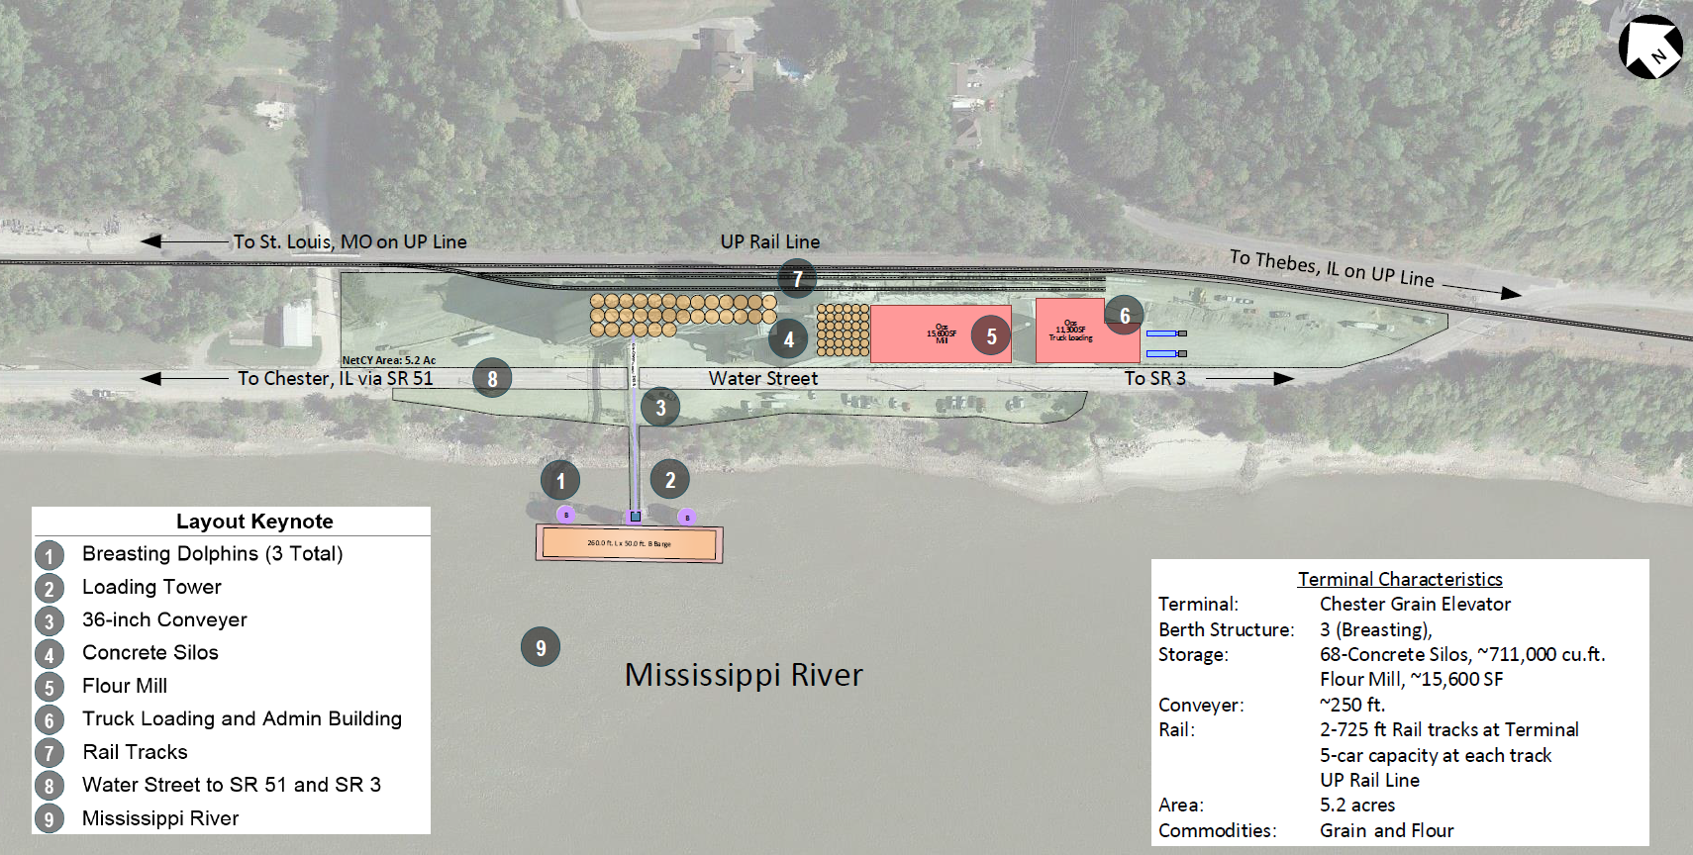
Facility Inventory: Chester Grain Elevator PRIME

Slide 23
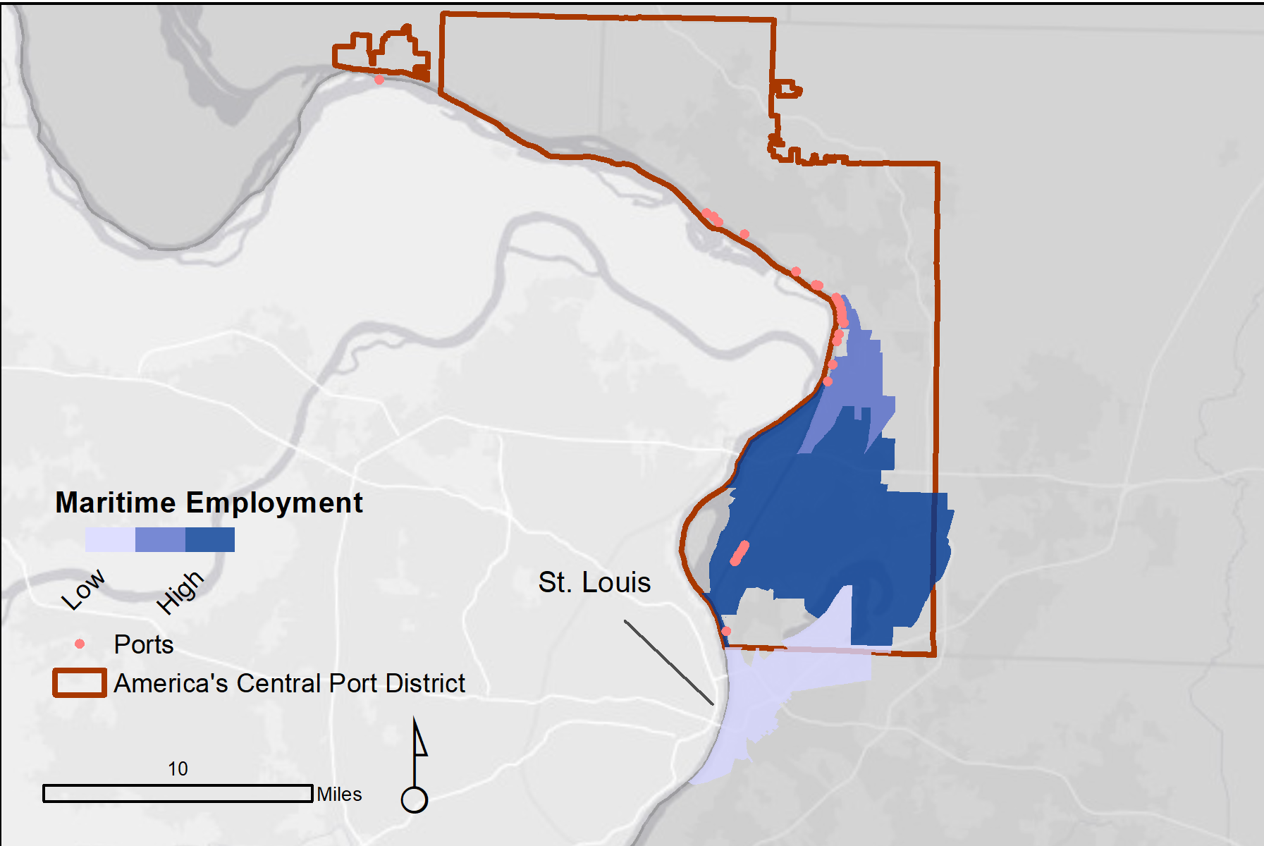
Maritime Activity – America’s Central Port District
Maritime Activity
Establishments | 12
Jobs | 549
Income | $60.0 million
Value Added | $111.7 million
Output | $298.0 million

Slide 24
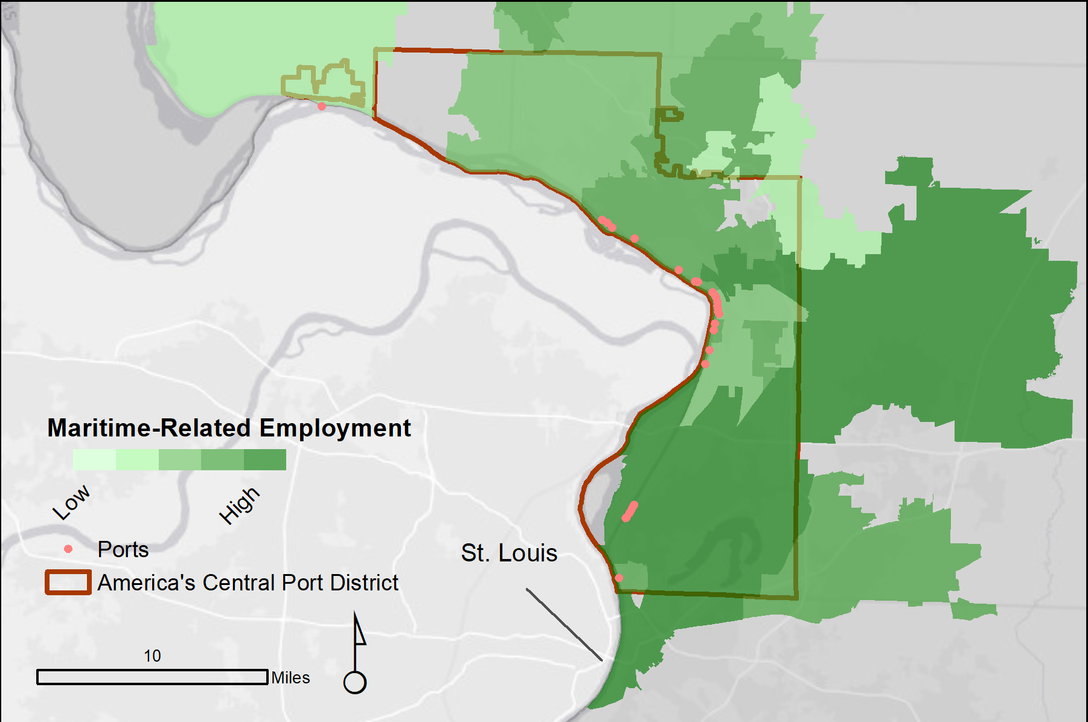
Maritime Activity – America’s Central Port District
Maritime-Related Activity
Establishments | 162
Jobs | 5,365
Income | $359.0 million
Value Added | $449.0 million
Output | $791.0 million

Slide 25
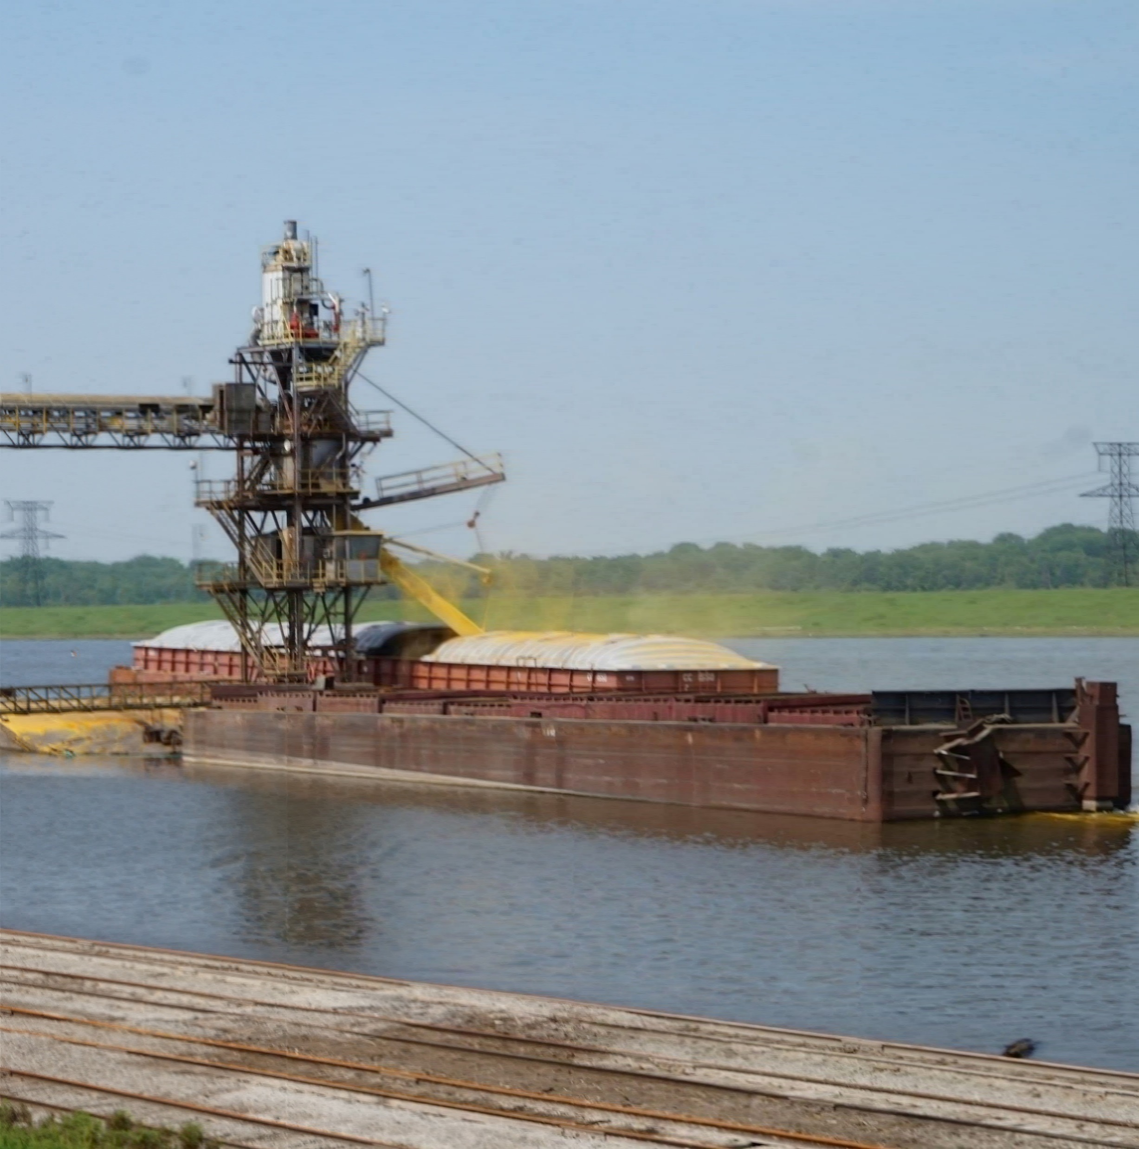
Stakeholder Outreach to Date

Slide 26

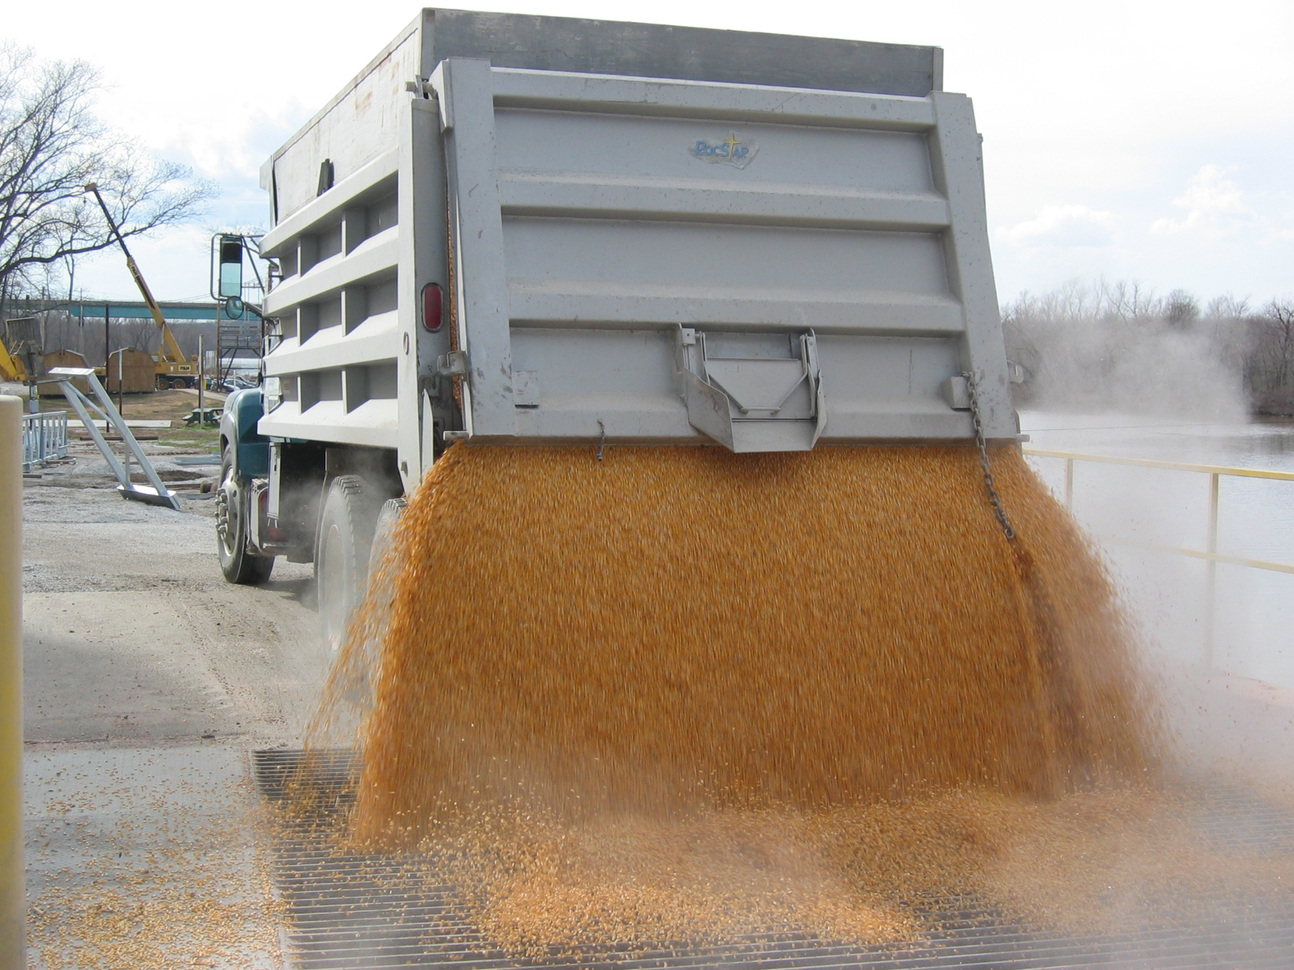
Stakeholder
Outreach to Date
21 Stakeholder Engagements
  17 in person
  4 via phone
Stakeholders
  Port Districts
  Agriculture Industry
  Chemical Industry
  Manufactures
  Aggregate Industry
  Tow Operators

Slide 27

What have we heard to date from stakeholders?
Lack of designated
state funding
  Comparative example: Missouri program
Role in economic development
Consolidation
Flooding
Assistance with Federal and state grants
State leadership
Environmental permitting for port dredge material

Slide 28



What have we heard to date from stakeholders (cont.)
Significance of freight cost & performance to economic health, competitiveness and diversity
Access routes: farm & plant to terminal
Locks and dams
  Modernization
  Closures
Unique advantages of Illinois Marine Transportation System
Truck weights
and configuration

Slide 29
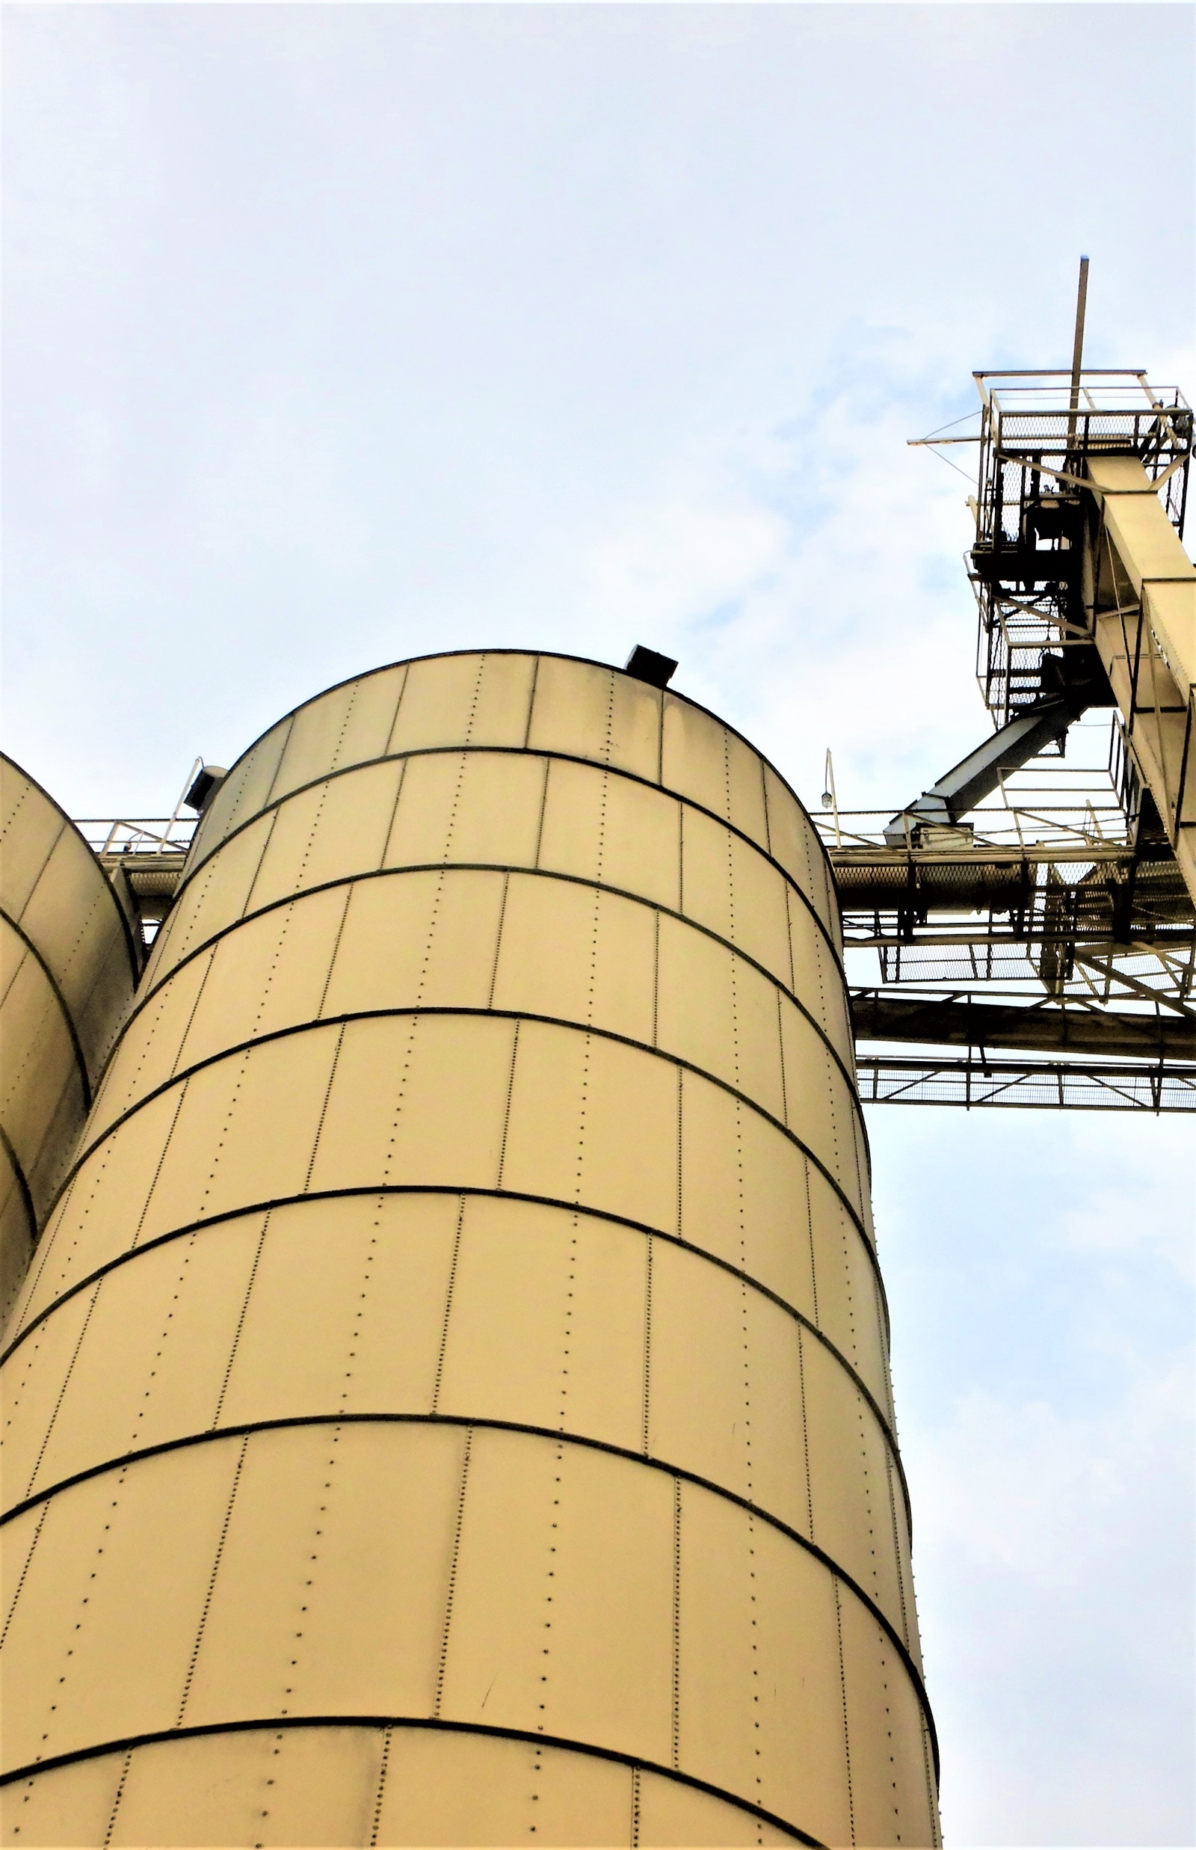

Commodity Flows Analysis

Slide 30
Commodity Flows Analysis Topics
Commodity Flows Information Sources and Analysis
Top Level View of 2017 Commodity Flows
Forecast by Waterway
Top Commodity Forecasts and Regional Distribution
Summary of Total Volume Forecasts and Regional Growth
Summary of Changes in Direction of Flows

Slide 31
Commodity Flows Information Sources and Analysis
Army Corps of Engineers Waterborne Commerce of the U.S.
  State-to-state commodity flows (no waterway segment detail)
  Waterway segments:
    Illinois River; Chicago area; segments of the Mississippi, Ohio and Tennessee Rivers.
    Direction of movement, and shipments versus receipts.
  Reconcile State and Waterway data (for state non-disclosed data)
County origins and destinations derived from Transearch
U.S. DOT Freight Analysis Framework (FAF) forecasted freight flows:
  Growth rates applied to 2017 Army Corps data
TOTAL IL 2017 TONNAGE (000) | Outbound | Inbound | Intrastate | TOTAL
 | 62,115 | 20,073 | 8,374 | 90,562

Slide 32
Illinois Waterway 2017 Freight Tonnage
Total 2017 Tons by Waterway and Direction
 | Direction
Waterway | Inbound | Outbound | Inb+Outb
Chicago | 9,531,080 | 3,767,503 | 13,298,583
Illinois River | 10,557,733 | 38,352,196 | 48,909,928
Kaskaskia | 53,813 | 5,411,996 | 5,465,809
Mississippi | 1,500,000 | 5,900,000 | 7,400,000
Ohio | 200,000 | 7,300,000 | 7,500,000
Total | 21,842,626 | 60,731,695 | 82,574,320

Slide 33
Top Illinois Commodity Flows on Waterways
Top Illinois Out Bound Shipments in 2017 in Millions of Tons

Slide 34
Top Illinois Commodity Flows on Waterways
Top Illinois Inbound Volumes in 2017 in Millions of Tons

Slide 35
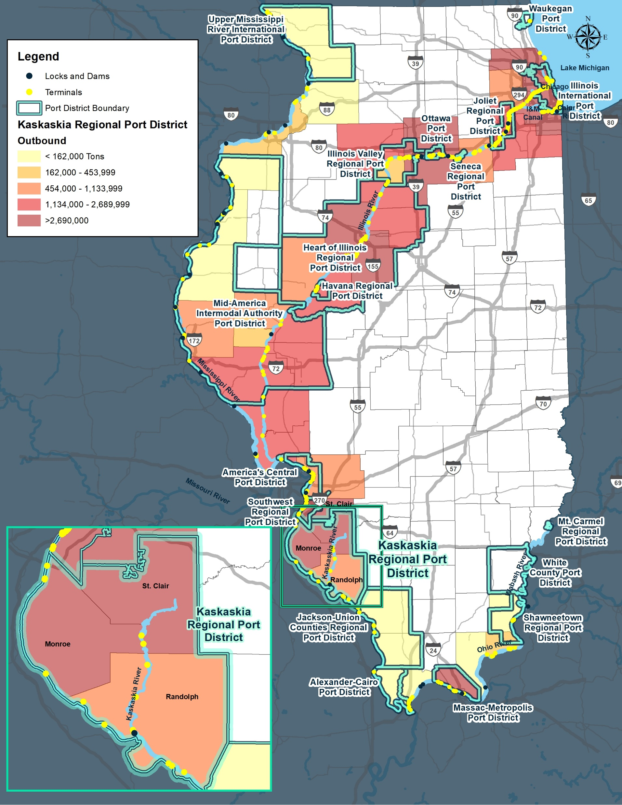
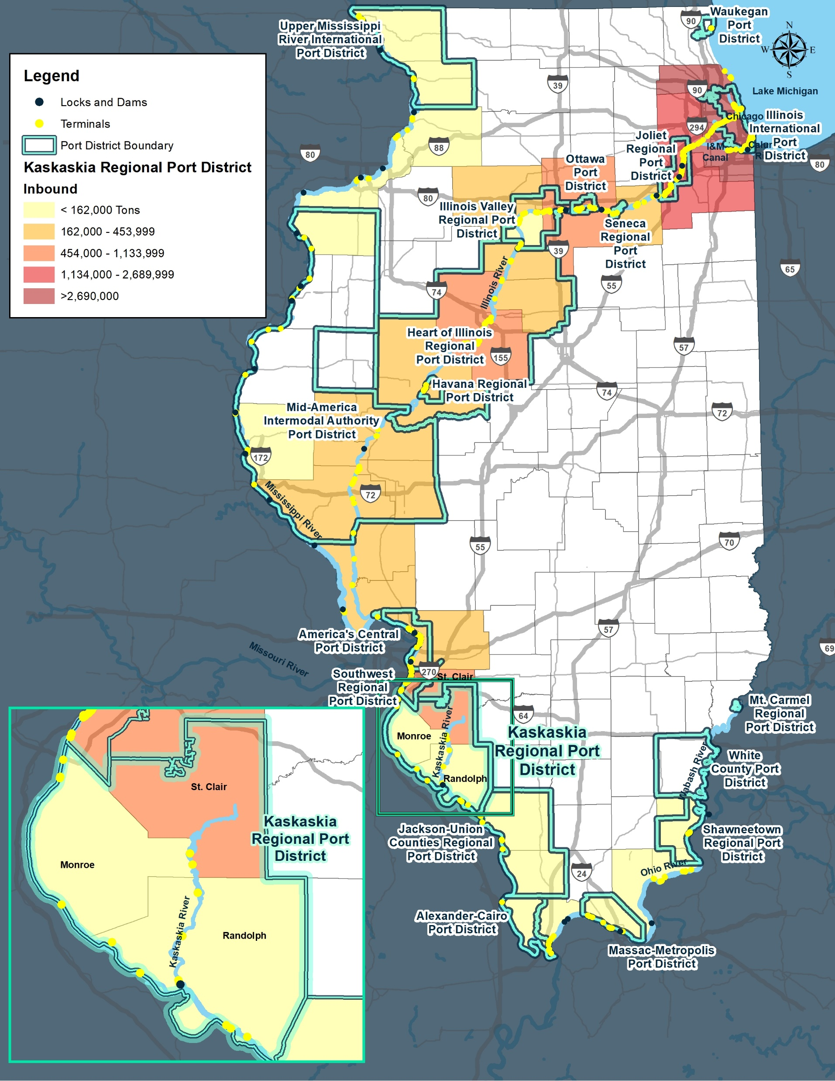
Port Districts & County Tons: Outbound/Inbound
OUTBOUND
INBOUND

Slide 36
Illinois Waterways Growth in Freight, 2017 to 2045
Forecast of Growth in Tons by Waterway
Direction | Waterway | Tons 2017 | Tons 2045 | Tons 2045-2017 | Pct Growth | Share of Change
Inbound | Illinois | 21,842,626 | 30,990,943 | 9,148,317 | 41.9% | 100.0%
 | Chicago | 9,531,080 | 13,035,613 | 3,504,533 | 36.8% | 38.3%
 | Illinois River | 10,557,733 | 15,639,473 | 5,081,740 | 48.1% | 55.5%
 | Kaskaskia | 53,813 | 84,902 | 31,089 | 57.8% | 0.3%
 | Mississippi | 1,500,000 | 1,968,490 | 468,490 | 31.2% | 5.1%
 | Ohio | 200,000 | 262,465 | 62,465 | 31.2% | 0.7%
Outbound | Illinois | 60,731,695 | 57,957,870 | -2,773,824 | -4.6% | 100.0%
 | Chicago | 3,767,503 | 3,540,026 | -227,477 | -6.0% | 8.2%
 | Illinois River | 38,352,196 | 42,246,970 | 3,894,774 | 10.2% | -140.4%
 | Kaskaskia | 5,411,996 | 2,774,374 | -2,637,622 | -48.7% | 95.1%
 | Mississippi | 5,900,000 | 6,557,011 | 657,011 | 11.1% | -23.7%
 | Ohio | 7,300,000 | 2,839,489 | -4,460,511 | -61.1% | 160.8%
Inb+Outb | Illinois | 82,574,320 | 88,948,813 | 6,374,493 | 7.7% | 100.0%
 | Chicago | 13,298,583 | 16,575,639 | 3,277,056 | 24.6% | 51.4%
 | Illinois River | 48,909,928 | 57,886,442 | 8,976,514 | 18.4% | 140.8%
 | Kaskaskia | 5,465,809 | 2,859,276 | -2,606,533 | -47.7% | -40.9%
 | Mississippi | 7,400,000 | 8,525,501 | 1,125,501 | 15.2% | 17.7%
 | Ohio | 7,500,000 | 3,101,955 | -4,398,045 | -58.6% | -69.0%

Slide 37
Outbound Coal
2017 County Distribution
Volume Forecast Tons 000

Slide 38
Outbound Fuel Oils
2017 County Distribution
Volume Forecast Tons 000

Slide 39
Total Forecasted Volumes
Outbound Tons 000
Inbound Tons 000
Outbound volumes are double those of inbound but slightly declining, while inbound volumes are projected to grow
Changes are largely related to declines in energy products

Slide 40
Small Net Declines in Outbound Volumes
Total Tons 000
Commodity Detail
 | 2017 | 2045 | Growth
Total | 63,565,923 | 60,270,554 | -3,295,369
Food | 35,522,074 | 40,429,056 | 4,906,982
Sand and Gravel | 4,618,904 | 5,829,350 | 1,210,446
Non Metal Mineral Products | 302,130 | 628,764 | 326,634
Fertilizers | 326,470 | 552,264 | 225,794
Articles Base Metal | 139,628 | 309,996 | 170,368
Base Metals | 548,750 | 711,129 | 162,379
Non Metallic Minerals | 385,627 | 537,878 | 152,251
Metallic Ores | 51,190 | 69,128 | 17,938
Chemical Products | 0 | 0 | 0
Wood Products | 0 | 0 | 0
Gasoline | 83,180 | 65,904 | -17,276
Crude Petroleum | 907,670 | 873,699 | -33,971
Basic Chemicals | 3,716,670 | 3,032,741 | -683,929
Coal NEC | 3,889,011 | 3,069,495 | -819,516
Fuel Oils | 2,357,277 | 1,347,388 | -1,009,889
Coal | 10,717,342 | 2,813,762 | -7,903,580
Growth is led by Food, Sand and Gravel
and Non Metallic Mineral Products
Large declines are in Energy Products

Slide 41
Growth in Inbound Volumes
Total Tons 000
Commodity Detail
 | 2017 | 2045 | Growth
Total | 24,076 | 33,744 | 9,667
Fertilizers | 3,780 | 6,252 | 2,472
Base Metals | 3,396 | 5,718 | 2,323
Non Metal Mineral Products | 2,146 | 4,098 | 1,952
Sand and Gravel | 4,294 | 5,636 | 1,341
Basic Chemicals | 2,520 | 3,338 | 818
Food | 761 | 1,551 | 789
Wood Products | 341 | 899 | 557
Articles Base Metal | 299 | 667 | 367
Chemical Products | 97 | 439 | 342
Non Metallic Minerals | 1,432 | 1,701 | 268
Metallic Ores | 307 | 414 | 108
Crude Petroleum | 0 | 0 | 0
Coal | 87 | 22 | -65
Gasoline | 374 | 11 | -363
Coal NEC | 2,199 | 1,756 | -443
Fuel Oils | 2,043 | 1,244 | -799
Growth is led by Fertilizers, Base Metals,
Non Metallic Mineral Products and
Sand and Gravel
Declines are in Energy Products

Slide 42
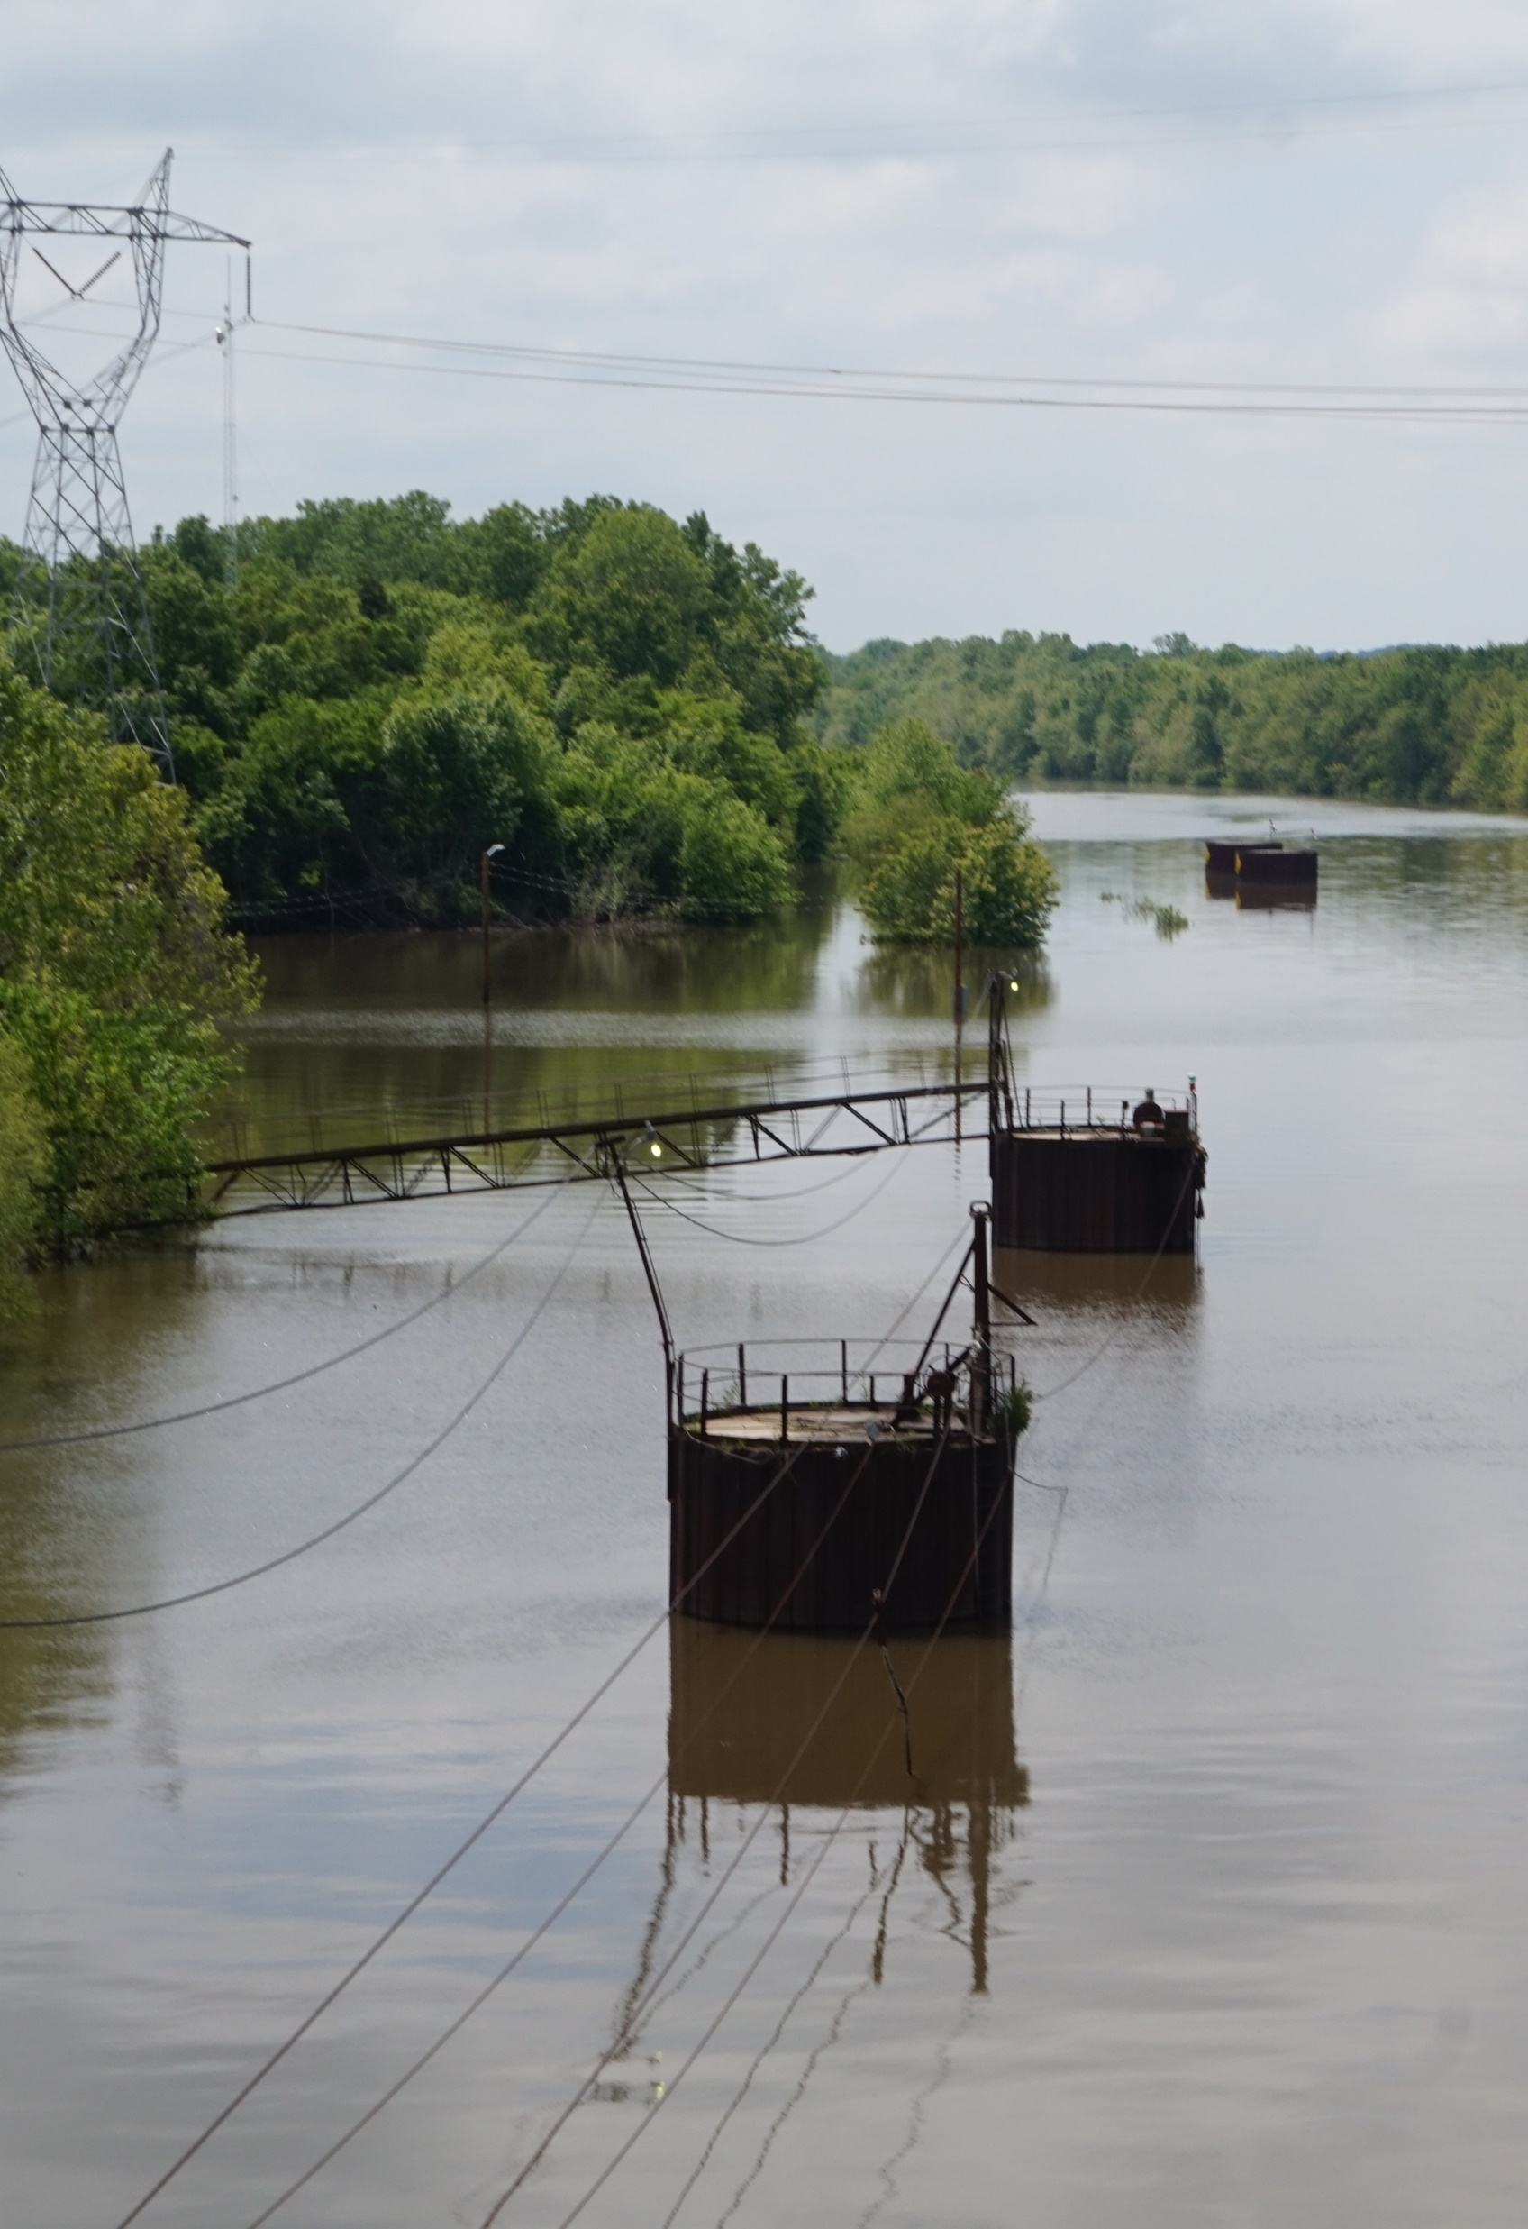
Funding Options

Slide 43
Illinois Port Facilities Funding Support Programs
Federal
Army Corps of Engineers Work Program (navigable waterways)
USDOT federal gas tax funds (highway access)
US Dept of Agriculture
Transportation Grants (BUILD, INFRA, Marine Highway, Port Infrastructure Development)
Economic Grants / Revenue Enhancement (USEDA Opportunity Zone, FTZ designation)
Innovative finance / loan programs (TIFIA, RRIF, PPP, etc.)
State
IL Capital Bill / provisions and expectations
IL DCEO funding (port revolving loan & others)
Highway and rail program expenditures
Local
Public port self-funding through revenues
Private investment (marine terminals, railroads, processing and industrial facilities, etc.)

Slide 44
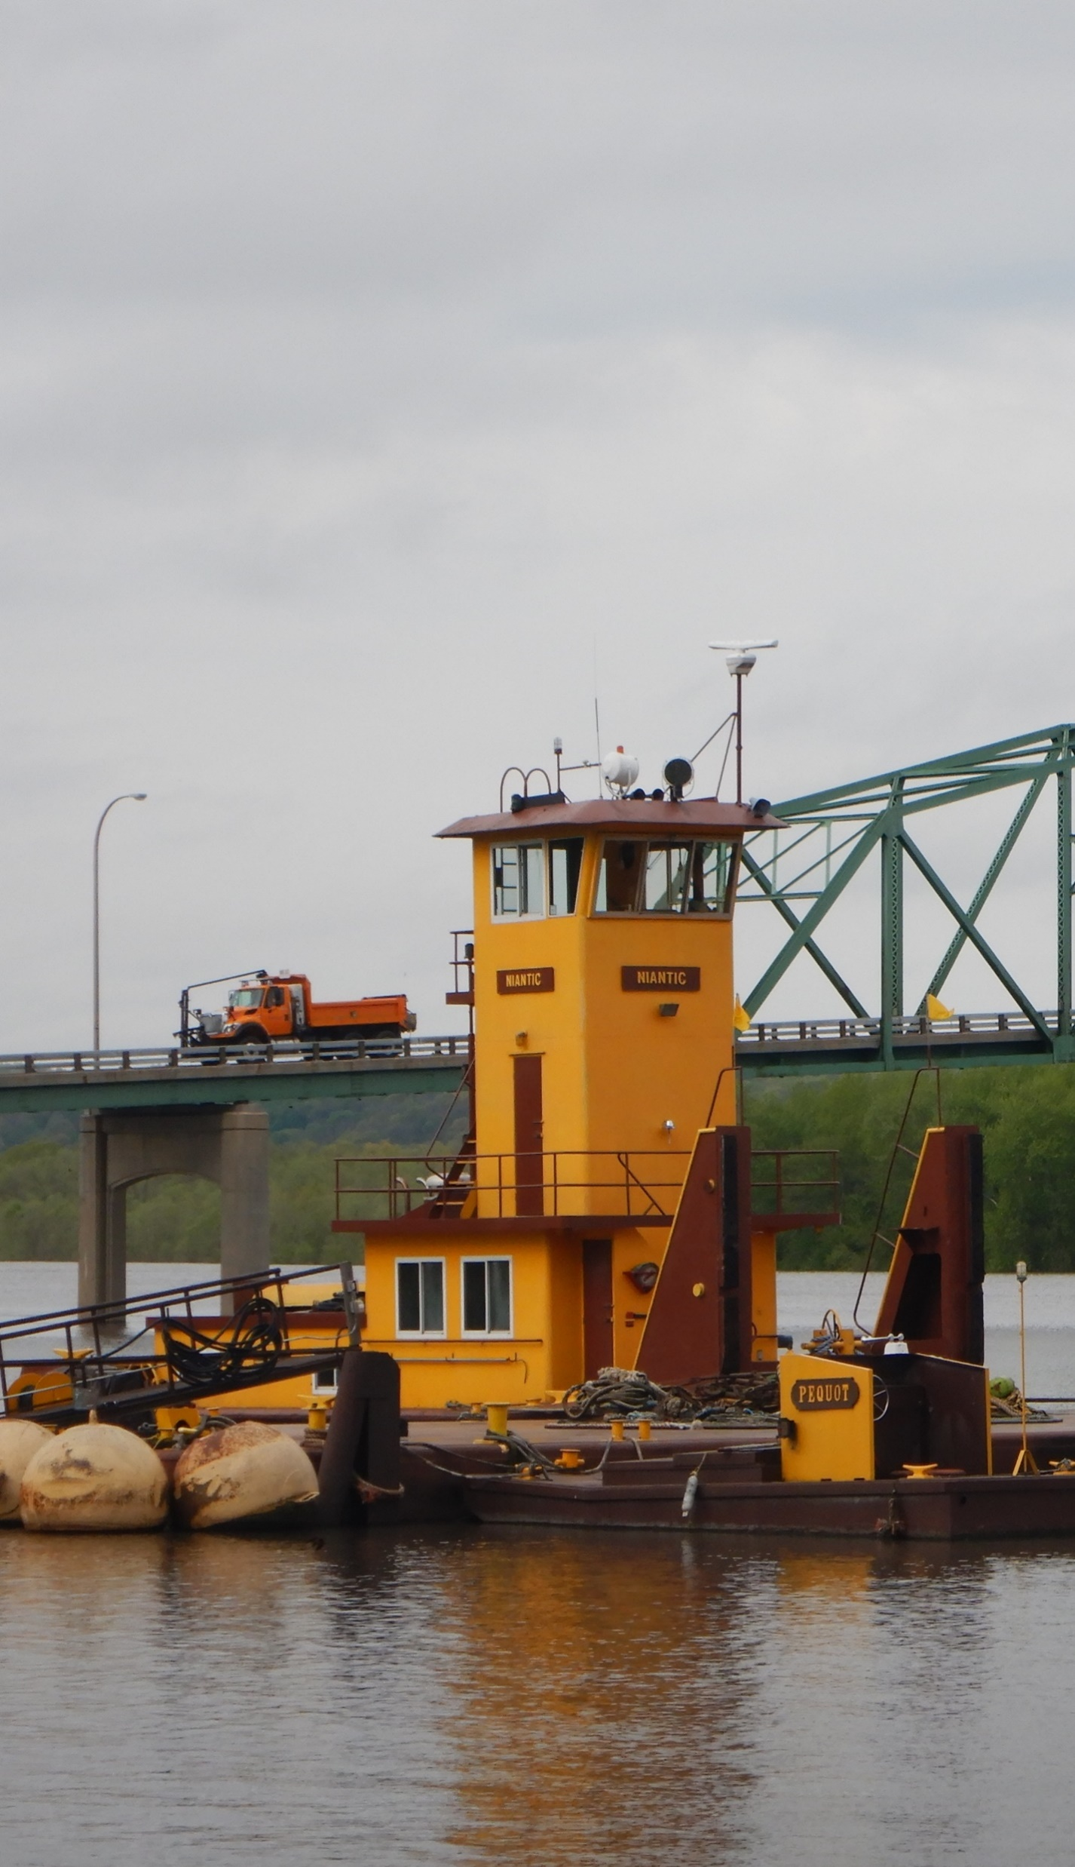
Next Steps

Slide 45
Next Steps
2nd Steering Committee Meeting - September
Prepare Inventory of Carriers and Operators
Develop Industry Profiles
Continue Stakeholder Outreach
Complete Economic Impact Analysis
Complete Facilities Inventory

Slide 46
IMTS Study Timeline
Study Timeline (February 2019 – March 2020)
  February 2019: IMTSP Initiation
  July 2019: System and Volume Information
  September 2019: User and Operator Information/Economic Value
  October/November 2019: Needs Assessment and Strategy Development
  December 2019: Benefits of Recommended Action Plans
  January 2020: Draft Report
  March 2020: Final Report

Slide 47

Questions?

