Slide 1
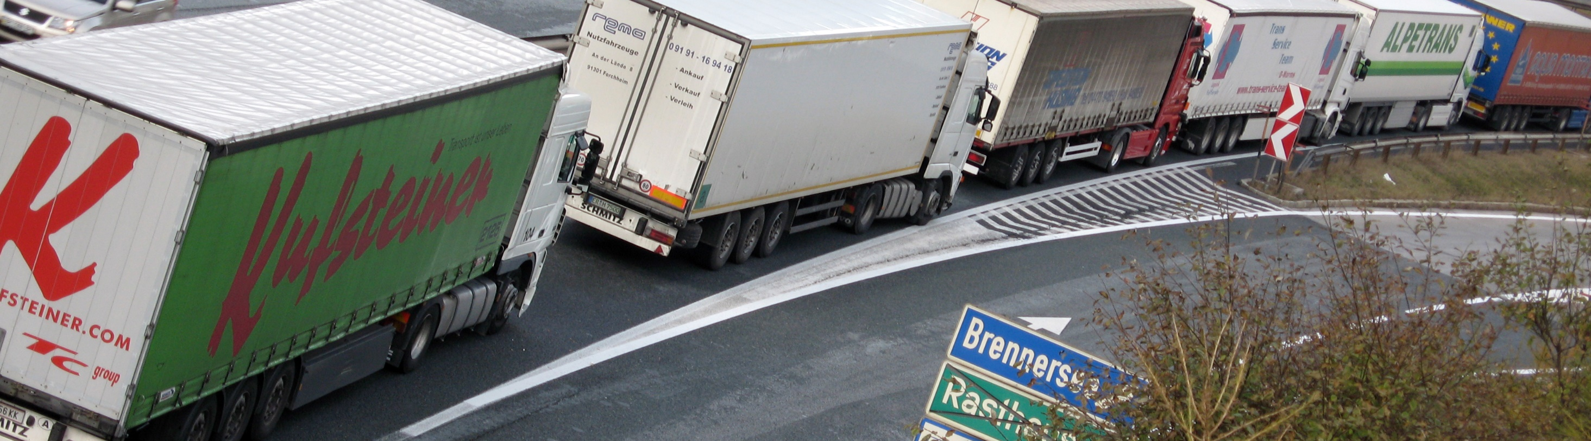
M(a)N with a (Vehicle Platoon) Plan
Craig Gustafson| Chief Counsel
Max Tsai | OCC Legal Extern
8/14/2019

Slide 2

Truck Platooning in MN
2019- Minnesota law is amended to authorize truck platoons.
Two key changes made in law:
  A platooning exemption to the law that requires 500 feet of separation between vehicles; and
  To platoon, you need an approved platooning plan.

Slide 3
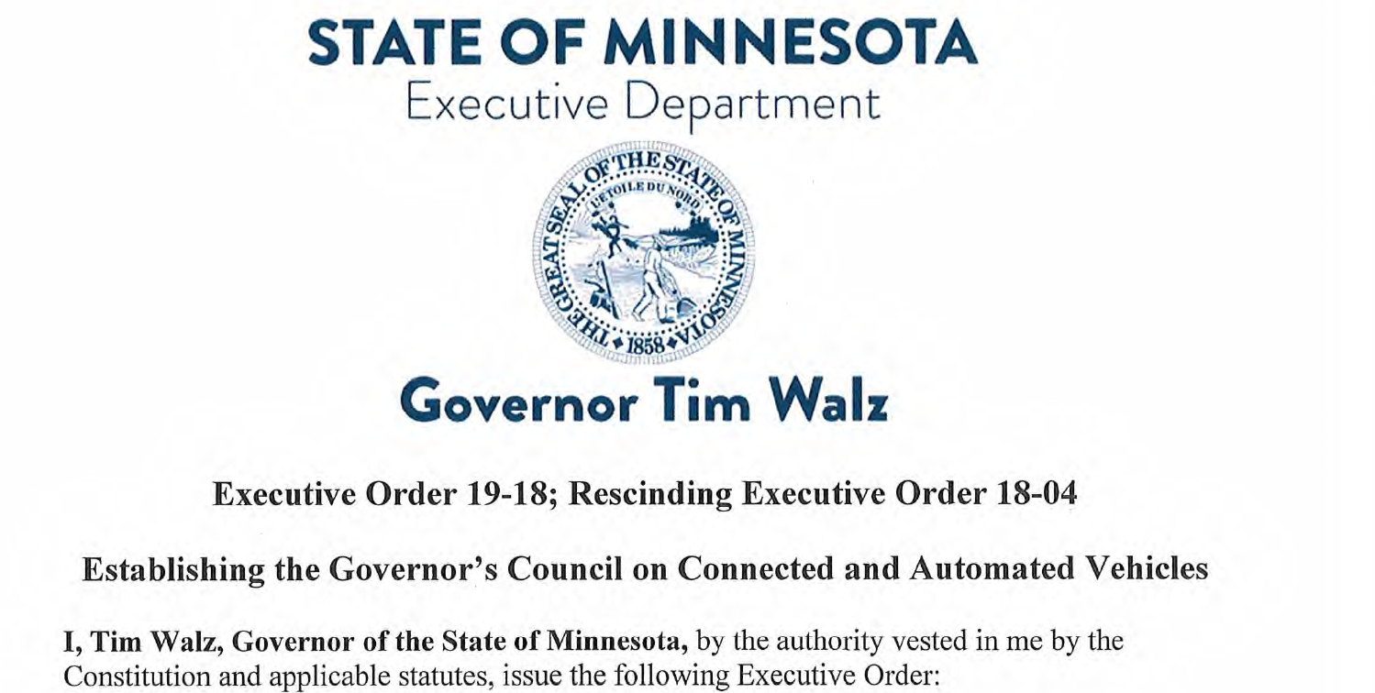
Background to Law Changes
Governors issued executive orders on connected and automated vehicles (CAV).
March 5th, 2018 executive order by Gov. Mark Dayton established an advisory council to study and report on CAV.
April 1, 2019 executive order by Gov. Tim Walz established a second advisory council to continue to study and report on CAV.

Slide 4
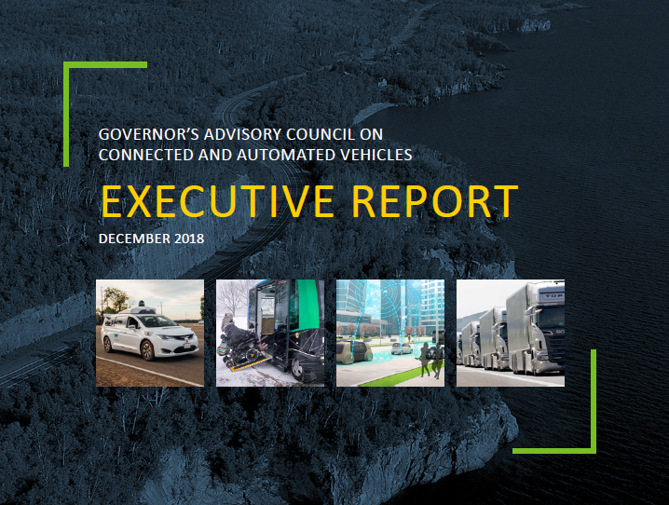
Executive Order 18-04
Executive Order 18-04 established the first Advisory Council on CAV
On December 1, 2018, the council recommended:
  That the legislature authorize the safe testing and deployment of truck platooning; and
  Infrastructure should be assessed to determine the impact of platooning on pavements and bridges

Slide 5
Executive Order 19-18: Next Steps
April 1, 2019 Governor Walz signed Executive Order 19-18 which will form a second Advisory Council on CAV.
The new council is still in its formation stages.

Slide 6

Law Changed to Authorize Truck Platoons in MN
May 2019- the law was amended to authorize the safe testing and deployment of truck platooning.
Key changes:
  500 foot following distance exemption;
  Required “vehicle platoon plans;” and
  Definitions also added to law.

Slide 7

Definitions Added to Law
Definitions for “platooning system” and “vehicle platoon” were added to the law:
  Platooning System: “Driver-assisted vehicle-to-vehicle technology that integrates electronic communications between and among multiple vehicles to synchronize speed, acceleration, and braking while leaving system monitoring and intervention in the control of each vehicle's human operator;” and
  Vehicle Platoon: “A group of commercial vehicles traveling in a unified manner through use of a platooning system or systems. A vehicle platoon consists of a lead vehicle and following vehicles. A vehicle platoon is not a combination vehicle under this chapter.”

Slide 8
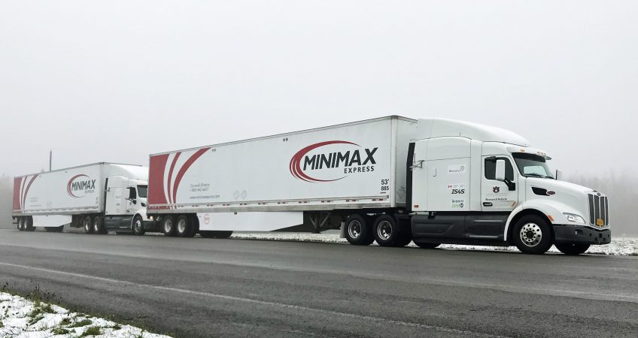
Following Too Closely Laws
MN law states:
  “The driver… of any motor truck or bus, when traveling upon a roadway outside of a business or residence district, shall not follow within 500 feet of another vehicle.
The 2019 amendment keeps the old law and adds:
  This paragraph does not apply to following vehicles in a vehicle platoon if the operator has an approved plan in compliance with Minn. Stat., section 169.881.

Slide 9
“Vehicle Platoon Plans”
Plans must include:
  Total length of the platoon;
  Configuration of the platoon;
  Proposed route;
  Proposed time frames of operation; and
  License info, vehicle specs, vehicle ID’s.

Slide 10
Legal requirements for platoons
Platoons must follow these legal requirements:
  A platoon may not include more than three vehicles;
  Each vehicle must have a platooning system installed, and that system must be engaged when platooning;
  A human driver must be present in EACH vehicle in the driver’s seat and must be monitoring the vehicle at all times;
  The platoon must allow reasonable access for the movement of other vehicles to change lanes and enter or exit the roadway;
  Other miscellaneous requirements (insurance, copy of plan on board, etc.).

Slide 11

Summary
Citation to MN platooning law:
  Laws of Minnesota 2019, 1st Special Session, Chapter 3, sections 31, 33, 38, and 70
The new law:
  1) created an exemption to minimum distance laws for platoons; and
  2) created mandatory plans for truck platoon operators.
Support of the trucking industry was the key to passage of the new law

Slide 12
Thank you!
Craig Gustafson
craig.gustafson@state.mn.us
651-366-4841

