Slide 1



Ohio’s Framework for Connected/Automated Vehicle Technology
Project Findings
XX, 2019
ODOT Statewide Connected and Autonomous Vehicle (AV/CV) Systems Engineering Analysis
MAASTO
August 14, 2019

Slide 2
Goal: Create Statewide Framework
DriveOhio’s first initiative: Coordinate statewide AV/CV
technology deployments
Required by Law § 23 CFR 940.11: Comprehensive Systems Engineering Analysis of Statewide Architecture
This Framework is first of its kind in U.S.
Notes:
Required by Law § 23 CFR 940.11: Comprehensive Systems Engineering Analysis of Statewide Architecture

Slide 3
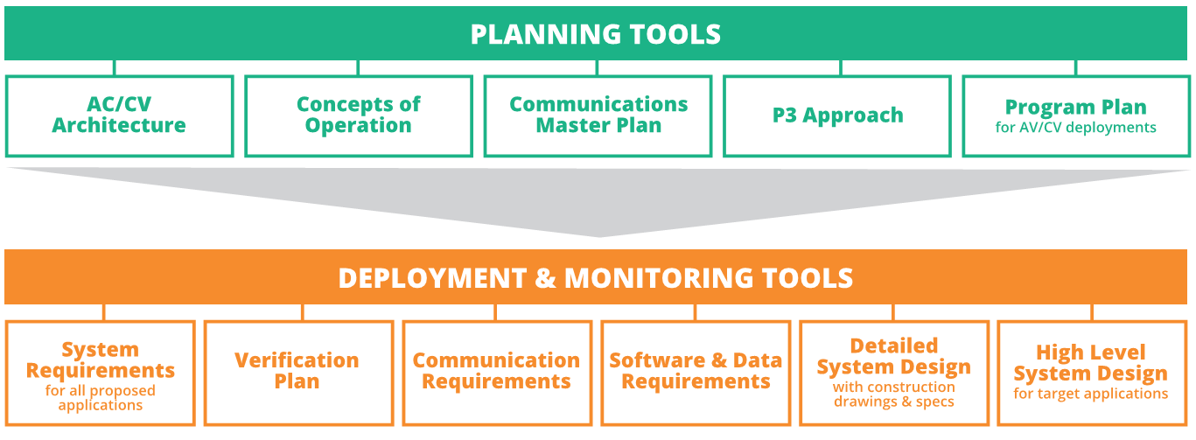
Framework Outcome: Playbook
Completed or underway: tools needed to plan, deploy and
monitor AV/CV projects that will work together

Slide 4
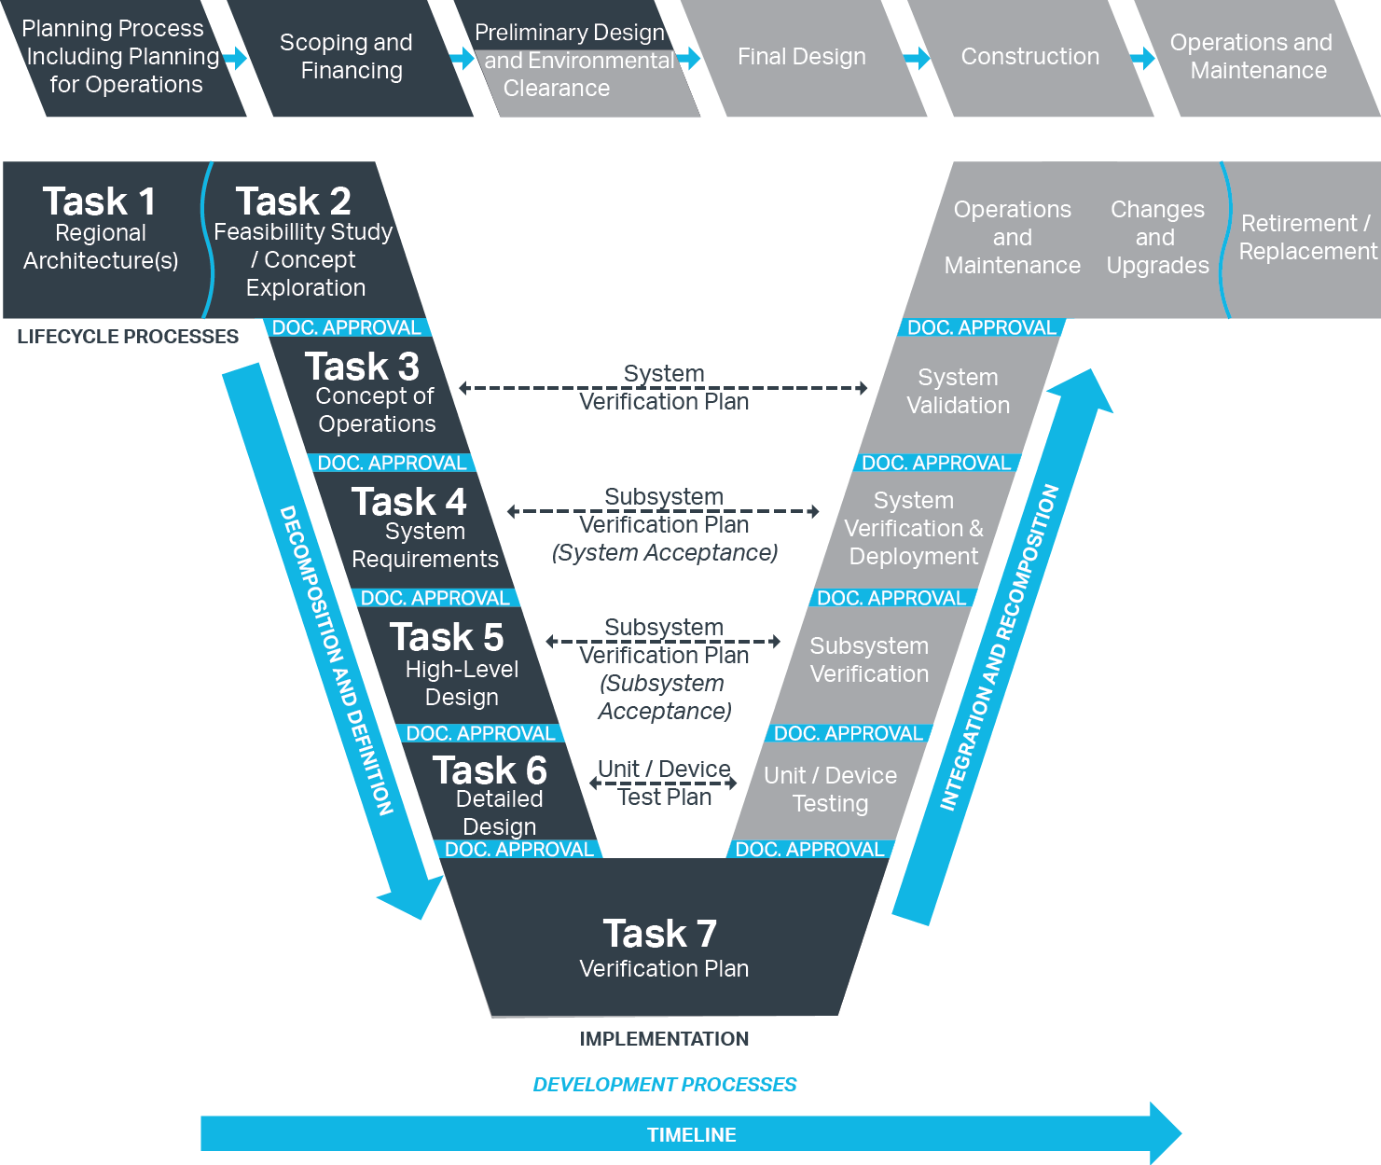
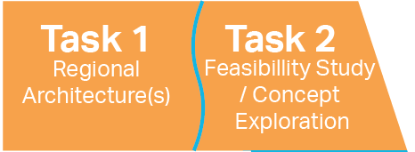
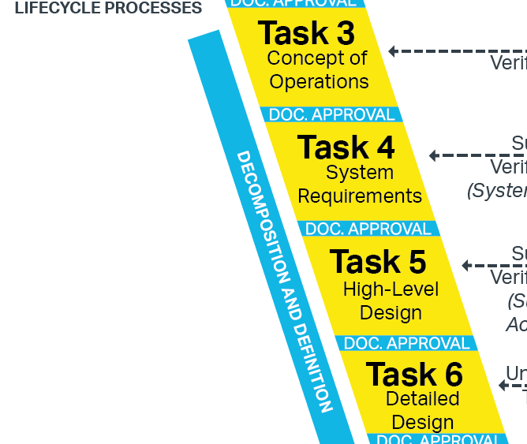
Proven Method for Success
RAD-IT Scope
SET-IT Scope
ARC-IT Scope

Slide 5
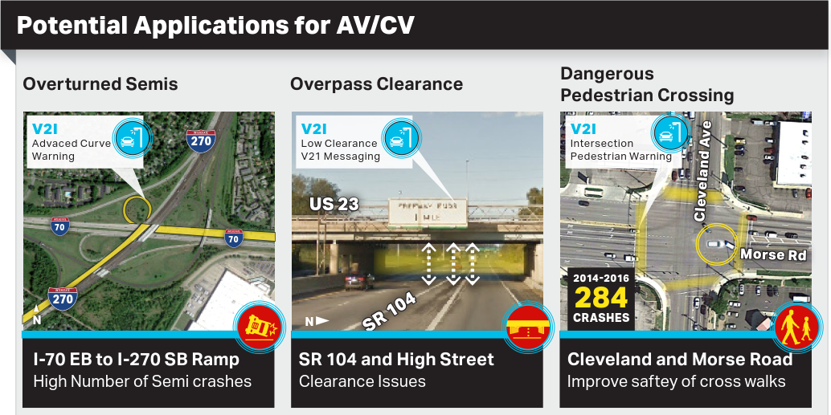
What can people see with initial implementation?
Notes:
Examples of AV/CV applications applied to existing ODOT deployments that are identified as part of AECOM’s Feasibility Exploration scope

Slide 6
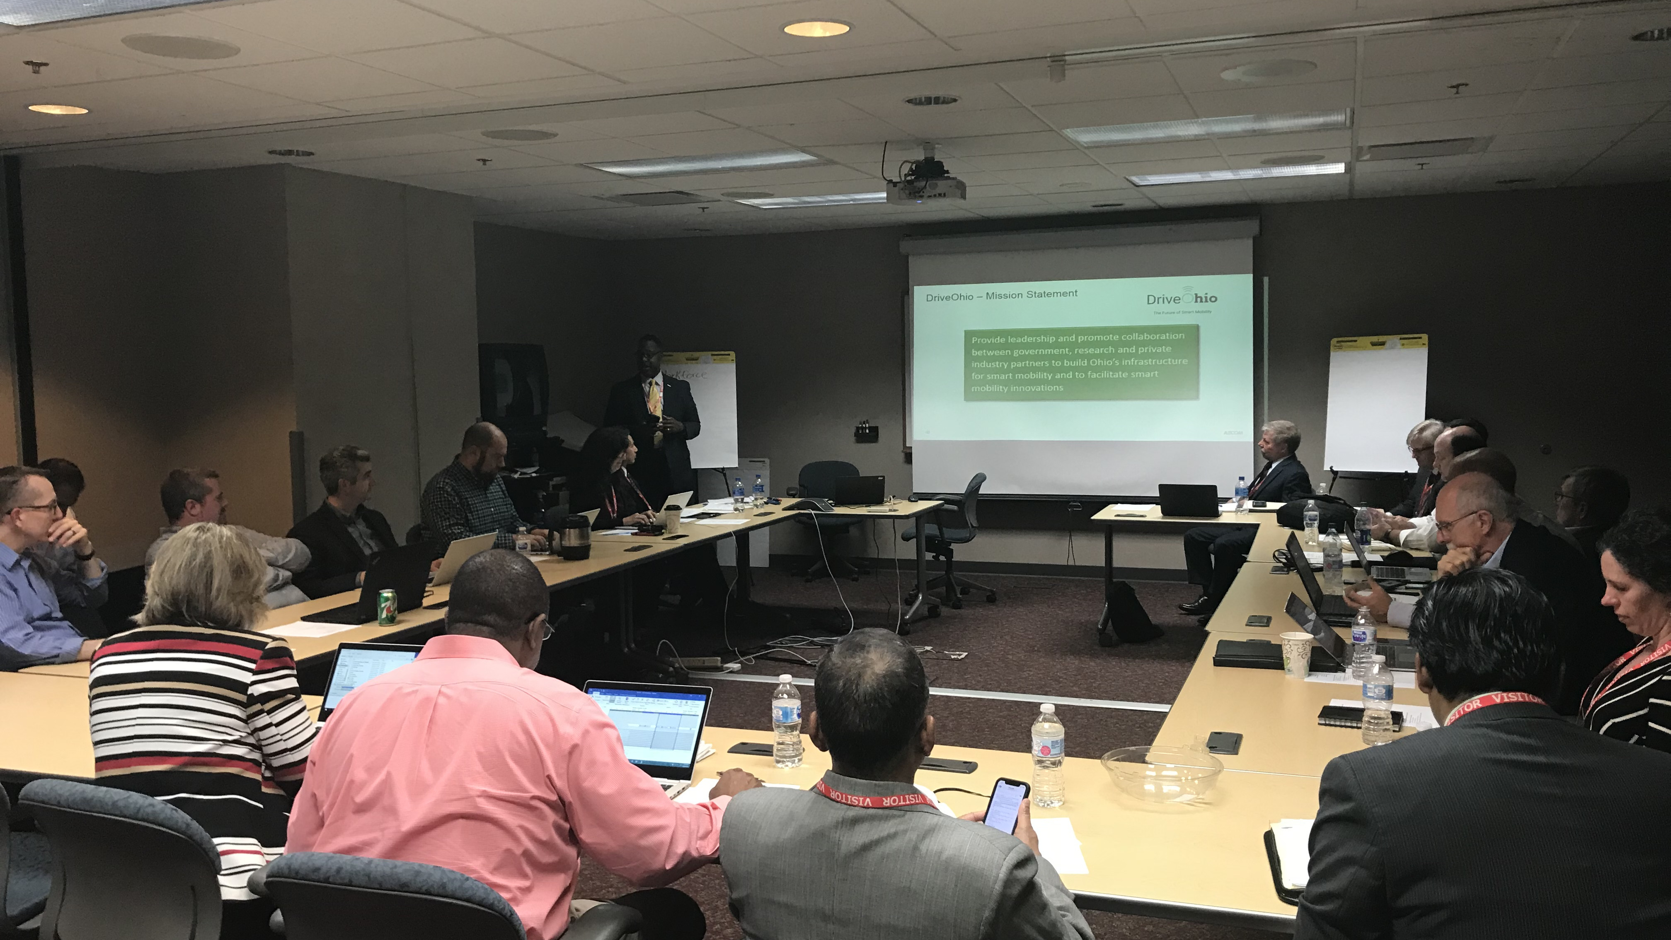

Project Status

Slide 7
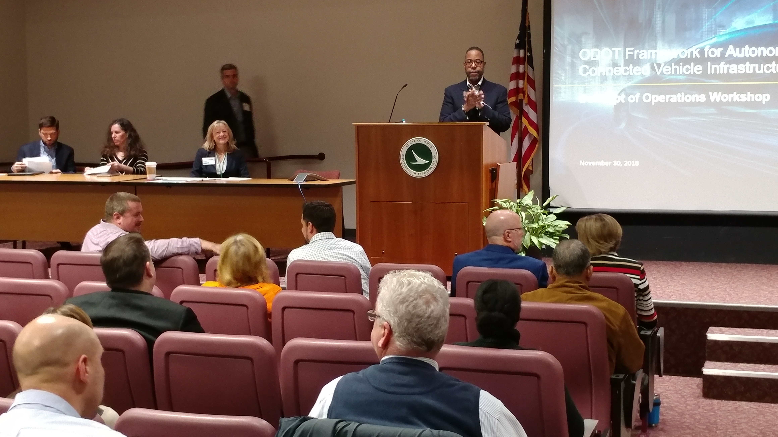
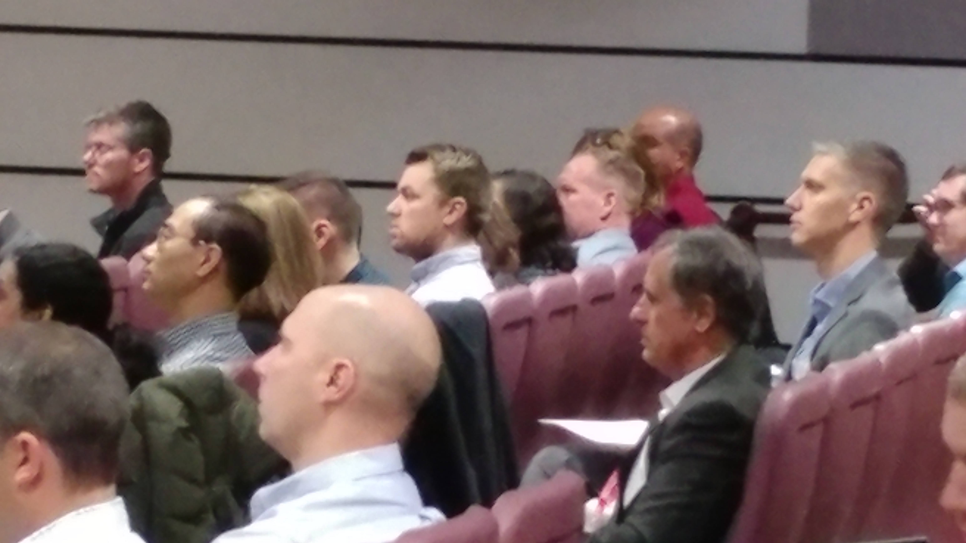
Held 10 Regional Stakeholder Workshops
Stakeholder Engagement
260+ Attendees
AMATS (Akron)
ODOT/DriveOhio
Eastgate (Youngstown)
MORPC (Columbus)
MVRPC (Dayton)
NOACA (Cleveland)
OKI (Cincinnati)
TMACOG (Toledo)
OARC (Dayton)
Buckeye Hills (Athens)

Slide 8
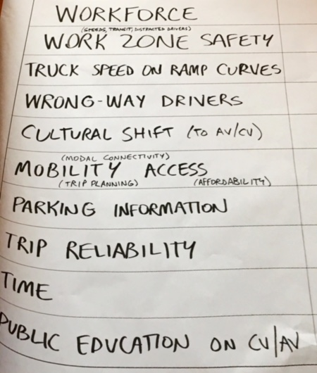
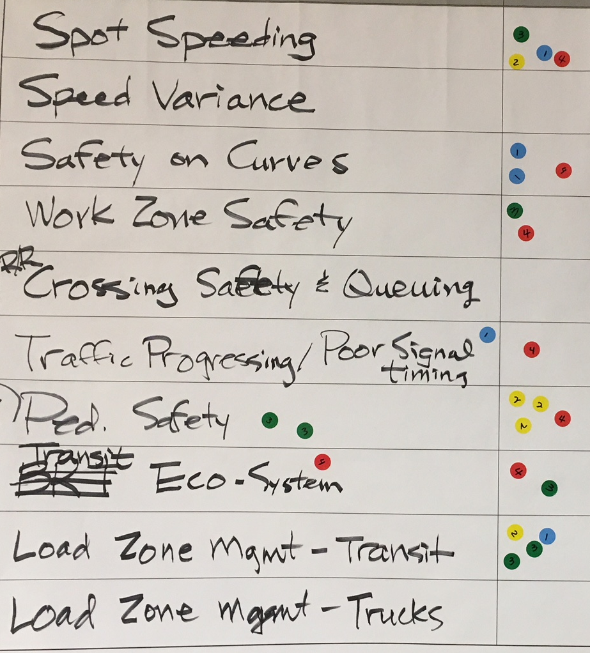
Shared Information and Listened to Input
Stakeholder Engagement
Explained the process
Discussed region’s current/
planned AV/CV projects
Identified related stakeholders
DriveOhio
MORPC

Slide 9
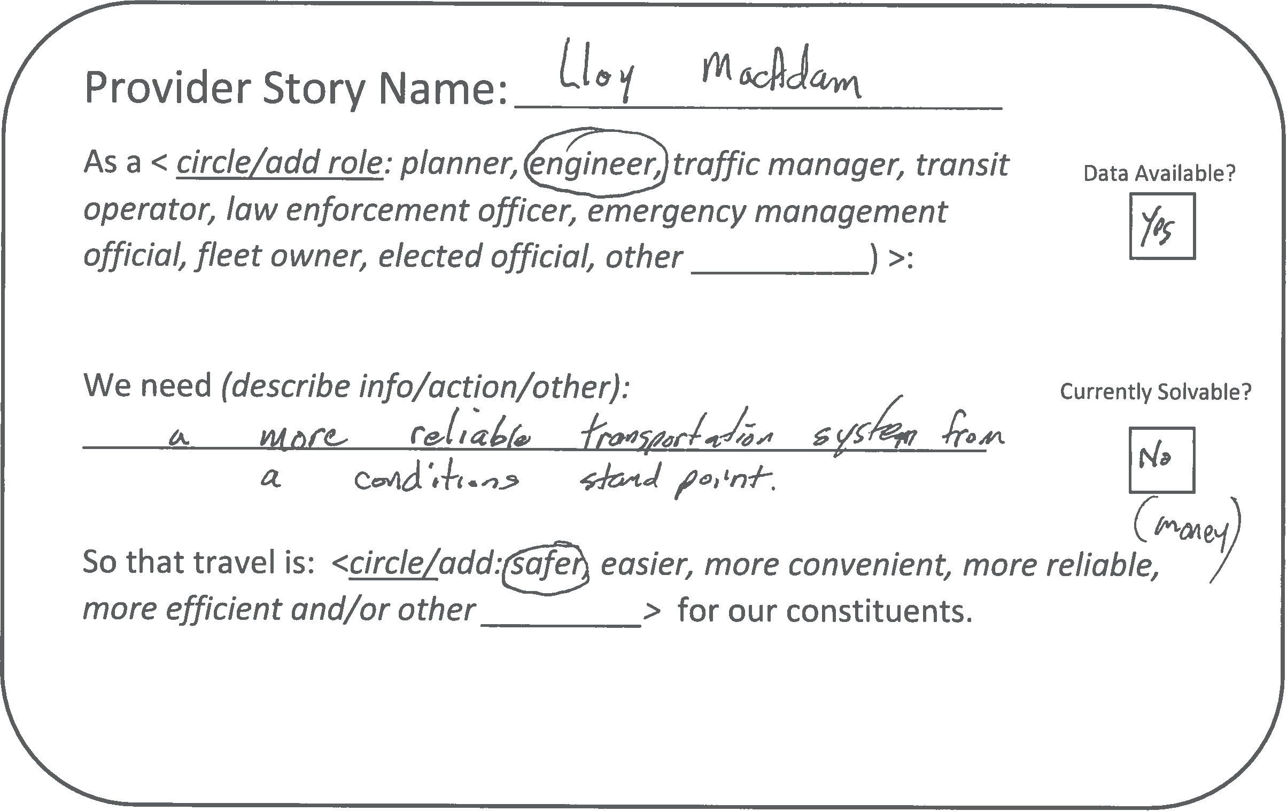

Heard Many End-User Needs
Stakeholder Engagement

Slide 10
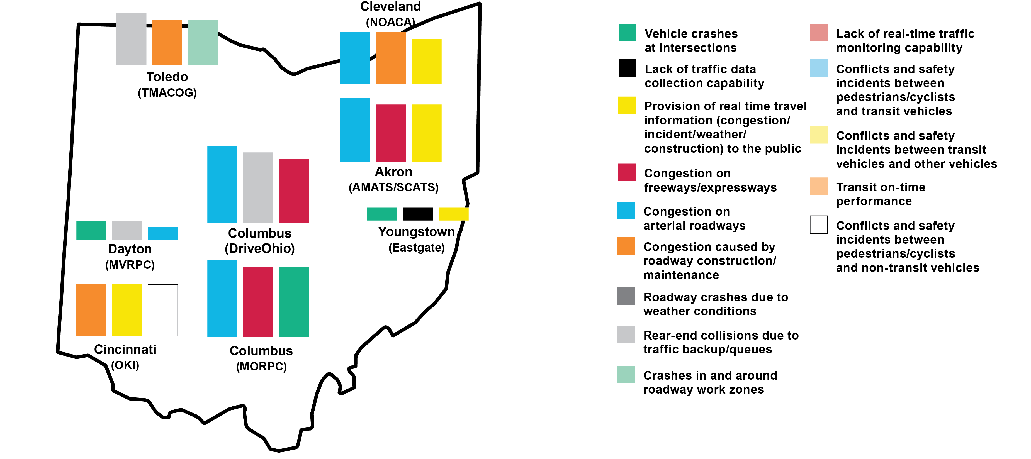
Identified Top Challenges that May Be Addressed by Technology
Stakeholder Engagement

Slide 11
Determined Top, Statewide User Needs
Stakeholder Engagement
Traffic signal timing optimization and coordination
Multi-agency/jurisdictional information exchange/sharing
Ped/bike safety at/near intersections or along roadway
Staffing skills, knowledge and resources to support technology
1
2
3
4
Notes:
Traffic signal timing optimization and coordination
Multi-agency/jurisdictional information exchange/sharing
Ped/bike safety at/near intersections or along roadway
Staffing skills, knowledge and resources to support technology
Real-time incident, road closure and alternate route information
Traffic signal priority/preemption
Real-time transit information
Mobility accessibility to elderly and people with disabilities
Better data for transportation planning and investment decision-making
Traffic condition information (congestion, travel time)

Slide 12
Identified Readiness Status of AV/CV Applications
Feasibility Exploration
Assessed applications being used across U.S.
Identified ready-, near-ready and future deployment applications
Application | Deployment Ready | Deployment Near Ready | Further Development Required
Emergency Electronic Brake Light | ●
Forward Collision Warning | ●
Do Not Pass Warning | ●
Intersection Movement Assist | ●
Vehicle Turning Right in Front of a Transit Vehicle | ●
Blind Spot Warning + Lane Change Warning |  | ●
Left Turn Assist (LTA) |  |  | ●
Notes:
Identified AV/CV applications feasible for deployment
Researched AV/CV applications being used across U.S.
Assessed readiness of applications and technology
Identified deployment-ready, deployment near-ready and future deployment applications

Slide 13
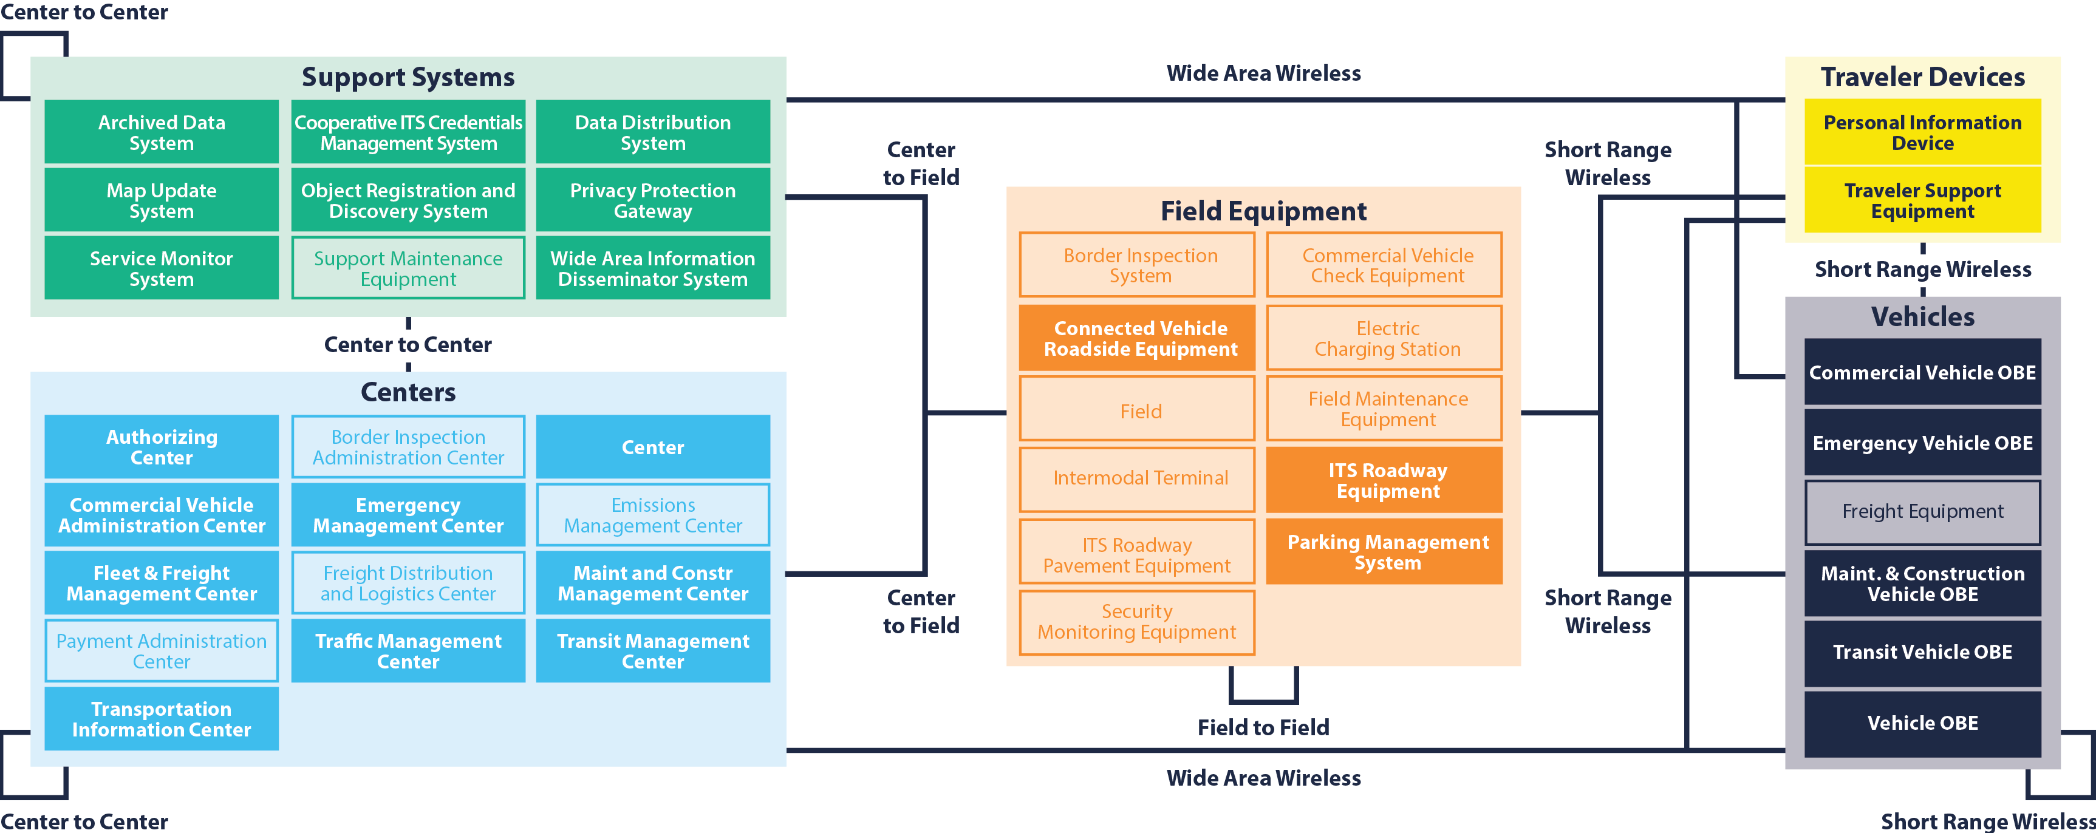
Developed Statewide AV/CV Architecture
Architecture
Notes:
developed Ohio Statewide AV/CV Architecture
includes stakeholders and technologies that are within the Ohio Statewide ITS Architecture previously developed by ODOT in 2016. Stakeholders and technologies were added into the AV/CV Architecture based on current AV/CV planning and deployment activities in Ohio, as well as stakeholder input gathered at multiple regional workshops.

Slide 14

Trained MPOs on Incorporating AV/CV into Regional Architecture
Architecture
Perform Customization Using
Notes:
Collect Project Information and Identify AV/CV Projects
Determine AV/CV Applications Relevant to Projects
Identify Service Packages
Customize Service Packages to Match the Projects

Slide 15
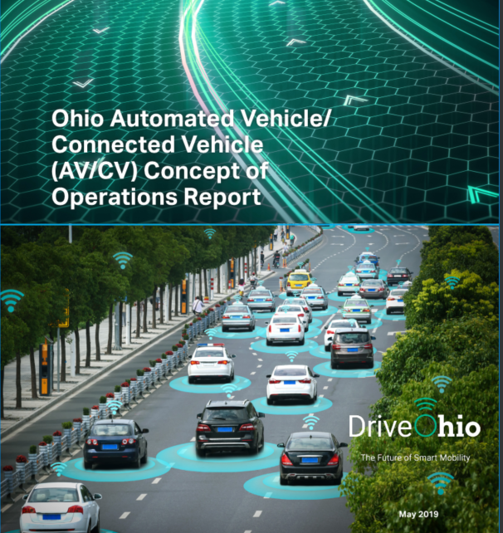
Developed Concept of Operations
Concept of Operations
Described target system and desired operation
Includes applications, core systems and infrastructure
Notes:
ConOps describes current
users, roles and responsibilities, systems involved, interaction required between various stakeholders and systems for each scenario

Slide 16
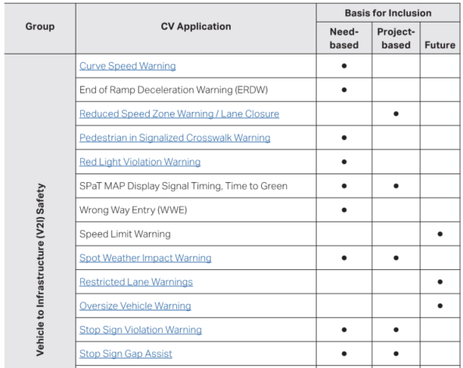
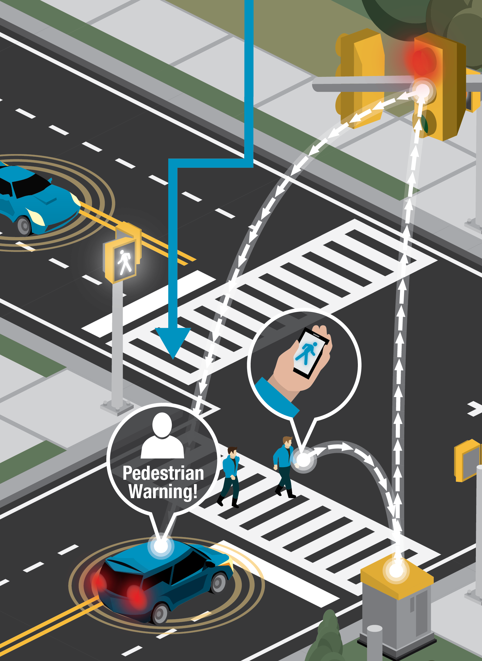
Identified AV/CV Applications for Inclusion in the Ohio Framework
Concept of Operations

Slide 17
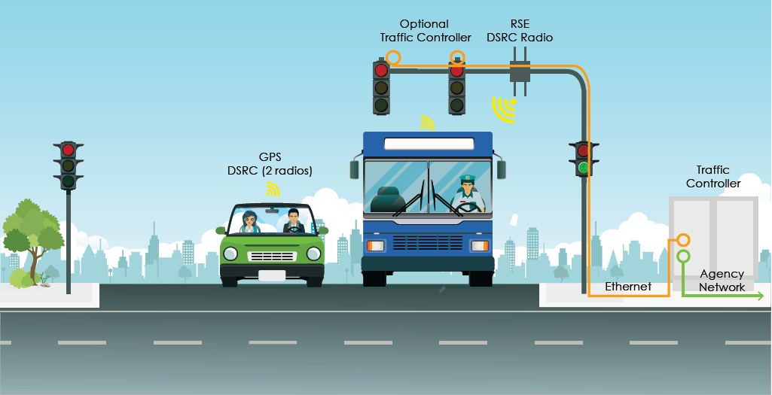
Identified Support Environment for AV/CV Applications
Concept of Operations
Core Services
Enabling systems and associated software
Physical entities

Slide 18
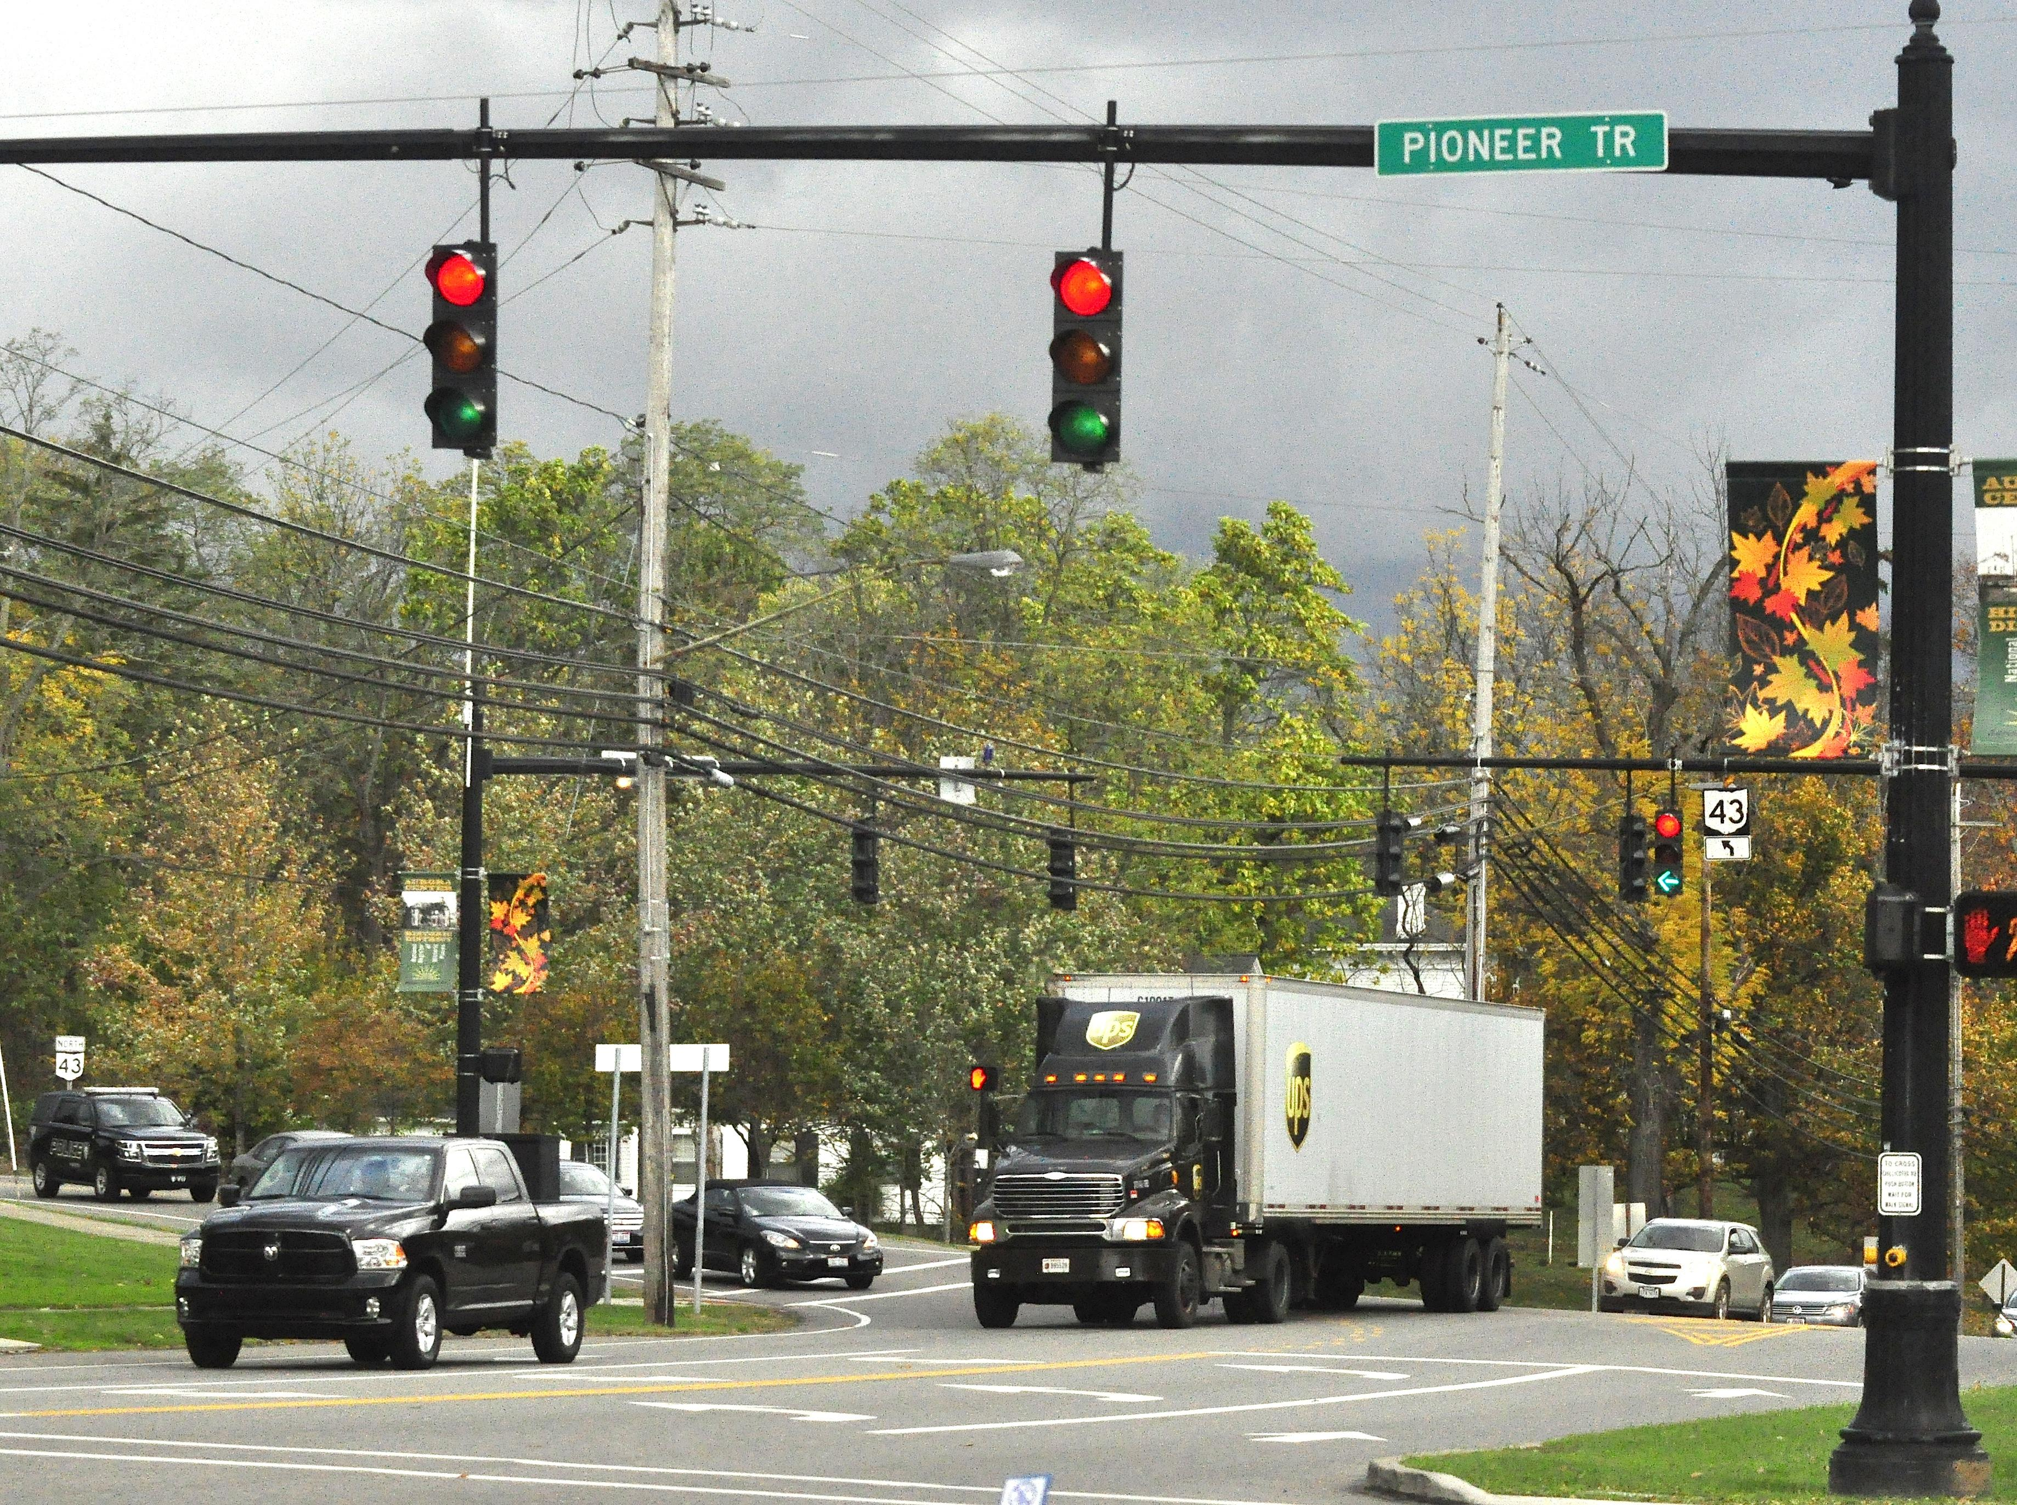
Convened Concept of Operations Workshop
Concept of Operations
Identified 8 operational scenarios:
  Traffic signal operation
  Rail crossing issues
  Unplanned incidents
  Work zones
  Trucker parking information
  Mobility support
  Disruption to mobility ecosystem
  Safety across transportation modes

Slide 19
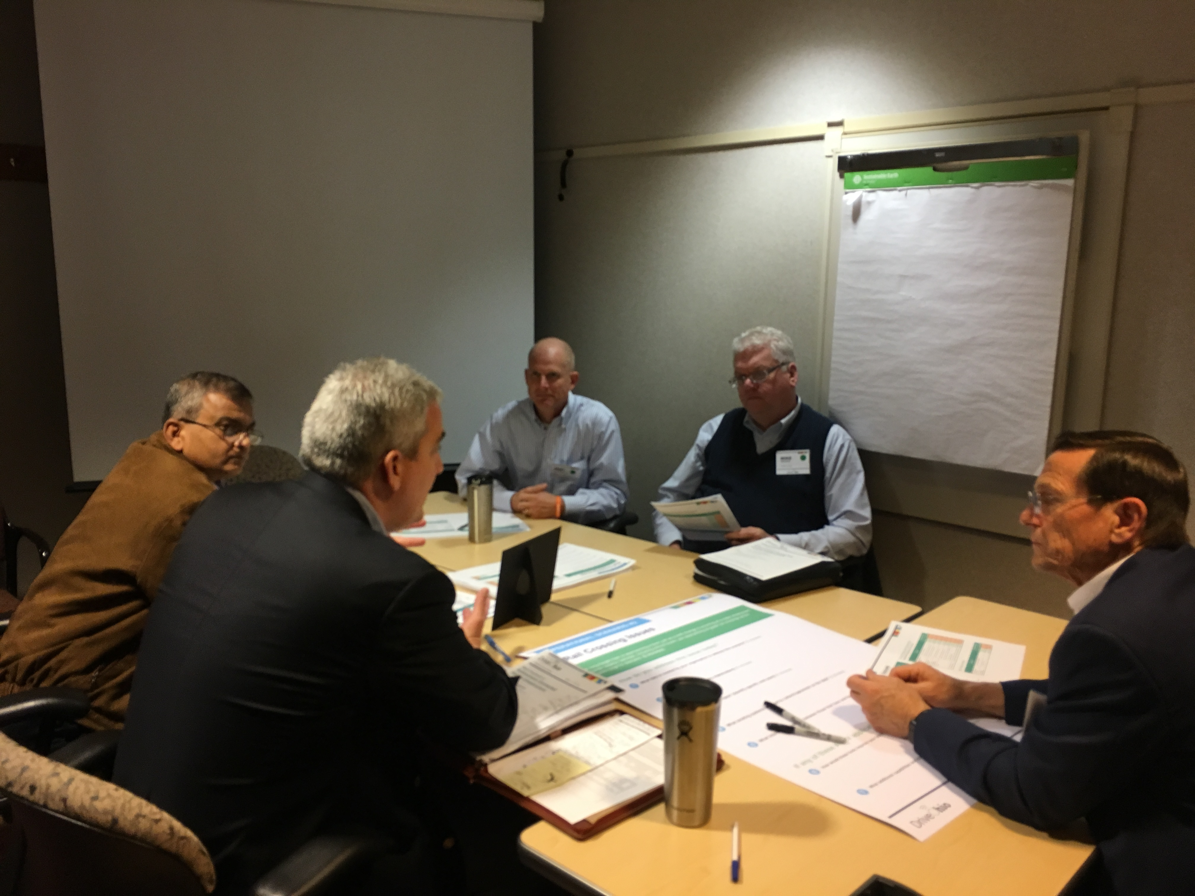
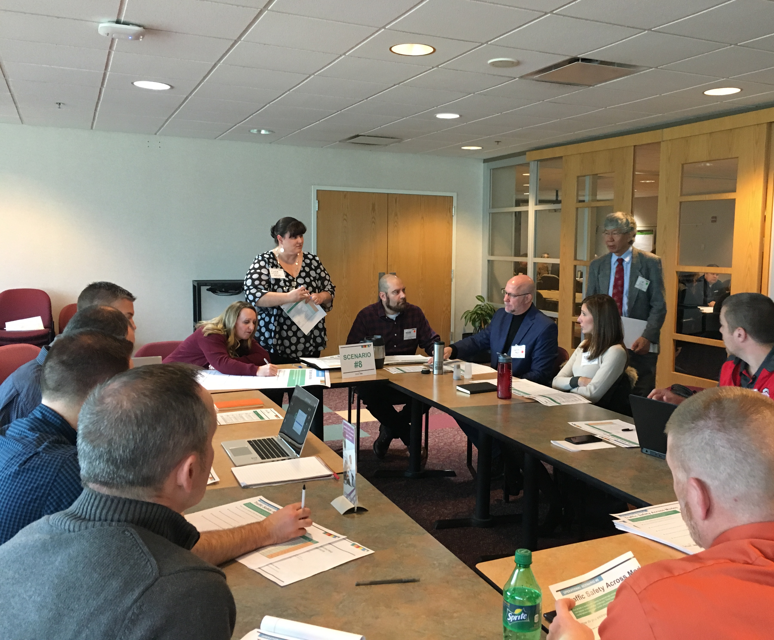
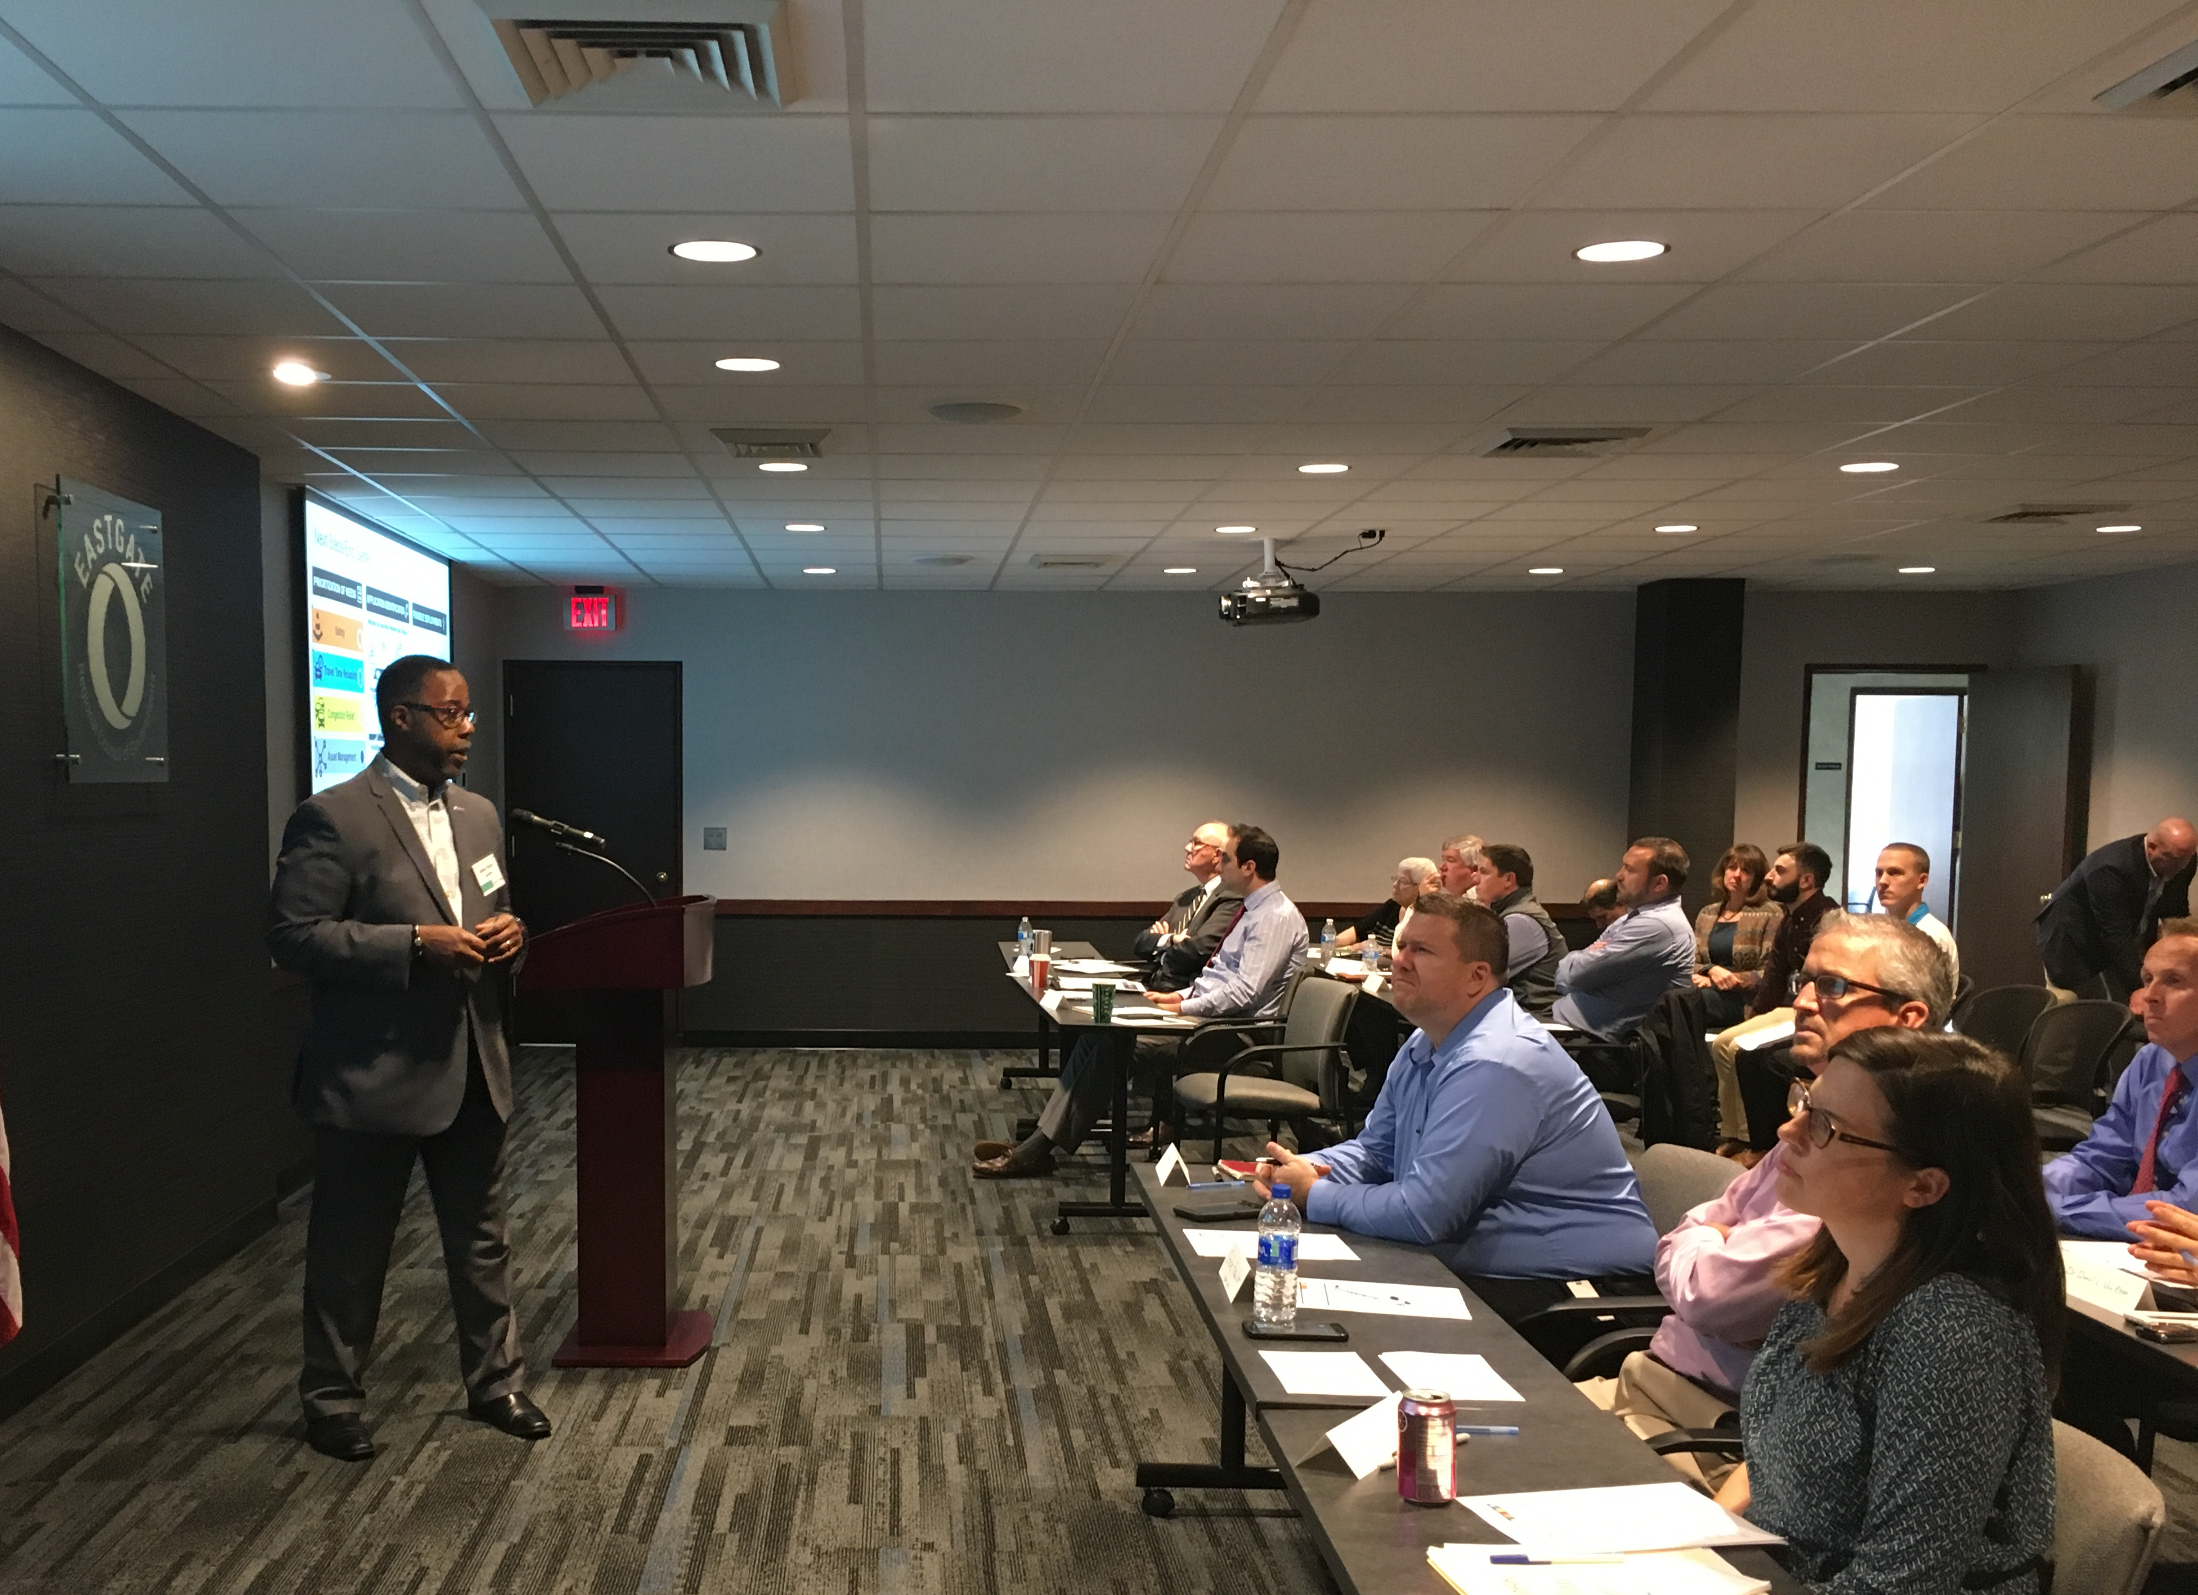
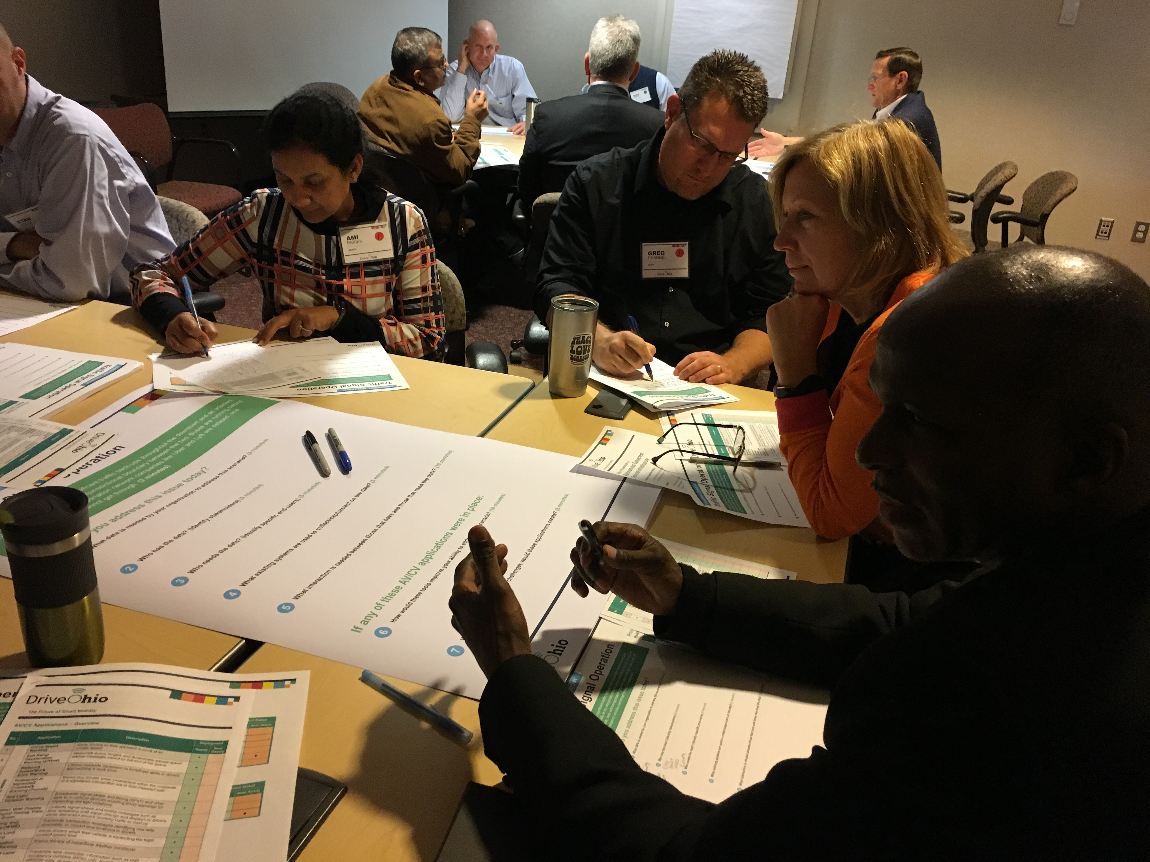
Discussed Current Operations
Concept of Operations
Identified:
  System users
  Roles and responsibilities
  Systems involved
  Interaction required between stakeholders and systems for each scenario
Notes:
ConOps describes current
users, roles and responsibilities, systems involved, interaction required between various stakeholders and systems for each scenario

Slide 20
Identified Influence of AV/CV on
Operational Scenarios: Crash
Concept of Operations
Current Crash Scenario
Potential AV/CV Application Examples
Data
Resources
Users
Advanced Traveler Information Systems
CV-enabled Turning Movement &
Intersection Analysis
Do Not Pass Warning
Emergency Electronic
Brake Light
Emergency Vehicle Preemption
Freight Signal Priority
Intelligent Traffic
Signal System
Intersection Movement Assist
Left Turn Assist
Probe-enabled
Traffic Monitoring
Queue Warning
Red Light Violation Warning
Road Weather Information and Routing for
Emergency Responders
Speed Harmonization
Vehicle Classification-based Traffic Studies
Vehicle Data for
Traffic Operations
Crash location, severity,
traffic impacts
911 calls by motorists, roadway data
Emergency/law enforcement, clean up crews, traffic management center
Vehicle detection, cameras, radio, traffic management center call-taking, data recording, preset response plans

Slide 21
Developed System + Software Requirements
System Requirements
Defines baseline AV/CV app functionality, infrastructure needs, institutional support environment
Identifies standard data sets by application
Includes security requirements based on data set, source, destination and transfer method
Living doc to be updated as apps develop and deploy!
Notes:
Developed System and Software Requirements
The requirements document:
Defines the baseline functionality of AV/CV applications, infrastructure needs, and institutional support environment
Identifies standard data sets by application
Includes security requirements based on data set, source, destination and method of transfer
Is a living document, to be updated by deployers as applications are developed and deployed

Slide 22
Requirements Components
System Requirements
General
  Enabling systems, software and infrastructure that act in a coordinated manner to allow data exchange
System Security and Privacy
  OBU, RSE and TMC Security needs for various communication flows
Core Services
  Allow secure transfer of data between AV/CV elements
AV/CV Application-Specific Requirements
  109 apps included as per ConOps
Foundational, supporting all
Notes:
General
Support Environment
CV Infrastructure Networks and Data Policies
Edge Suite
Communications
Installation Requirements
System Security and Privacy
V2X Platform
OBU CV Application Interface
OBU Security
RSU CV Application Interface
RSU Security
TMC CV Application Interface
TMC Security
Roadway Equipment Security
Core Services
Core Authorization
Data Distribution
Infrastructure Management
Location and Time
Map Management
Object Registration and Discovery
Privacy Protection
System Monitoring
Security and Credentials Management
AV/CV Application-Specific Requirements
118 apps included as per ConOps

Slide 23
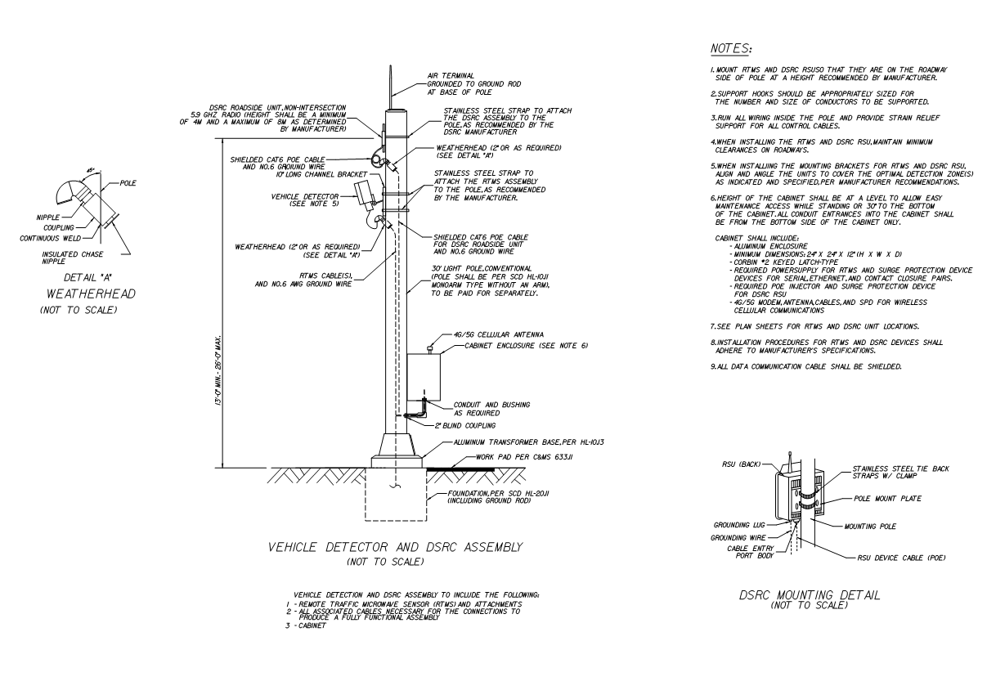
Prepared Standard Drawings
Design Drawings
Dedicated Short Range Communications
Closed Circuit TV Assembly
Vehicle Detector
Highway Advisory Radio and
Beacon Sign
Dynamic Message Sign
Destination Dynamic Message Sign
Ramp Meter
Notes:
Prepared Standard RSE (spellout?) Research Software Engineers Drawings
Need to tie back to AV/CV work and how it benefits the audience

Slide 24
What’s Next

Slide 25
Still to Come
Tools needed to plan, deploy and monitor AV/CV projects that will work together
a
a
a
a

Slide 26
AV/CV Project Deployment Process
ID primary needs
Map needs to AV/CV apps
Pull AV/CV requirements for chosen apps
Confirm functional requirements meet project goals
Select standard design drawings
Update document set with local/project-specific requirements & drawings
Use compiled package for procurement
Complete SERF to obtain project approval
Update statewide docs & drawings to assist future users
Notes:
How to Use the Requirements
Identify primary need(s) to be addressed (refer to the Concept of Operations for list of user needs captured throughout the state)
Needs are mapped to a set of potential AV/CV applications
Pull AV/CV application-specific requirements for the chosen applications
Identify existing gaps (if any) with the institutional or infrastructure elements needed to support those applications
Pull necessary institutional/infrastructure component requirements from the foundational requirements
Select standard design drawings as needed
Update the compiled set of requirements and drawings with local or project-specific requirements
Use the compiled package to prepare procurement document set
Circle back to update the overall requirements document and design drawings with updates and clarifications that may assist future users

Slide 27
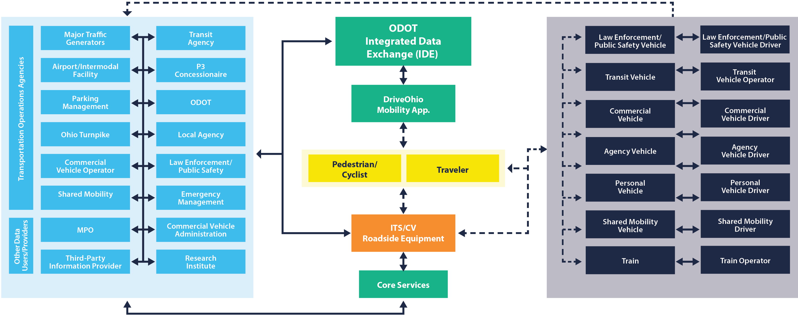
Integrated Data Exchange (IDE) Concept

Slide 28













Thank You

