Slide 1



Supply Chain Resiliency
Requires Freight Transportation Infrastructure Resiliency
Jolanda Prozzi

Slide 2


Starting On The Same Page
Defining Resiliency
  Resilience is “the ability to prepare and plan for, absorb, recover from, or more successfully adapt to adverse events.”
Defining the Multimodal Freight Network
  The Multimodal Freight Network (MFN) includes highways, freight railroads, ports and waterways, cargo airports, and international border crossings.
  DOTs are primarily responsible for the Highway Freight Network as defined by the Freight Mobility Plans.

Slide 3


Identify Resiliency Goals for
Multi-Modal Freight Network
Resiliency Goals
Resiliency Performance Measures
  Maintain continuity of critical function
  Minimize recovery time
  Minimize damage/operational impacts
  Ensure redundancy
  Infrastructure
  Operational

Slide 4

Multimodal Freight System Performance
Outage and Recovery
Better
Okay
Bad
System Performance
Time

Slide 5




Framework for Assessing Disruptive Events to Multimodal Freight Network
Disruptive Events
Freight Transportation System
Outcomes
Events that can not be controlled
System Components that can be controlled
or at least can be influenced
Measures that can be monitored/improved
  Natural disasters (flooding, drought, severe storms, earthquakes, sea level rise)
  Human-made (cyber attacks, terrorist attacks, policies)
  Pandemics
Infrastructure Impacts
Identify and model effects of disruptive events on MFN
  Highway infrastructure failure/inundation
  Loss in multi-modal freight transportation system performance
  Loss in supply chain performance
  Economic costs
Adaptation
Identify and implement strategies to prepare, protect, and recover from future events
Recovery
Assess repair cost, loss of function, and user costs

Slide 6
Framework for Assessing Disruptive Events to Multimodal Freight Network
Disruptive Events
Freight Transportation System
Outcomes
Events that can not be controlled
System Components that can be controlled
or at least can be influenced
Measures that can be monitored/improved
  Natural disasters (flooding, drought, severe storms, earthquakes, sea level rise)
  Human-made (cyber attacks, terrorist attacks)
  Pandemics
Infrastructure Impacts
Identify and model effects of extreme events on TMFN
  Highway infrastructure failure/inundation
  Loss in multi-modal freight transportation system performance
  Loss in supply chain performance
  Economic costs
Adaptation
Identify and implement strategies to prepare, protect, and recover from future events
Recovery
Assess repair cost, loss of function, and user costs

Slide 7
Framework for Assessing Disruptive Events to Multimodal Freight Network
Extreme/Disruptive Events
Freight Transportation System
Outcomes
Events that can not be controlled
System Components that can be controlled
or at least can be influenced
Measures that can be monitored/improved
  Natural disasters (flooding, drought, severe storms, earthquakes, sea level rise)
  Human-made (cyber attacks, terrorist attacks)
  Pandemics
Infrastructure Impacts
Identify and model effects of disruptive events on MFN
  Highway infrastructure failure/inundation
  Loss in multi-modal freight transportation system performance
  Loss in supply chain performance
  Economic costs
Adaptation
Identify and implement strategies to prepare, protect, and recover from future events
Recovery
Assess repair cost, loss of function, and user costs

Slide 8
Framework for Assessing Disruptive Events to Multimodal Freight Network
Extreme/Disruptive Events
Freight Transportation System
Outcomes
Events that can not be controlled
System Components that can be controlled
or at least can be influenced
Measures that can be monitored/improved
  Natural disasters (flooding, drought, severe storms, earthquakes, sea level rise)
  Human-made (cyber attacks, terrorist attacks)
  Pandemics
Infrastructure Impacts
Identify and model effects of extreme events on TMFN
  Highway infrastructure failure/inundation
  Loss in multi-modal freight transportation system performance
  Loss in supply chain performance
  Economic costs
Adaptation
Identify and implement strategies to prepare, protect, and recover from future events
Recovery
Assess repair cost, loss of function, and user costs

Slide 9
Assessing Disruptive Events

Slide 10

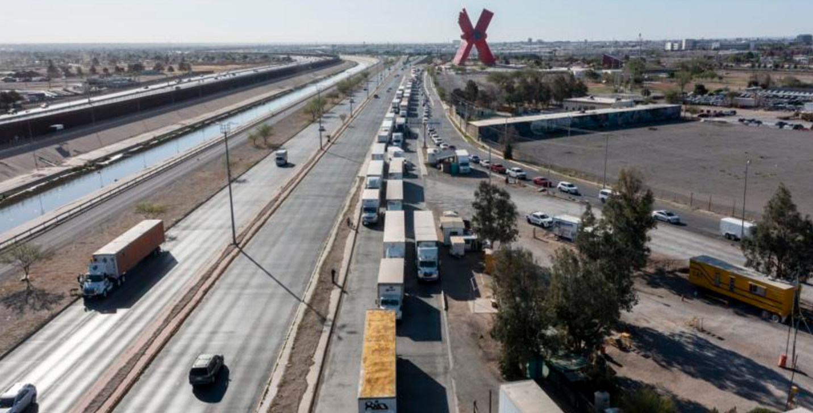
Disruptive Events
Source: Omar Ornelas
Extreme Weather
Pandemic
Policy Actions
Hurricane Harvey (2017)
Tornado (2017)
Fog (2019)
Winter Storm (2021)
  Covid-19 (2020)
  Migrant Surge (2021)
  Increased Truck Inspections (2022)

Slide 11





Impacts of Hurricane Harvey
$125 billion in direct cost (damage)
Indirect cost/ economic impact on GSP
$16.8 billion (year 1)
$2 billion (year 2)
$1 billion (year 3)
Shut down of:
25% of U.S. refining capacity
24.5% of oil production in Gulf of Mexico
25.9% of natural gas production
One-third of U.S. chemical production disrupted
Notes:
(August 2017)

Slide 12

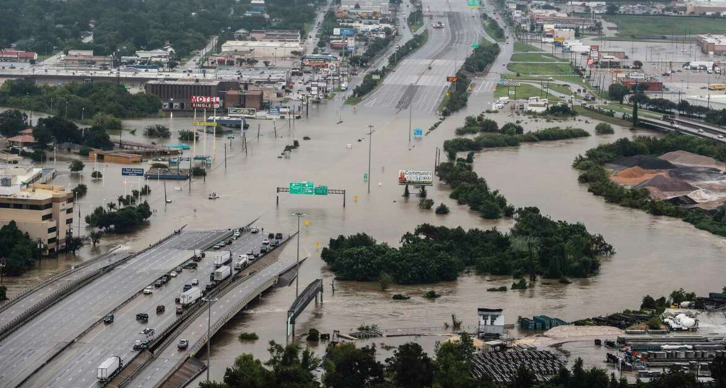
Impacts of Hurricane Harvey
Transportation Impacts
Major highways inundated:
(I-45, I-10, I-69, I-610, and US 59)
Ports of Corpus Christi, Freeport, Galveston, and
Houston closed to marine traffic
BNSF, KCS, and UP experienced
storm damage and closures
Source: chron.com

Slide 13
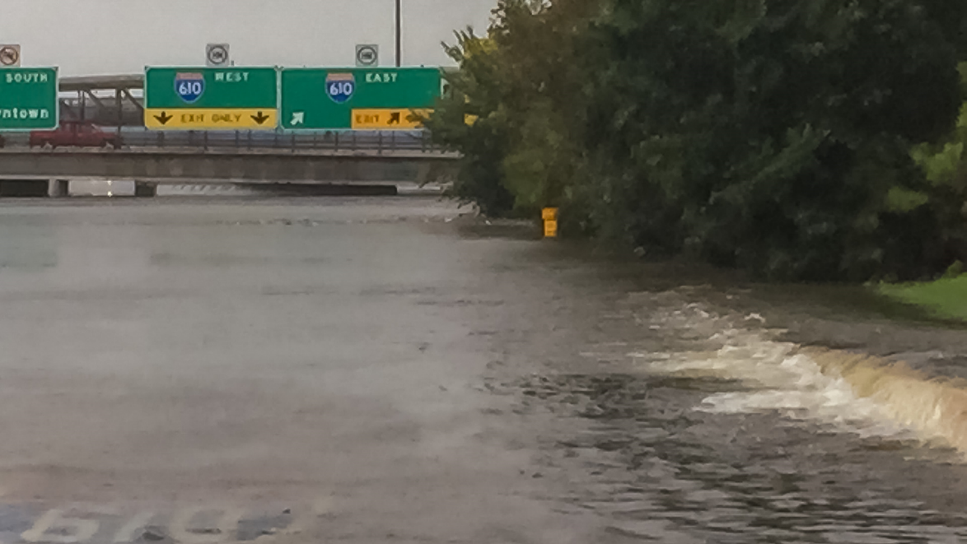
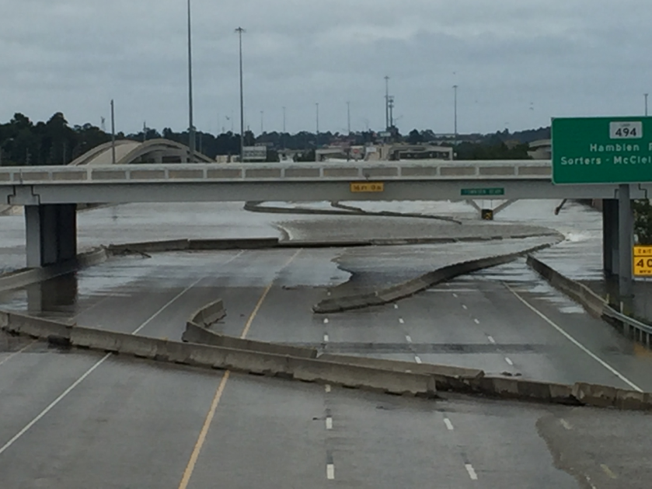
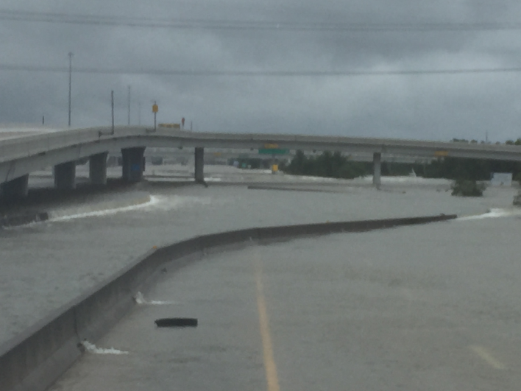
Infrastructure Impacts of Hurricane Harvey

Slide 14
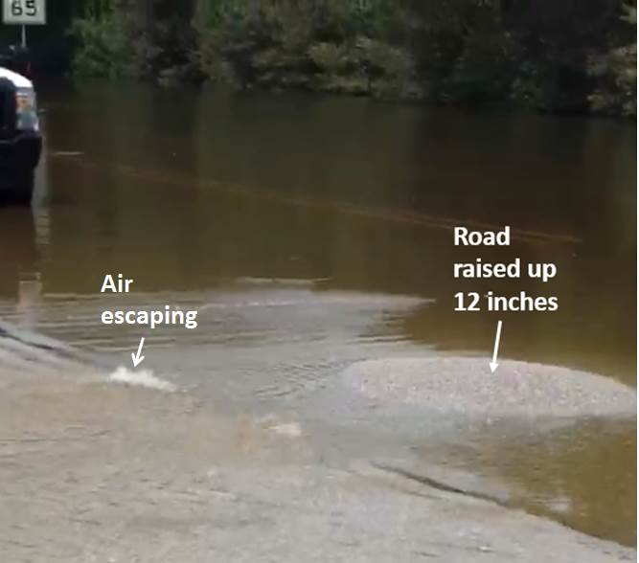
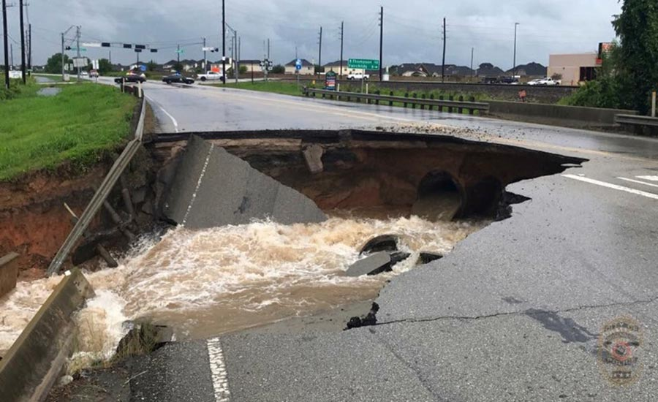
Infrastructure Impacts of Hurricane Harvey
Engineering News-Record, August 28, 2017. Photo by Associated Press.
http://www.enr.com/articles/42639-how-badly-has-hurricane-harvey-damaged-texas-infrastructure

Slide 15
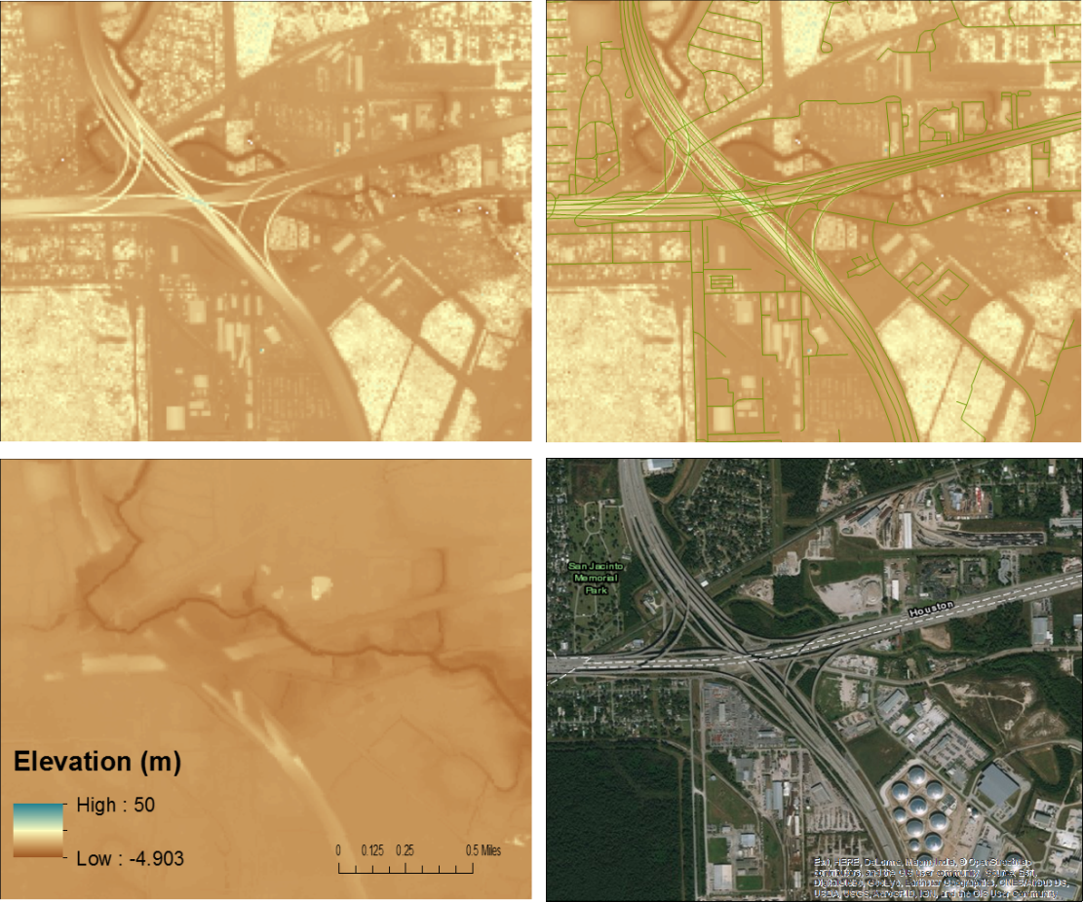
Impacts of Hurricane Harvey
FEMA flood maps
  100 yr. (1% annual chance of flooding)
  500 yr. (0.2% annual risk of flooding) or minimal risk
Assess flooding risk more explicitly
  Considering frequency of flood events, depth of water
Assess infrastructure-water inundation (risk) more explicitly
  Location of roads
  Elevation of roads relative to surface or soil water height
  Pavement structure
Four Views of the Intersection at
I-10 and North Loop Freeway

Slide 16
Calculate Infrastructure Impacts
Pavement impacts depend on pavement structure, proximity to flood, and elevation
channel level
ground water level
flood water level
ground water level
Time Effects
Flood frequency and dissipation
channel level
ground water level
ground water level

Slide 17
Calculate Infrastructure Impacts
Pavement Structures
I (5) II (10) III (6)
Notes: AC = asphalt concrete, CTB = cement treated base, LTSG = lime treated subgrade, FB = flexible base, and SG = subgrade

Slide 18
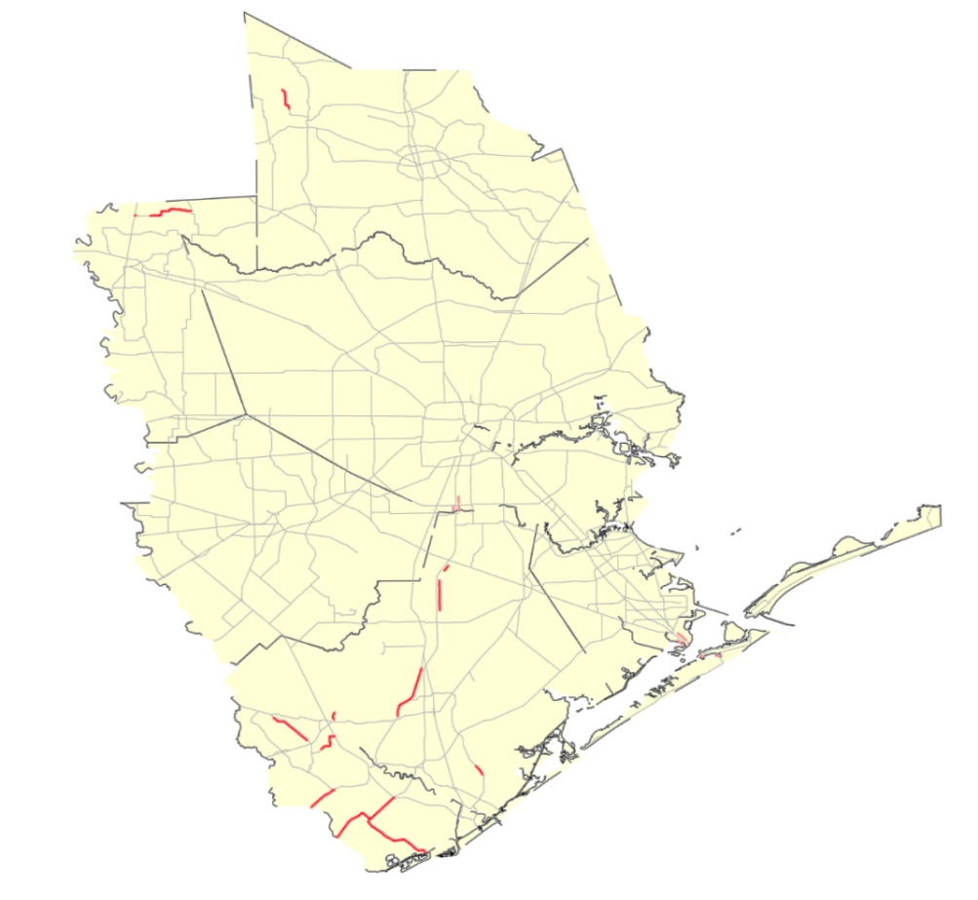
Calculate System Impacts
Locations of Pavement Types 6 and 10 Roadways
in the Houston District
Pavement failures
  ~110 lane miles of thinner pavement structures
  53 lane miles - minimal risk of flooding
  57 lane-miles ~ $17.2 million
Disruption
  12% of lane-miles in Harris County at risk of flooding (100 year)

Slide 19
Cost of Elevating Infrastructure
HOU Roadways for Possible Raise
County | Roadway | Limits | Estimates | Description | Flood Frequency
Fort Bend | Spur 10 | SH 36 to Cottonwood School | 60,000,000 | elevate pavement | Harvey 2017
Fort Bend | US 90 A | FM 359 to SH 99 | 50,000,000 | evelate pavement and replace bridges | Memorial 2016, Harvey 2017
Fort Bend | FM 723 | Brazos River to FM 359 | 100,000,000 | evelate pavement | Memorial 2016, Harvey 2017
Fort Bend | SH 6 | Fort Bend County Line to FM 1092 | 250,000,000 | elevate pavement and replace bridges | Harvey 2017
Fort Bend | FM 1093 | Brazos River to FM 1489 | 75,000,000 | elevate pavement | Tax Day 2016, Memorial 2016, Harvey 2017
Brazoria | SH 6 | SH 35 to Fort Bend County Line | 450,000,000 | elevate pavement and replace bridges
Harris | SH 6 | Addicks Dam to Clay Road | 200,000,000 | bridge roadway through revisore | Memorial 2015, Tax Day 2016, Memorial 2016, Harvey 2017
Harris | I 45 N | Cypresswood to Parramatta | 250,000,000 | elevating pavement and rebuild two intersections | Memorial 2015 Frontage Road, Tax Day 2016 Frontage Road, Memorial 2016 Frontage Road, Harvey 2017 Frontage Road and Mainlanes
Harris | US 290 | Skinnner Road to Telge Road | 200,000,000 | elevating pavement and rebuild two intersections | Tax Day 2016, Harvey 2017
Waller | I 10 | 1000' East and West Petterson Road | 75,000,000 | replace and build urban intersection | Harvey 2017

Slide 20




Disruptive Events
Covid-19
Winter Storm
Migrant Surge
DPS Inspections
2019
2020
2021
2022
Source: Bureau of Transportation Statistics

Slide 21
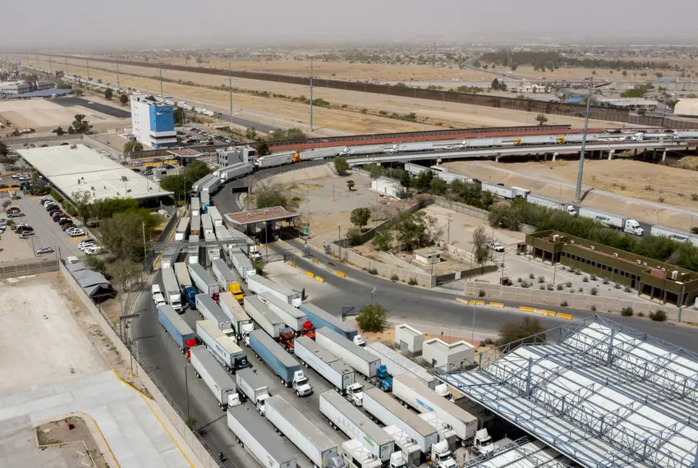
DPS Increased Border Truck Inspections
Impact Texas’ International Border Crossings (2022)
Cross-border traffic decreased to one third of normal levels
Long queues of trucks in Mexico (more than 6 miles)
Waiting times reached 8 hours at some crossings
Canceled orders, delayed shipments, and spoiled produce and products
Protests at Pharr International Bridge and Zaragoza Bridge
Blockade lasted two days
Source: The Texas Tribune

Slide 22






DPS Increased Border Truck Inspections
Impact Texas’ International Border Crossings (2022)
U.S. GDP
Texas GDP
$8.967 billion
$4.233 billion
Source: Perryman Group
Source: Perryman Group
U.S. Employment
Texas Employment
77,019 job years
36,330 job years
Source: Perryman Group
Source: Perryman Group

Slide 23
Adapting to Disruptive Events

Slide 24
Impacts Disruptive Events
Infrastructure Impacts
Recovery
Adaptation
  Failure
  Inundation
  Operational
  Loss of function/time to recover
  Cost (debris removal, user cost)
  Repair cost
  Prepare
  Protect
  Respond

Slide 25
Implementing a Resilient Freight Highway Network
PLANNING
MAINTENANCE
PROJECT DEVELOPMENT
ENV Clearance, ROW, Design, etc.
EXTREME EVENTS
Recover/Adapt/Mitigate
CONSTRUCTION

Slide 26
Planning
Coordinate
on a framework to ensure freight network resilience is incorporated in the next FMP update
Link
to disruptive event vulnerability in the Texas Asset Management Plan
Identify (evaluate)
at-risk MFN components and reasonable alternatives

Slide 27
Project Development
Update
design manuals
Enhance
stormwater management designs
Adopt
design standards or guidelines with more conservative flood frequency events (i.e., 500‑year floods vs. 100-year floods)

Slide 28




Construction
Warm-mix asphalt
as opposed to hot-mix asphalt
Moisture-resistant
pavement sublayers
Materials
to withstand higher
numbers of very hot days
Improving
drainage and reinforcing
embankments in flood-prone areas

Slide 29
Maintenance
Consider vulnerability assessment developed in planning in development of TAMP
Track extreme weather damage and maintenance costs to inform resilience strategies
Share data on upgraded facilities so the information can be referenced as adaptation strategies in the development of DOT’s planning documents

Slide 30
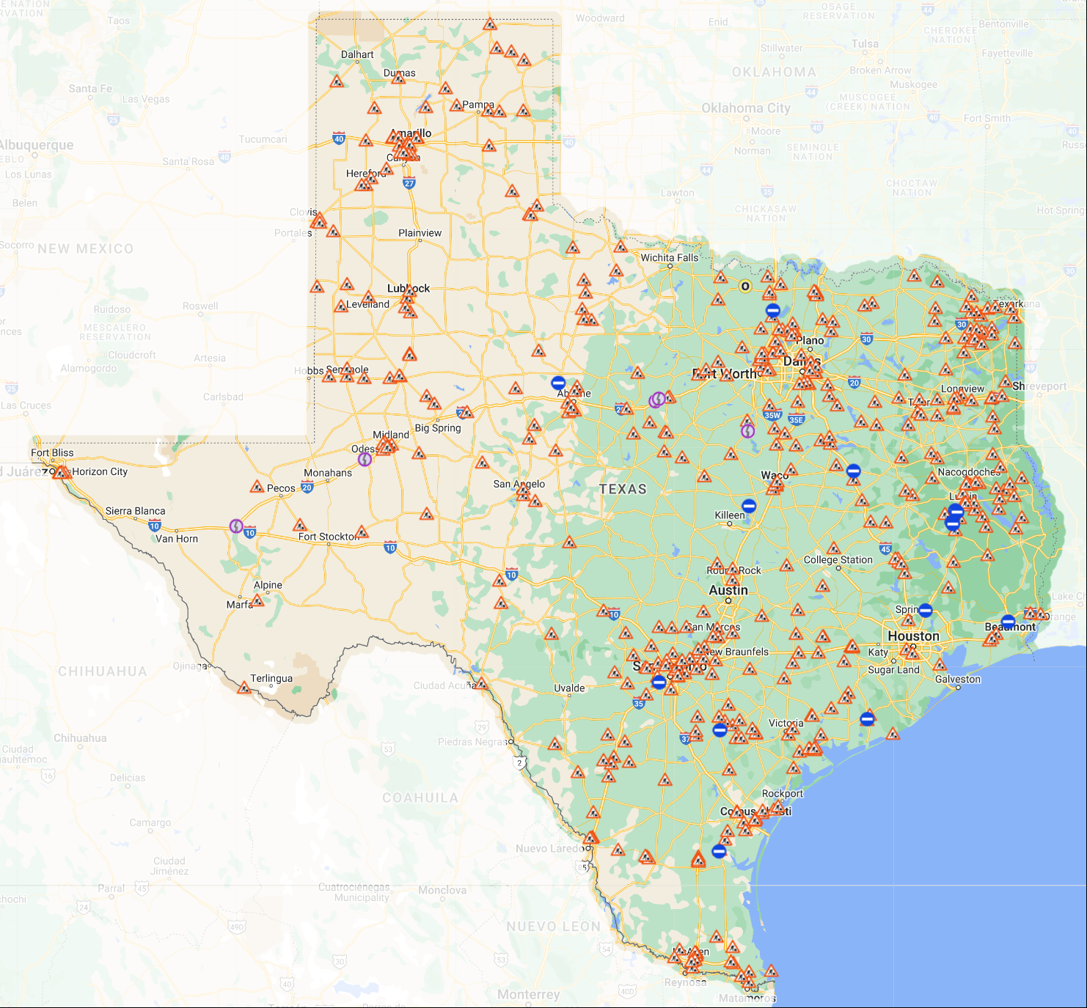
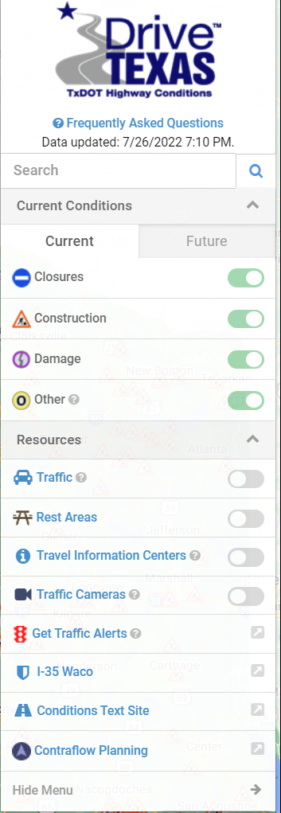
Maintenance Data

Slide 31

Jolanda Prozzi
j-prozzi@tti.tamu.edu
(512) 584 9143

