Slide 1
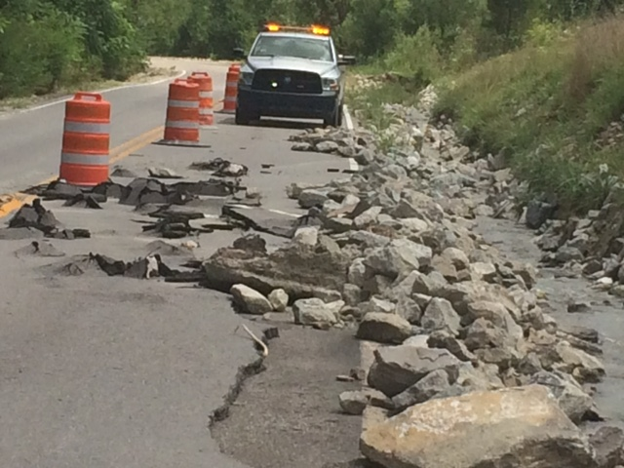
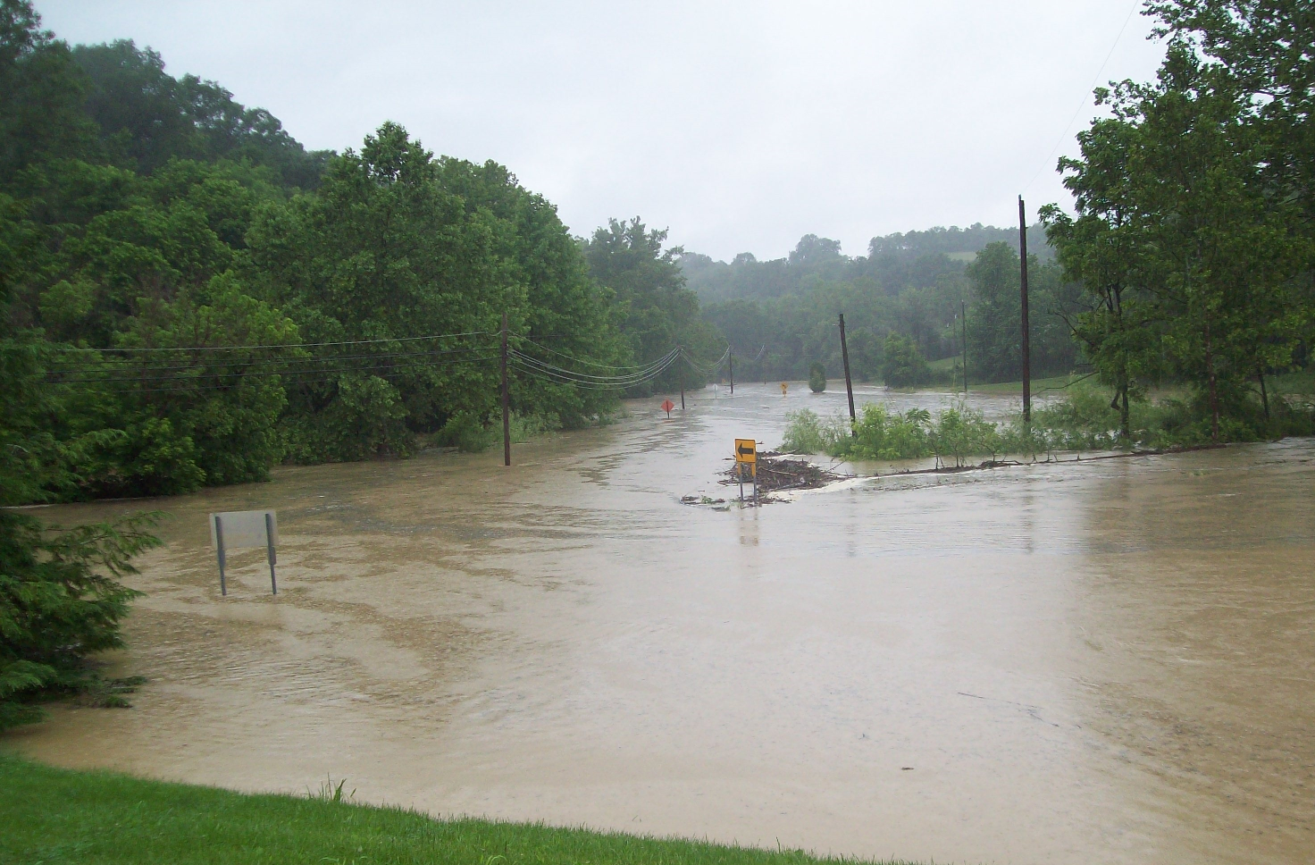
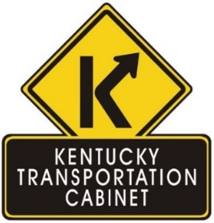
Addressing Extreme Weather, Natural Hazards, and Transportation Resiliency in Kentucky
Scott Schurman
Kentucky Transportation Cabinet
Ben Blandford
Kentucky Transportation Center
University of Kentucky

Slide 2
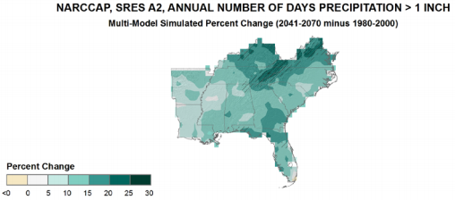
Transportation Resiliency
Climate change and extreme weather events present significant and growing risks to the safety, reliability, effectiveness, and sustainability of transportation infrastructure and operations.
The impacts of a changing climate and extreme weather events are affecting the lifecycle of transportation systems and are expected to intensify.
Transportation infrastructure is designed to handle a broad range of impacts based on historic climate.
Preparing for climate change and extreme weather events is critical to protecting the integrity of the transportation system.

Slide 3
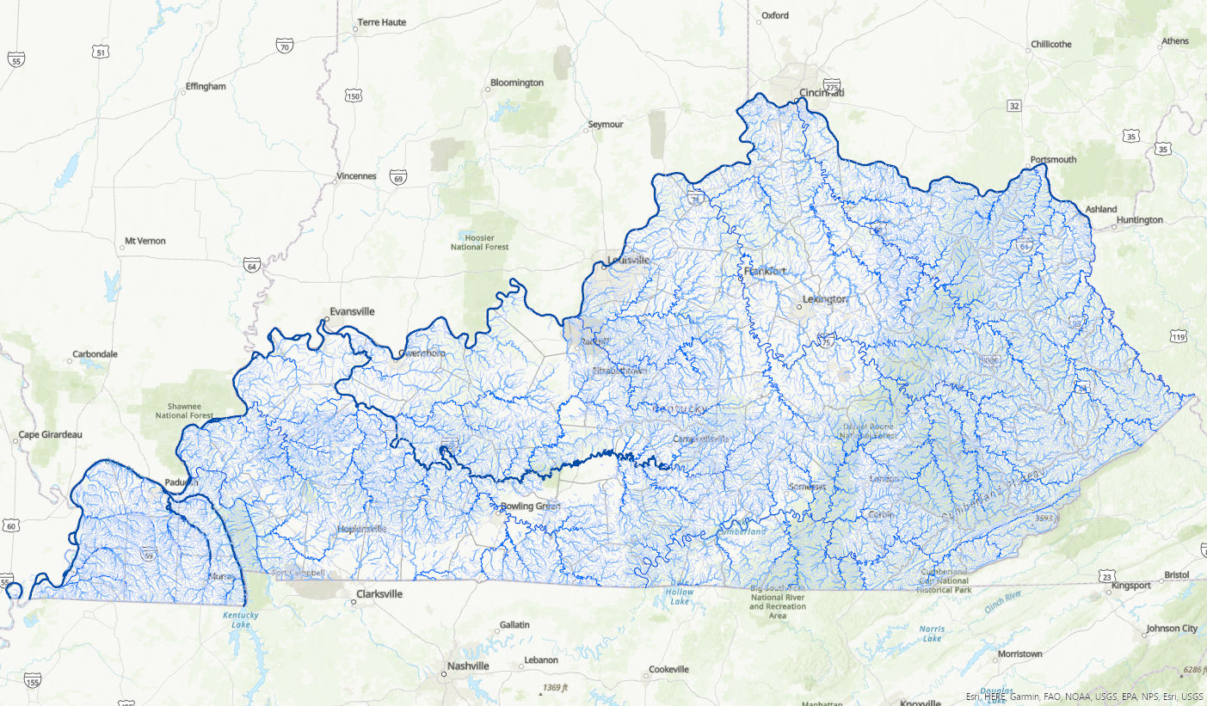
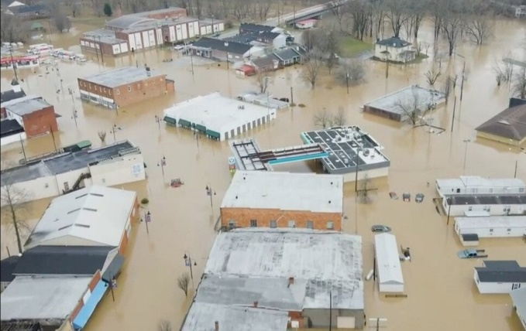
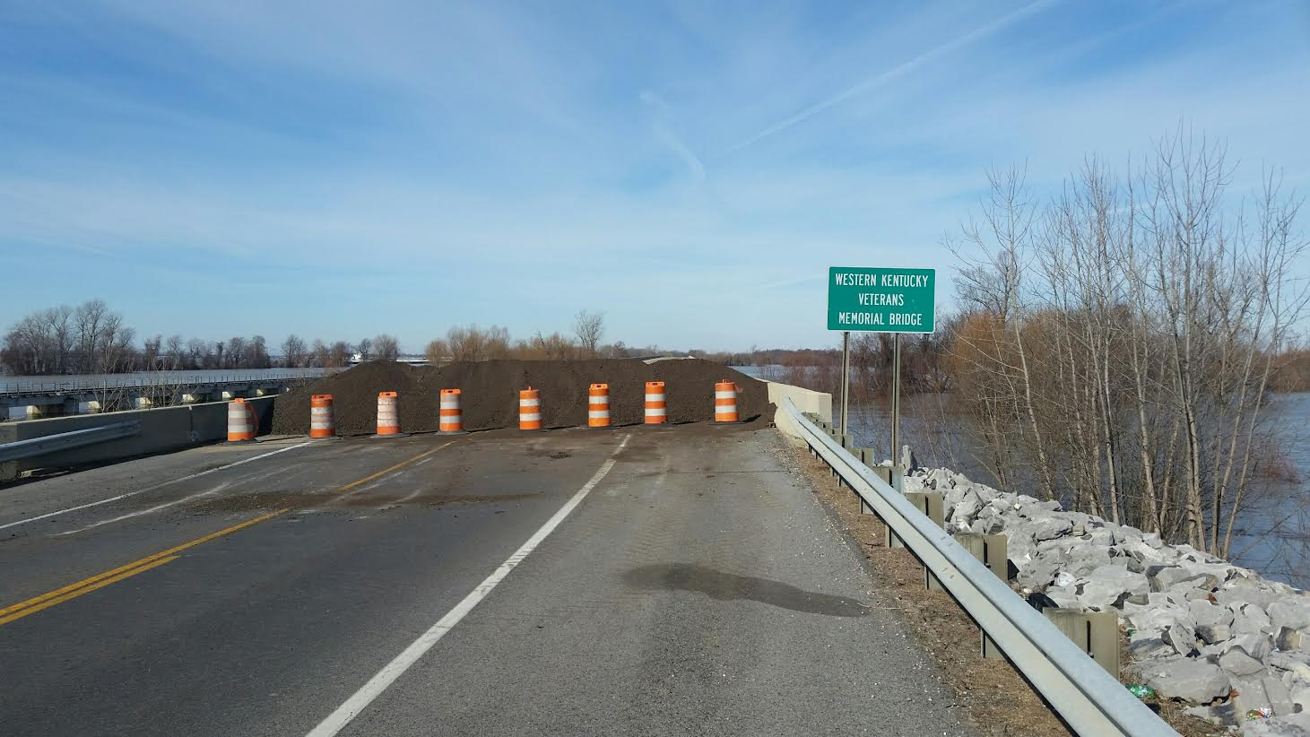
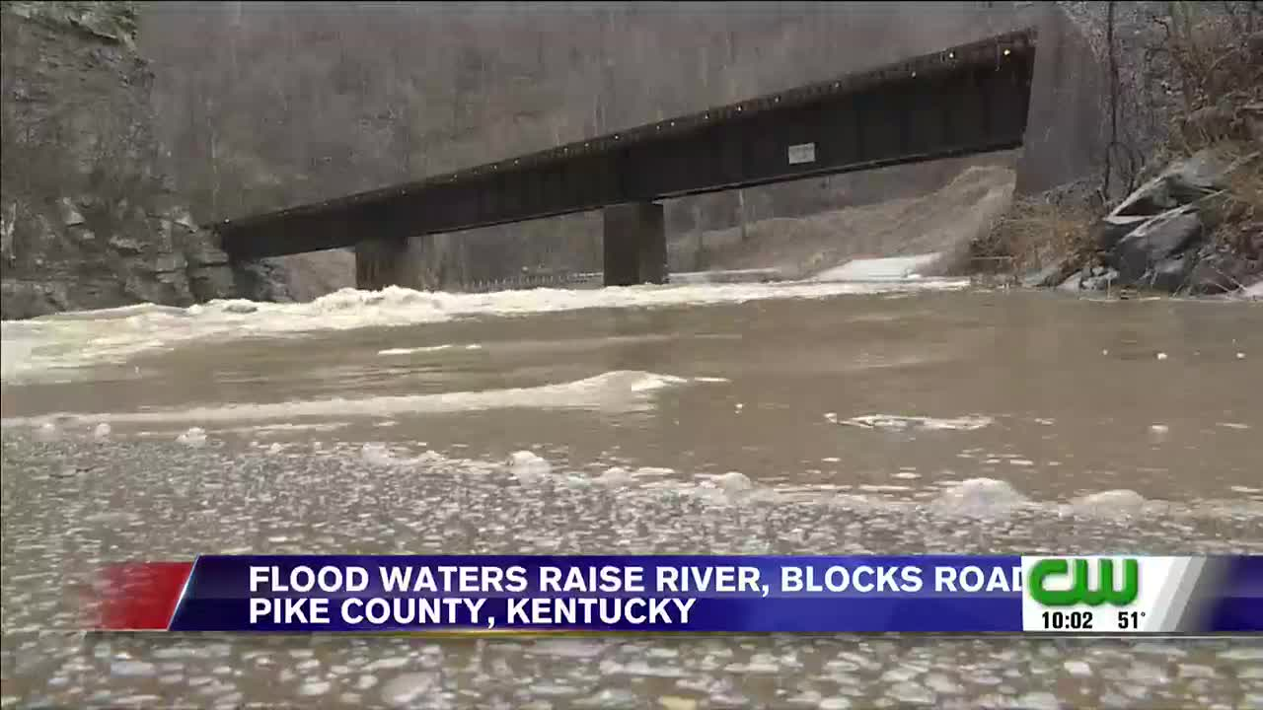
Natural Features in Kentucky
Over 90,000 miles of streams and 13 major river basins

Slide 4
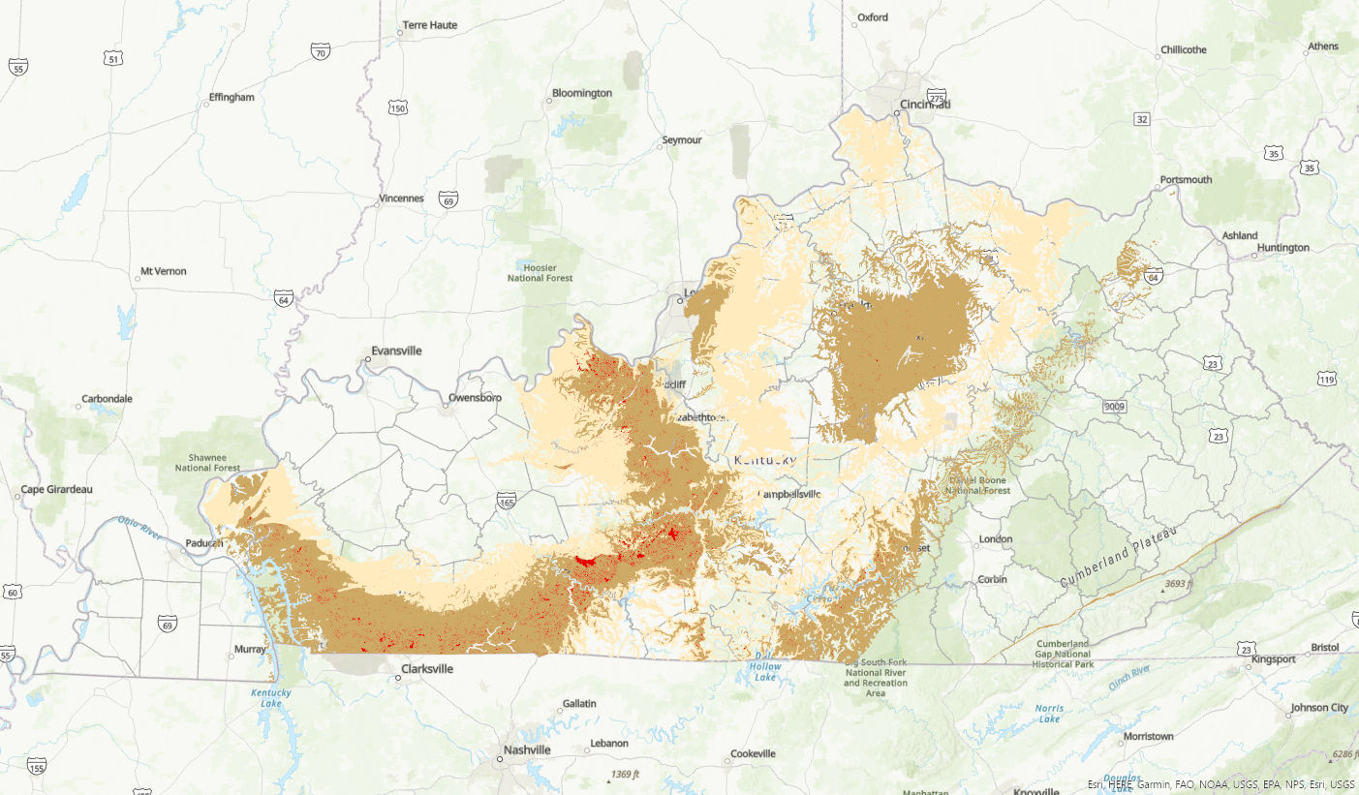
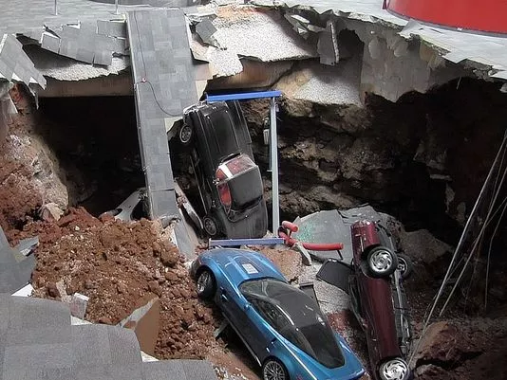
High Karst Potential: over 100,000 sinkholes identified by Kentucky Geological Survey (KGS)

Slide 5
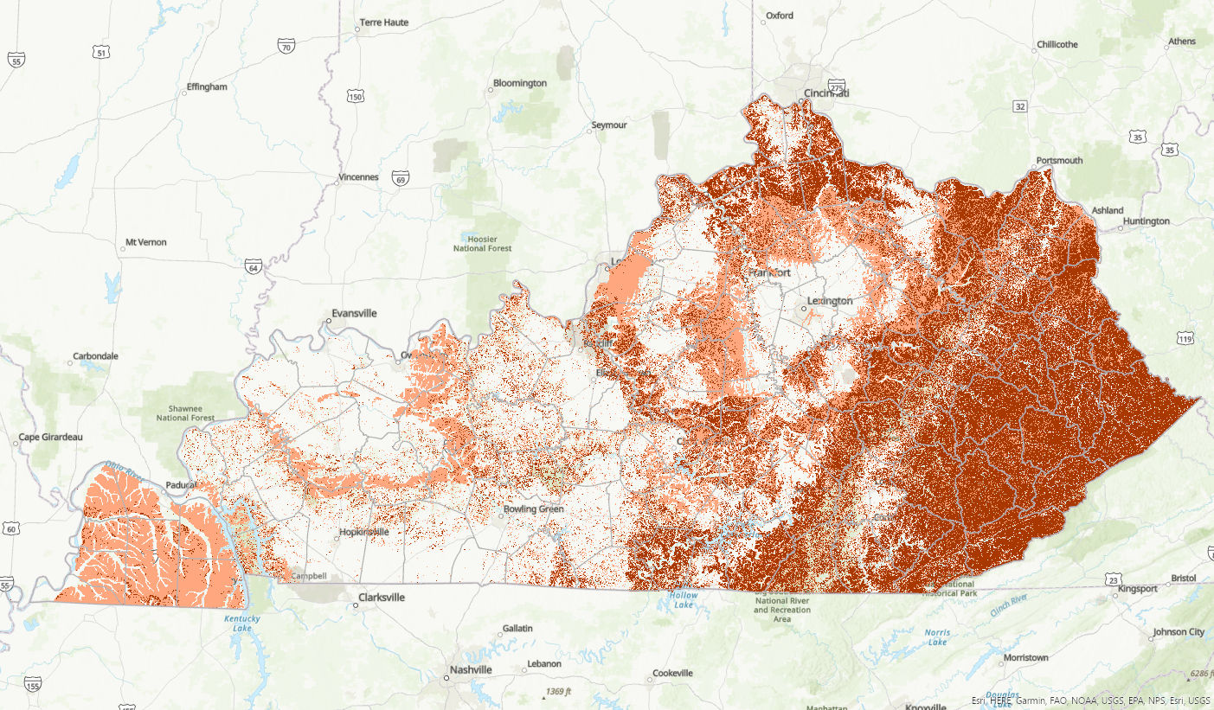
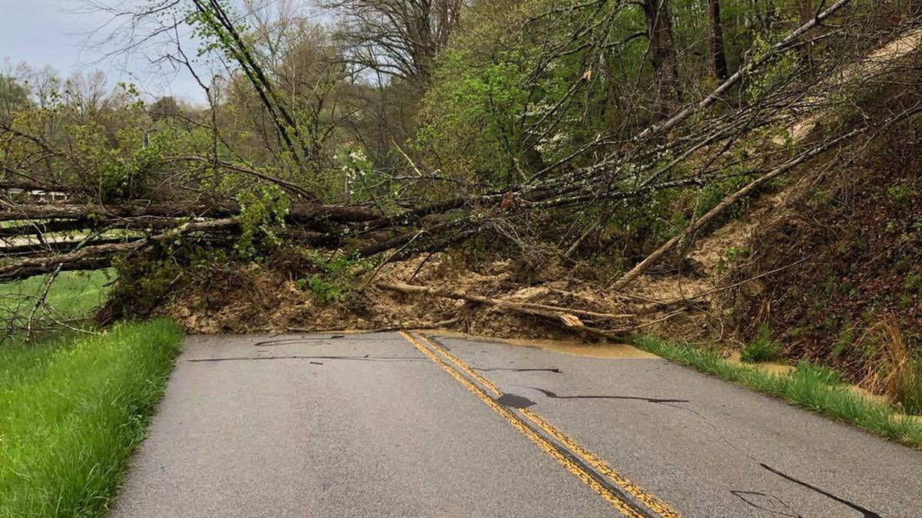
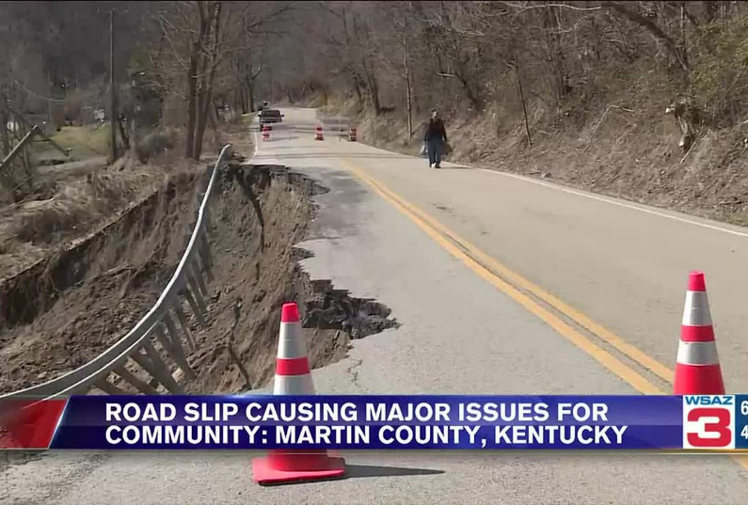
Landslide Susceptibility: Slides, Rockfalls, Roadway Slips

Slide 6
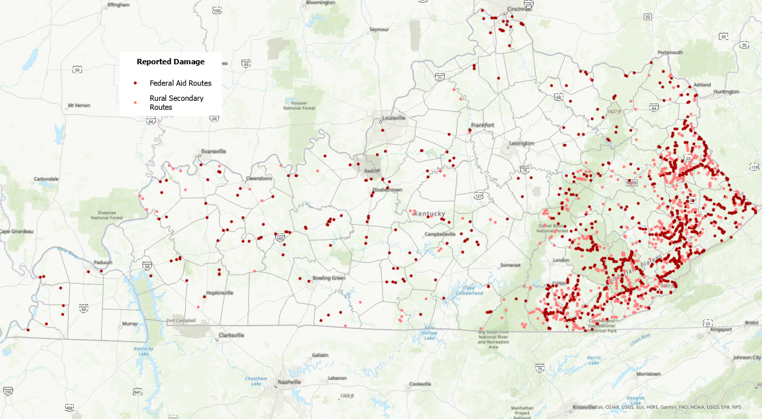
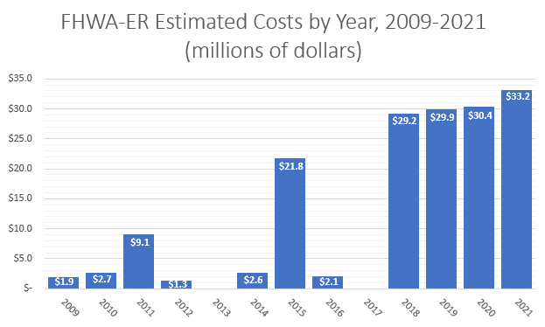
Kentucky Roadway Damage: 2009 - 2021
*no emergencies declarations in 2013 or 2017

Slide 7
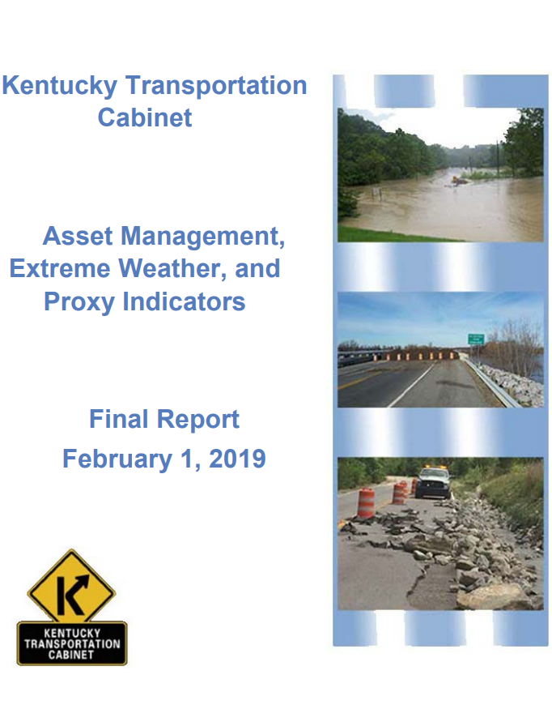
Asset Management, Extreme Weather, and Proxy Indicators
FHWA Pilot Project: Kentucky one of six state DOTs participating (also TX, MD, MA, NJ, AZ)
KY’s pilot focused on two primary climate threats (extreme precipitation and extreme heat) and their potential impacts on two transportation asset classes (bridges and pavement).
Technical Approach I: Composite Bridge Sensitivity Index
Technical Approach II: Modeling the Effects of a Warming Climate on Pavement Performance
KYTC Resiliency-related Process Improvements

Slide 8
Composite Bridge Sensitivity Index
Purpose
Synthesize existing information on bridge/culvert structural condition, the geomorphic environment, and criticality to locate structures which may be particularly sensitive to high-magnitude flooding.
General Approach
Crafted to avoid additional fieldwork and accommodates rapid score updates when new data are received.
Collaborated with KYTC Bridge Maintenance section to work out the BSI components.
Computed by classifying, weighting, and summing values from the NBI and KYTC.

Slide 9
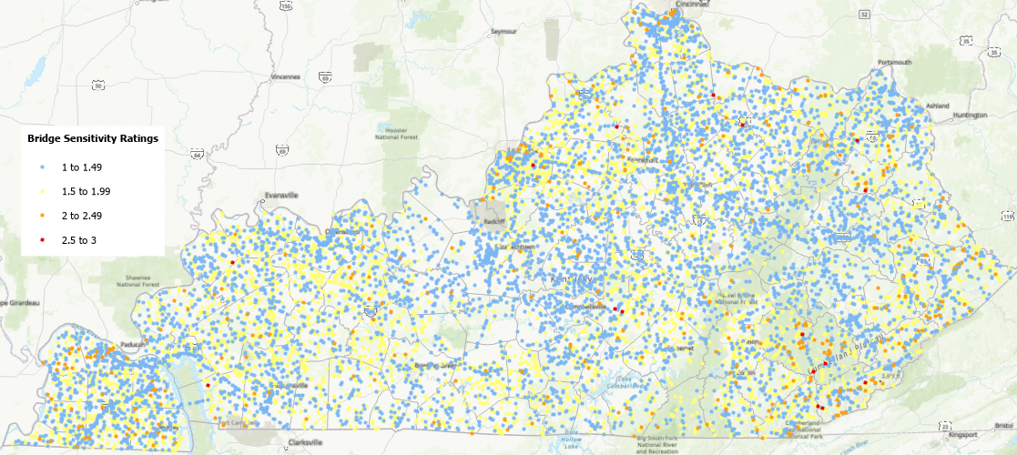
Results for KYTC Bridges
Value(s) | ALL KYTC BRIDGES
 | Composite BSI | Structural Condition | Geomorphic Sensitivity | Structure Criticality
1 to 1.49 | 6,283 | 5,268 | 10,377 | 7,447
1.5 to 1.99 | 5,506 | 2,174 | 1,469 | 3,249
2 to 2.49 | 644 | 4,442 | 465 | 1,340
2.5 to 3 | 24 | 573 | 147 | 423
No calculation | 2 | 2 | 1 | 0
TOTAL | 12,459 | 12,459 | 12,459 | 12,459

Slide 10
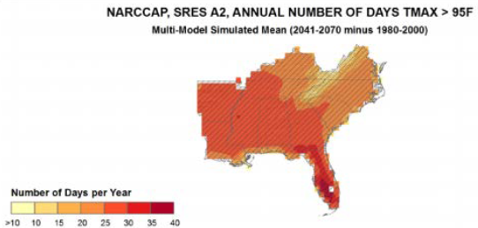
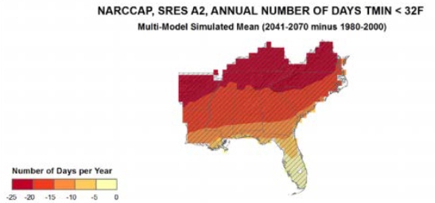
Modeling the Effects of a Warming Climate on Pavement Performance
Background: CMIP5 climate projection data (RCP8.5 – emissions uncapped scenario):
Projects an average temperature increase of 3.3°F over the first 20-year period (2021 – 2040) and 5.5°F degrees over the second 20-year period (2041 – 2060).
Average annual precipitation increases by 2.5 inches over the first period and 3.0 over the second.
Goal:
Develop methodology that uses projected climate data as an input into pavement design and performance monitoring software.
Approach:
Access and process future climate projection data downscaled to the county level.
Analyze pavement performance of I-65 in Warren County using Pavement ME against the future climate scenarios.

Slide 11
RESULTS AND INTEGRATION ACTIONS
Pavement Performance Results
Pavement distresses measured in terms of % fatigue cracking and depth of rutting (inches).
Model resulted in increases in asphalt rutting and fatigue cracking.
However, increases were within the expected variation in pavement performance .
Distresses incurred within these climate scenarios not severe enough to warrant changes in pavement design.

Slide 12
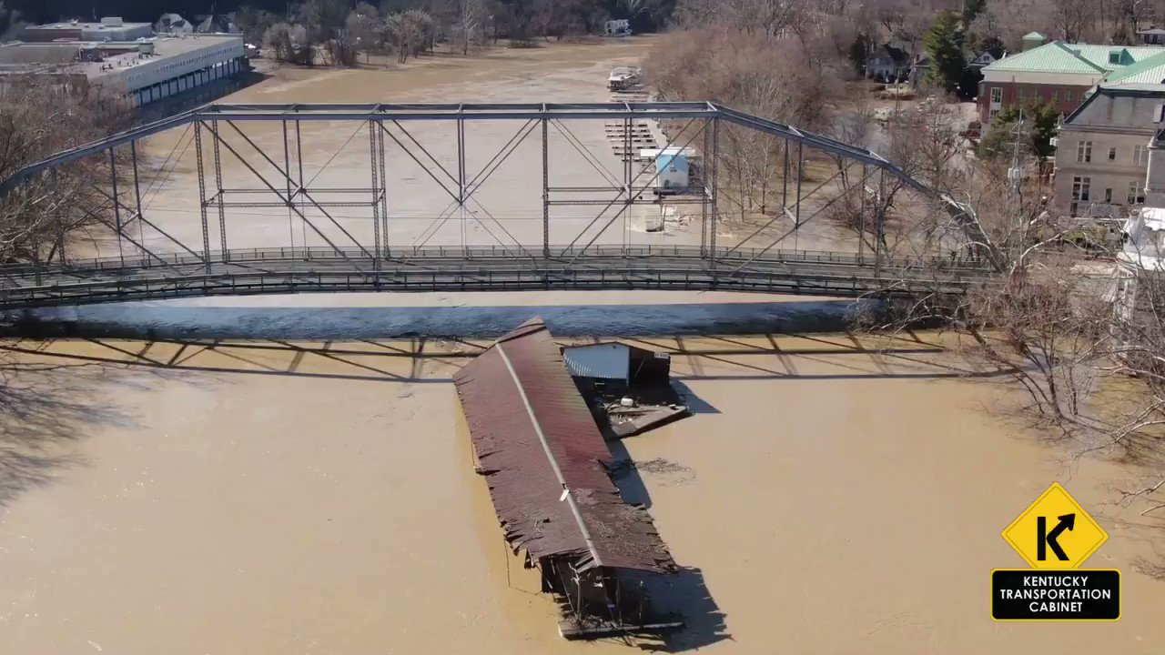
RES AND INTEGRATION ACTIONS
KYTC Process Improvements
Improved tracking of FHWA ER projects to meet 23 CFR Part 667 requirements.
Development of reported damages database and mapping.
Improved documentation and coordination for ER events.
Development and rollout of KYTC’s First Look app.
Formation of a resiliency working group.
Interagency resiliency working group formed in 2021. Includes KYTC, MPOs, researchers, and other state agencies.
Data and documentation to feed into future asset management efforts and life cycle planning.
TAMP
SHIFT
Resiliency Improvement Planning

