Slide 1
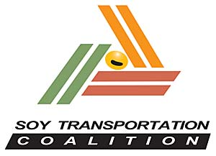
Mid-America Freight Coalition
Multi-state Collaboration: What Can it Look Like?
July 27, 2022

Slide 2

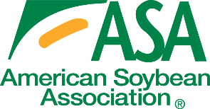












The Soy Transportation Coalition – Farmer funded & farmer led
Established in 2007. Comprised of 13 state soybean organizations, the United Soybean Board, & American Soybean Association.

Slide 3
Farmer organizations: A natural collaboration opportunity with state DOTs.
Importance to state economy
Ripple effect it produces (manufacturing, technology, banking, etc.)
Reliant on multiple modes. An infrastructure that will serve the interests of agriculture will serve much of the remainder of the economy.
Credibility of farmers

Slide 4
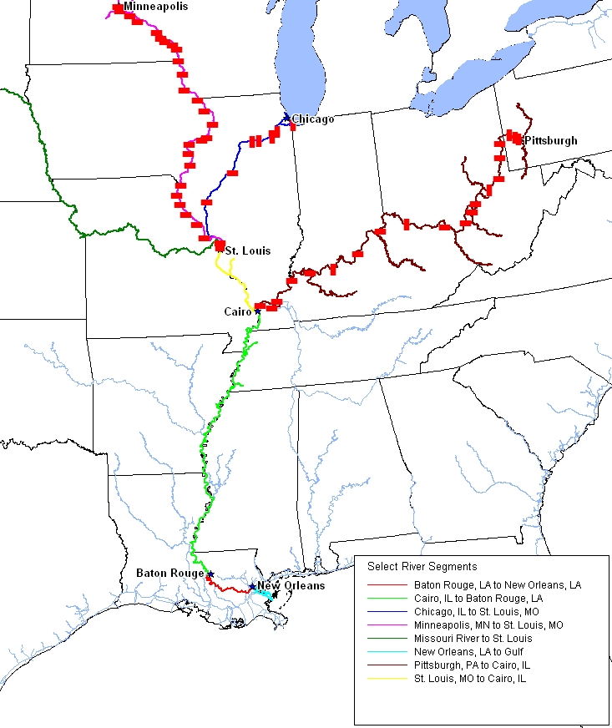
America’s Rivers: An Efficient Maritime Highway
Mississippi Gulf (Baton Rouge to Gulf of Mexico): #1 export region for soybeans & corn

Slide 5
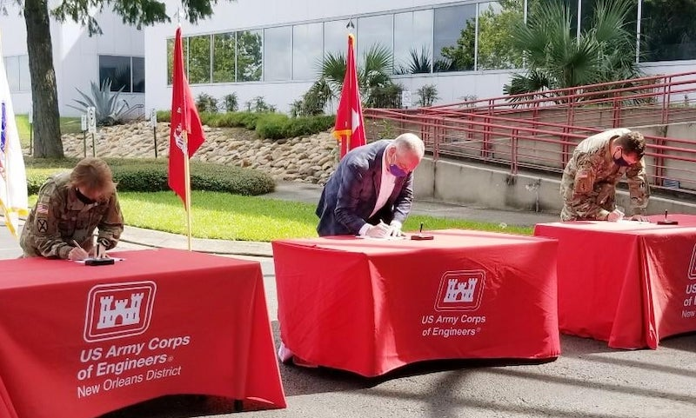
Dredging Lower Mississippi River: Impact on Midwest Agriculture
Project officially kicked off on July 31st, 2020; Deepening work commenced on September 11, 2020
“The soybean industry made for a great case study and reason to deepen the Mississippi River. Once this project is completed, the deepening of the Mississippi River will improve the global imports and exports of goods, and in turn, improve jobs, business and the quality of life for thousands of Louisianans and others who depend on the Mississippi River. I am grateful for our partnership and the commitment of time and money from the farming leaders of the United Soybean Board, the Soy Transportation Coalition, and countless others who have made this project possible.” (Governor John Bel Edwards, D-LA)
Current drafts: 50 ft. (Gulf to Port of New Orleans); 49 ft. (Port of New Orleans
to mile 175 AHP); 45 ft. (mile 175 to 233.8 AHP)
Soybean farmers contributed $2 million toward the project

Slide 6
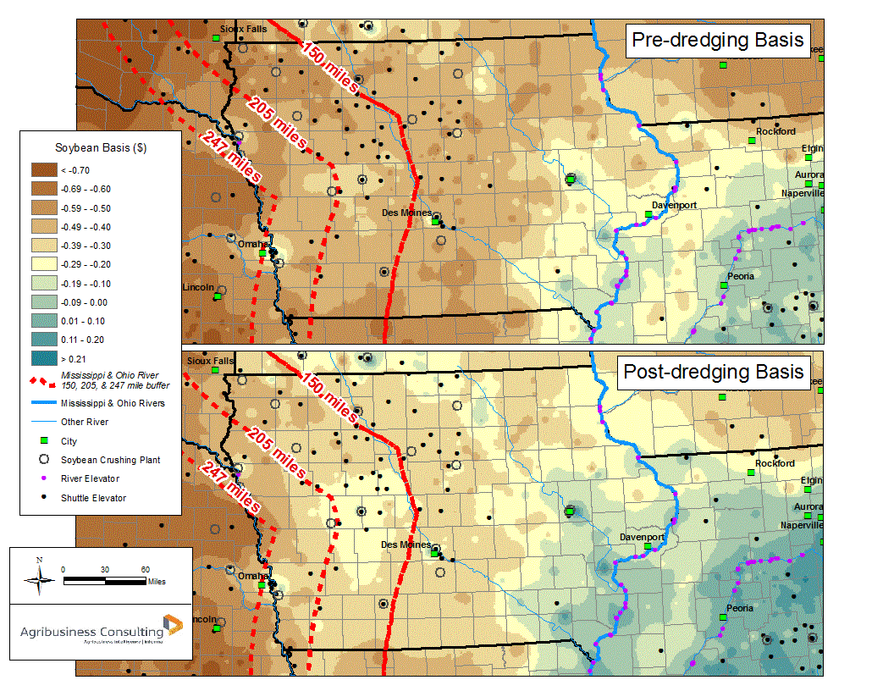
Dredging Lower Mississippi River: Impact on Midwest Agriculture
Iowa soybean farmers will receive $71.5 million more for the value of their soybeans post dredging the lower MS River. U.S. soybean farmers - $461 million more

Slide 7
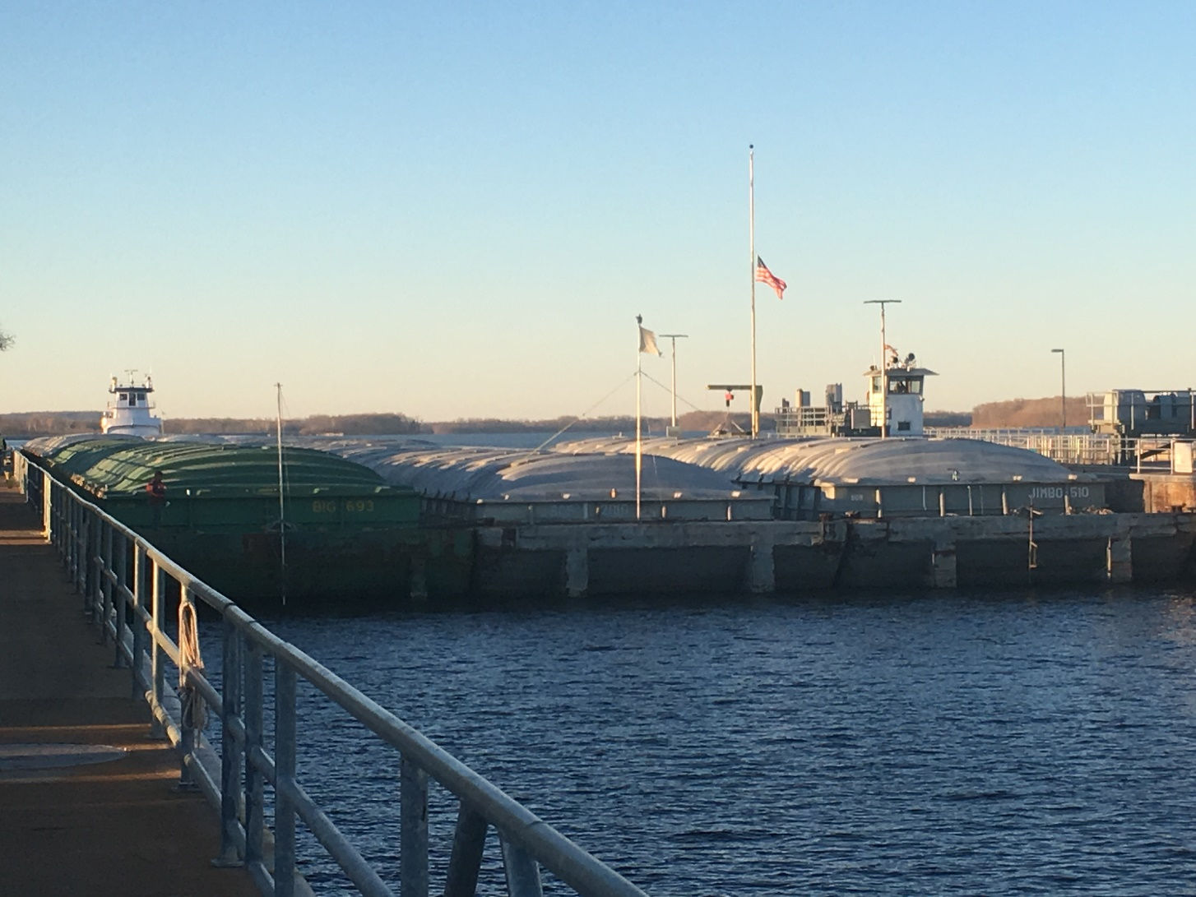
Lock & Dam #25
Location: Winfield, MO (46 miles north of St. Louis
1st day of operation: May 18, 1939
Most southern lock & dam on Mississippi River with single, 600 ft. X 110 ft. lock chamber

Slide 8
Pre-engineering & design (PED) expenses for Lock & Dam #25
$1 million raised from the following:
  United Soybean Board
  Soy Transportation Coalition
  Illinois Soybean Association
  Iowa Soybean Association
  Iowa Corn Promotion Board
  Minnesota Soybean Research & Promotion Council
  Missouri Soybean Merchandising Council
Could farmer organizations help be a catalyst for an important project finally moving from the “on deck circle” to the “batter’s box”?
January 19th, 2022: Lock & Dam #25 to receive $732 million; Will be the first construction project within the Navigation and Ecosystem Sustainability Program (NESP); Due to successful collaboration (Agriculture, WCI, Barge & Towing Industry, NWC, etc.)
Uncertainty that the Army Corps of Engineers will be able to accept the contributed funding.

Slide 9
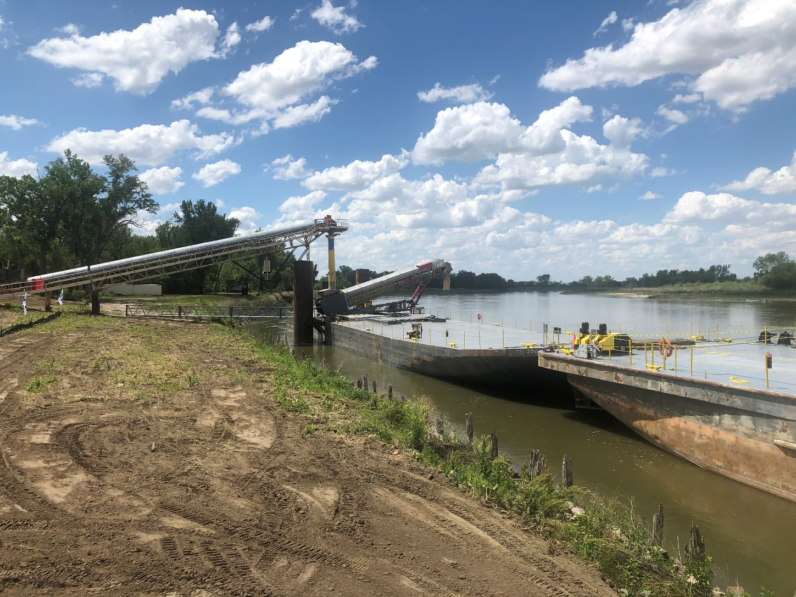
Missouri River: Becoming a more viable supply chain option
NEW Cooperative barge facility in Blencoe, Iowa
Reputation of the Missouri River…
Iowa Soybean Association provided funding to help offset site development expenses
Port of Blencoe ribbon-cutting (6-2-21); Photo credit: Mike Steenhoek

Slide 10
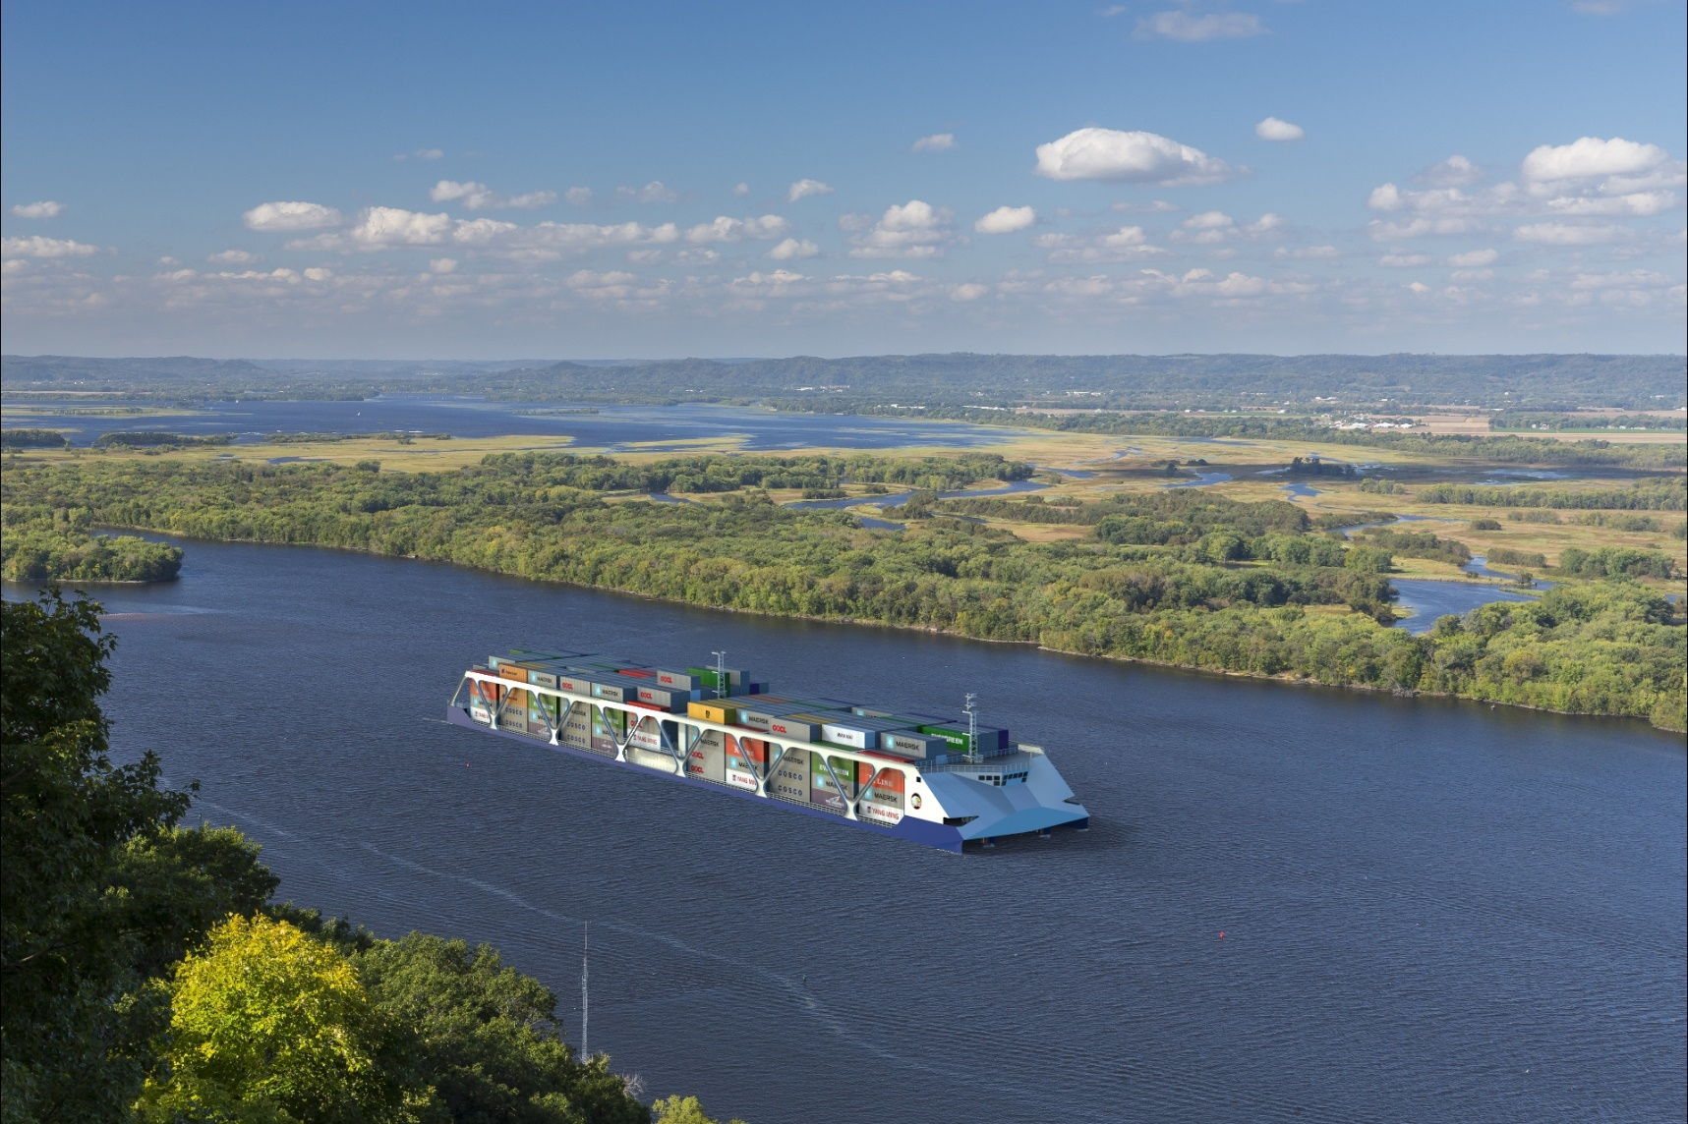
American Patriot Holdings Container on Vessel: Opportunity for U.S. Agriculture
Conceptual image provided by American Patriot Holdings

Slide 11
American Patriot Holdings Container on Vessel: Opportunity for U.S. Agriculture
  Vessel Features:
    Exoskeleton Hull (Patent) - optimizes cargo payload
    Minimum Resistance Bow (Patent) - optimizes speed / minimizes wake
    Upriver speeds of 13 MPH vs. 5 MPH head current
    Parallel docking without assist tugs
    Environmental features (no wake, low emissions)
    Ability to turn in own length
    Redundant propulsion & take me home power

Slide 12
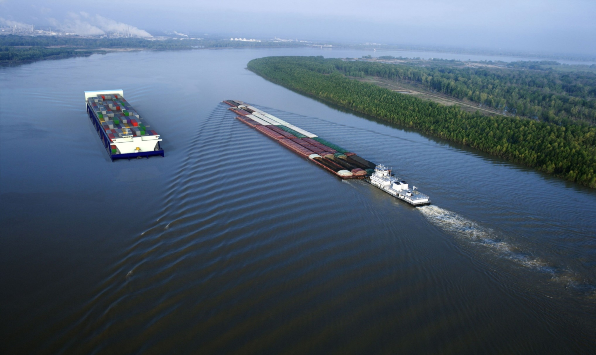
American Patriot Holdings Container on Vessel: Opportunity for U.S. Agriculture (Liner Vessel)
Length Overall | 595+ ft. | Ballast Tanks | Eight (8)
Beam | 134 ft. | Fuel | LNG
Height Above Water | 48 ft. | Fuel Capacity | 1000cm (3 trips)
Speed (Upriver) | 13 MPH | Power Plant | Diesel Electric
Operating Draft | Up to 10 ft. | Main Generators | Four (4) – 2880 kW each
DWT | 12.7k-14.8k LT | Horsepower | 14,850
TEU Capacity | 2500 | Propulsion Drives (Stern) | Three (3) Drives
Reefer TEU Capacity | 500+ Electric power as needed | Bow Drives | Two (2) (1000kw Each)
Crew Size | Expect 10-12 | Deck Machinery | Electric
Trading Range | Mississippi River | Gross Registered Tons | > 10,000

Slide 13
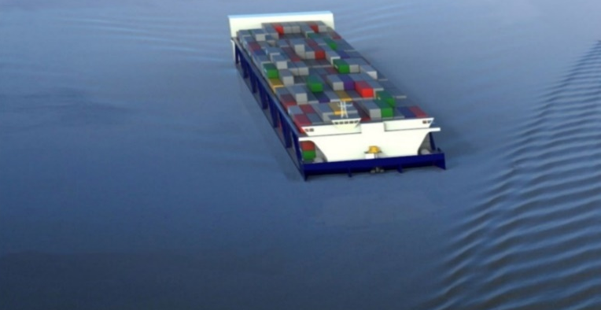
American Patriot Holdings Container on Vessel: Opportunity for U.S. Agriculture (Hybrid Vessel)
Length Overall | 595 ft. | Ballast Tanks | Eight (8)
Beam | 100 ft. | Fuel type | LNG
Height Above Water | Approx: 40-42 ft. | Fuel Capacity | 3 trips
Speed (Upriver) | 13 MPH | Power Plant | Diesel Electric
Operating Draft | Up to 10 ft. | Main Generators | Three (3) 2880 kW each
DWT | 9000+ LT | Horsepower | 11,600
TEU Capacity | 1800+ | Propulsion Drives (Stern) | Three / Four Drives
Reefer TEU Capacity | 300+ Electric Power as Needed | Bow Drives | Two (2) 750 kW each
Crew Size | Expect 10-12 | Deck Machinery | Electric
Trading Range | Tributary Rivers | GRT | TBD
Notes:
(2)

Slide 14
Soybean producing states adjacent to Great Lakes/St. Lawrence Seaway
State Production Rank
Illinois 672.6 million bushels 1st
Minnesota 356.3 million bushels 3rd
Indiana 335.6 million bushels 5th
Ohio 275.7 million bushels 7th
Wisconsin 113.9 million bushels 13th
Michigan 109.1 million bushels 14th
Pennsylvania 31.6 million bushels 19th
New York 17 million bushels 22nd
Source: U.S. Department of Agriculture

Slide 15
Cardinal rule in supply chains: “Don’t put all your eggs in one basket.”

Slide 16
St. Lawrence Seaway Management Corporation & STC sign “Gateway Incentive Agreement”
STC: First organization to sign Gateway Incentive Agreement
Must be new freight utilizing Great Lakes/St. Lawrence Seaway
Toll reduction of 50%
75,000 metric ton minimum threshold
Separate exporters can be aggregated under the STC agreement & receive 50% toll reduction
  Exporter #1: 25,000 metric tons of new business
  Exporter #2: 25,000 metric tons of new business
  Exporter #3: 25,000 metric tons of new business
Eligible commodities: soybeans, soy products, grain, or grain products

Slide 17
Option A or B? Given 1.) Truck driver shortages, 2.) Need to decrease costs; 3.) Need to decrease emissions; 4.) Need to increase motorist safety; 5.) Need to transport more volume; 6.) Rail service challenges, which is preferable?
Grain Elevator A
6 million bushels handled (4 million bushels of corn + 2 million bushels of soybeans)
Utilizing 5 axle, 80,000 lbs. semis, Grain Elevator A would annually require 4,149 trips for corn (964 bushels per load) and 2,222 trips for soybeans (900 bushels per load). Total annual trips = 6,371. If the delivery location for the grain elevator is 40 miles or 80 miles roundtrip, 509,680 miles would be driven annually.
Grain Elevator B
6 million bushels handled (4 million bushels of corn + 2 million bushels of soybeans)
Utilizing 6 axle, 91,000 lbs. semis, Grain Elevator B would annually require 3,604 trips for corn (1,110 bushels per load) and 1,929 trips for soybeans (1,037 bushels per load). Total annual trips = 5,533. If the delivery location for the grain elevator is 40 miles or 80 miles roundtrip, 442,640 miles would be driven annually.
Therefore, Grain Elevator A handling the same number of bushels would annually have to incur 838 additional trips – driving 67,040 additional miles – compared to Grain Elevator B.

Slide 18
Rural Bridges – The Problem…
Challenge facing rural America: The area of the country in which our bridge problem is most severe also happens to be the area of the country in which resources are most limited.
A typical rural county can often have 100-300 bridges. Replacing a single bridge via traditional methods can often cost $250,000 - $500,000. Many rural counties will only have $500,000 - $1.5 million available annually to repair and replace their bridges.
Example: A single weight restricted bridge results in a 5 mile detour for local semi and truck traffic; 25 trucks are impacted each day
    125 miles of detour are incurred each day (25 trucks X 5 miles)
    45,625 miles of detour are incurred each year (125 miles X 365 days)
    If it costs $2 per mile to operate the semi, the annual cost of the detour for the single weight restricted bridge is approximately $100,000. These are costs that will be inserted into food delivery and other industries.

Slide 19
The Top 20 Innovations for Rural Bridge Replacement and Repair
Goal: Highlight a relatable number of innovative concepts that 1.) Will provide initial or lifecycle cost savings, 2.) Have been validated by a credible engineering entity or organization, and 3.) Are accessible in a large section of rural America.
STC assembled a group of 13 bridge engineers and experts (county engineers, state DOTs, LTAP programs, universities, engineering firms) from the 13 states that comprise the organization. Three engineers served as principal analysts for the project with the remaining ten engineers or experts serving as advisory committee members.
STC and farmers can play a role in 1.) Increasing awareness, 2.) Increasing understanding, and 3.) Increasing motivation

Slide 20
The Top 20 Innovations for Rural Bridge Replacement and Repair
Bridge Replacement Innovations
Railroad Flat Car Bridges
Geosynthetic Reinforced Soil – Integrated Bridge System (GRS-IBS)
Vibratory H-Piling Drivers
Buried Soil Structures
All Steel Piers
Galvanized H-Piling
Press Brake Tub Girders
Galvanized Steel Beams
Prestressed Precast Double Tees
Precast Inverted Tee Slab Span Bridges
Bridge Repair Innovations
Piling Encasements
Concrete Pier Piling Repairs
Driving Piling through Decks
Epoxy Deck Injections
Deck Overlays with Type O Concrete and Plasticizers
Deck Patching
Thin Polymer Concrete Overlays
Penetrating Concrete Sealers
Spot Cleaning Painting Steel Beams
Concrete Overlay on Adjacent Box Beams

Slide 21
Principal Analysts & Advisory Committee Members
Principal Analysts:
Indiana: Pat Conner, P.E. (Lead Engineer, Asset Management, Local Technical Assistance Program at Purdue University)
Iowa: Brian Keierleber, P.E. (County Engineer, Buchanan County, Iowa; President of the National Association of County Engineers – 2017-2018)
North Dakota: Kelly Bengtson, P.E. (Bridge and Pavement Engineer – Upper Great Plains Transportation Institute at North Dakota State University)
Advisory Committee Members:
Illinois: Duane Ratermann, P.E. (County Engineer, Knox County, Illinois; President of the National Association of County Engineers – 2015-2016; President of the Illinois Association of County Engineers – 2019-2020)
Kansas: Calvin Reed, P.E. (Director of Engineering and Design – Kansas Department of Transportation)
Kentucky: Duane Campbell, P.E. (County Engineer, Boyle County, Kentucky; President of the Kentucky Association of County Engineers and Road Supervisors)
Michigan: Dave Juntunen, P.E. (former Bridge Engineer – Michigan Department of Transportation; Bridge Management Practice Lead – The Kercher Group)
Minnesota: Dave Conkel, P.E. (State Aid Bridge Engineer – Minnesota Department of Transportation)
Missouri: Derin Campbell, P.E. (former County Engineer, Boone County, Missouri; Project Manager – Allstate Consultants, LLC)
Nebraska: Josh Steelman, P.E. (Associate Professor, Civil Engineering – University of Nebraska)
Ohio: Warren Schlatter, P.E. (County Engineer, Defiance County, Ohio)
South Dakota: Andrew Peterson (Field Services Manager – Local Technical Assistance Program at South Dakota State University)
Tennessee: Matt Cate, P.E. (Director, Tennessee Transportation Assistance Program – University of Tennessee)

Slide 22
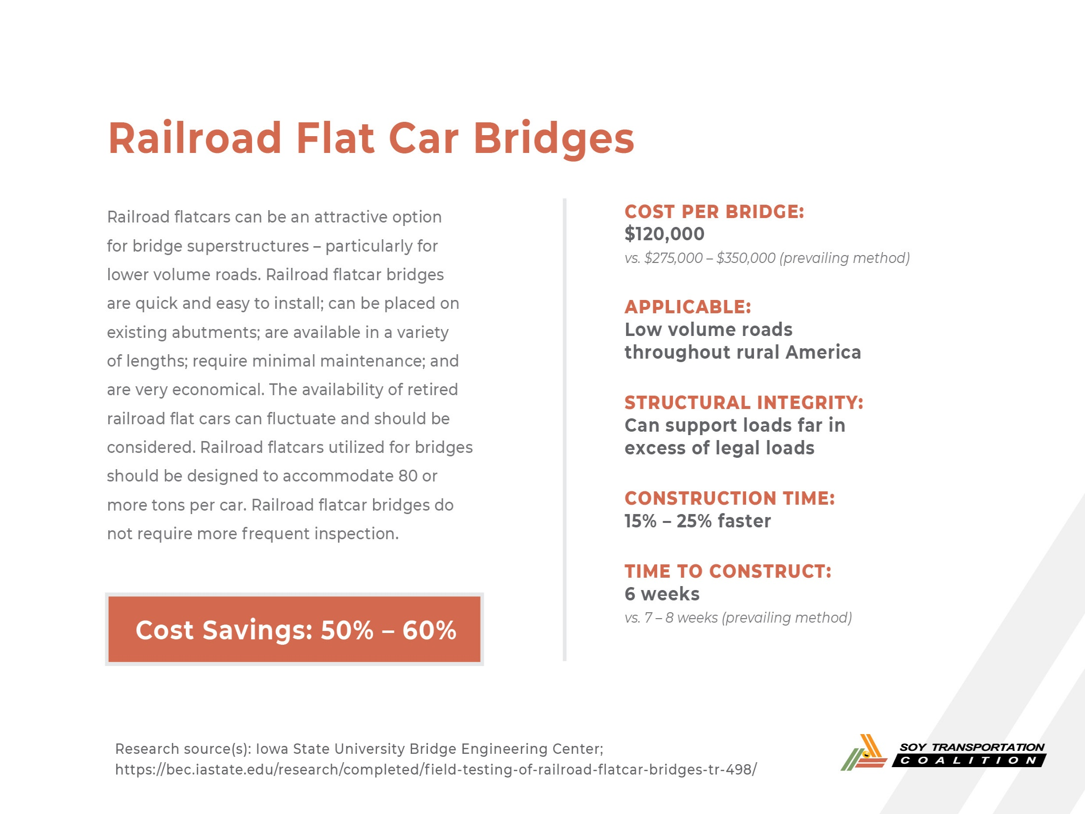

Slide 23
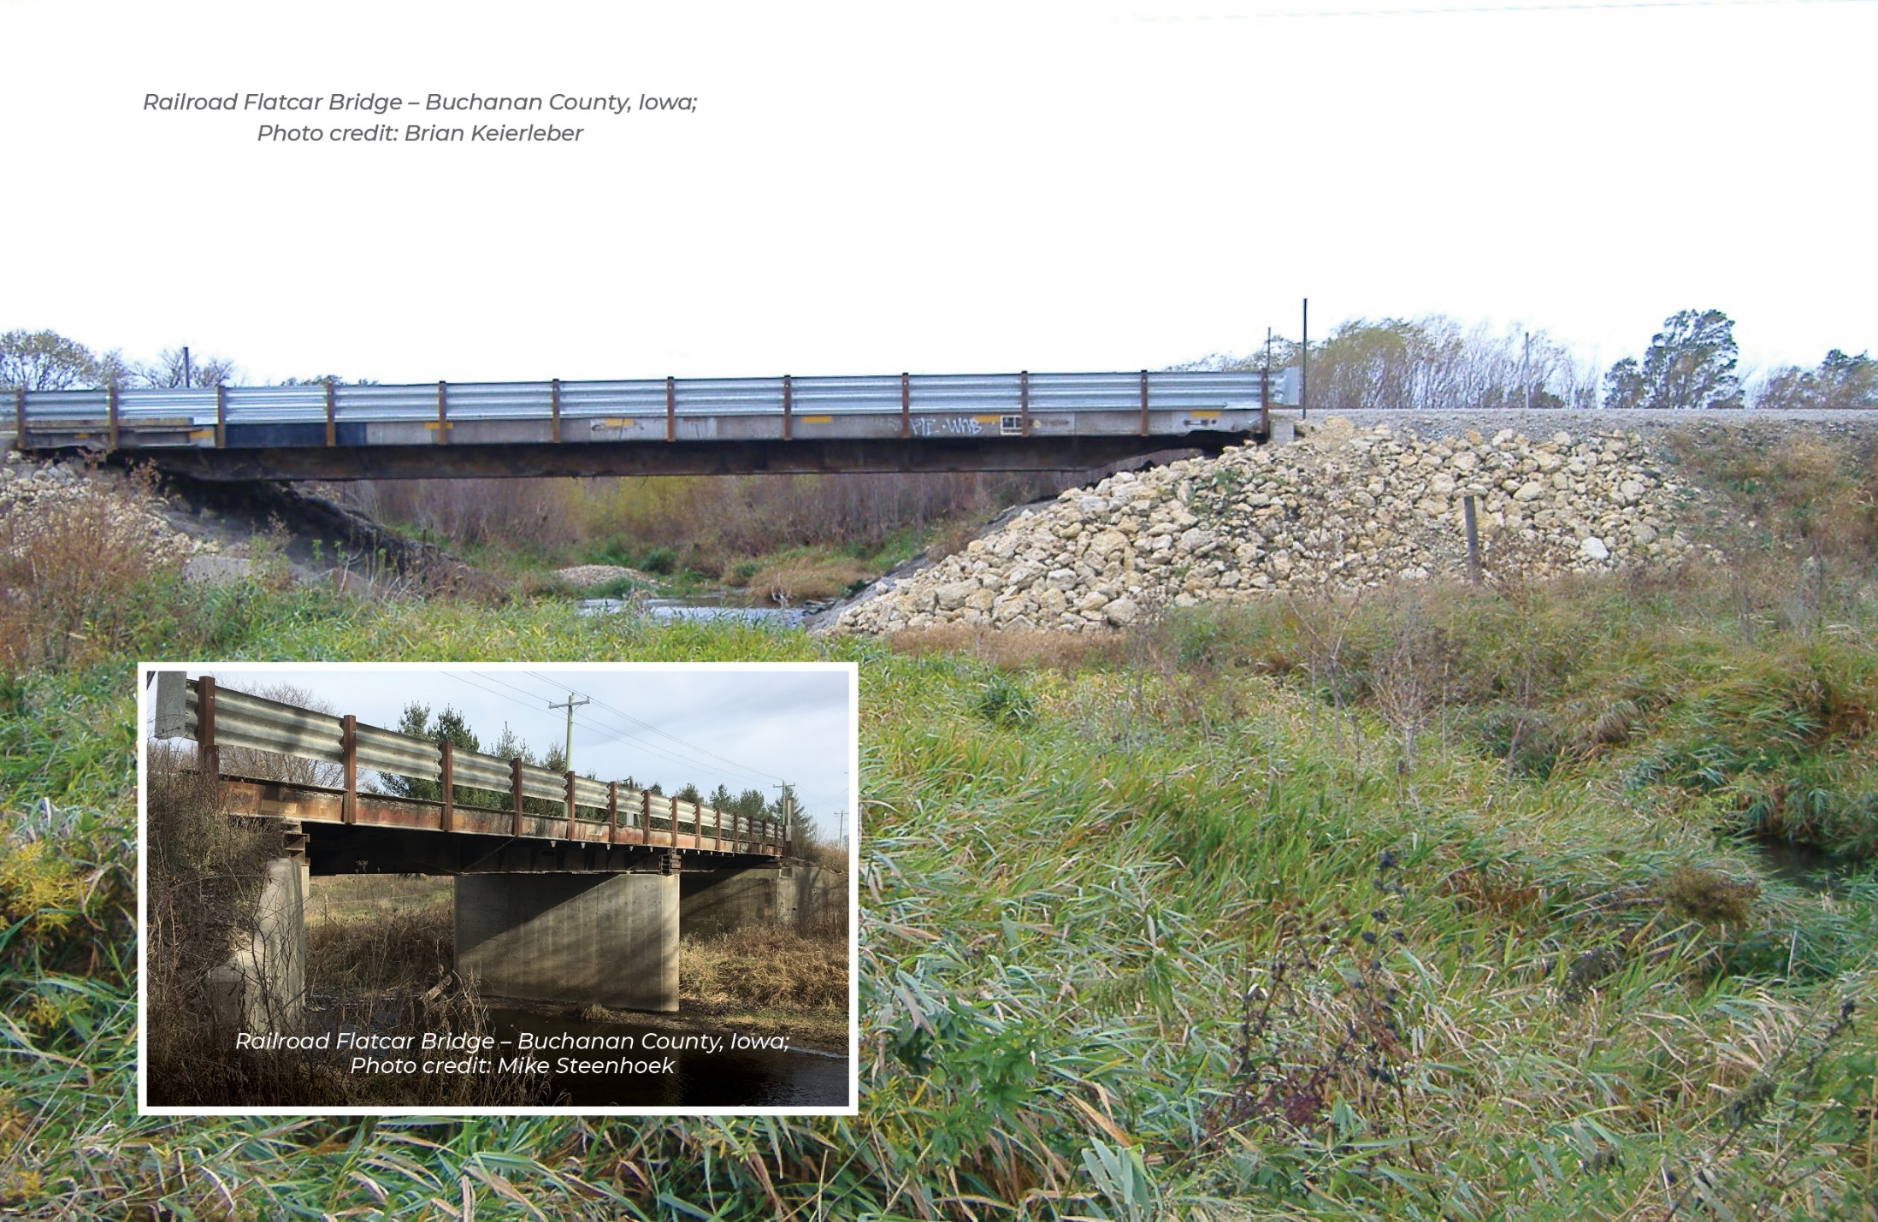
Railroad Flatcar Bridges

Slide 24
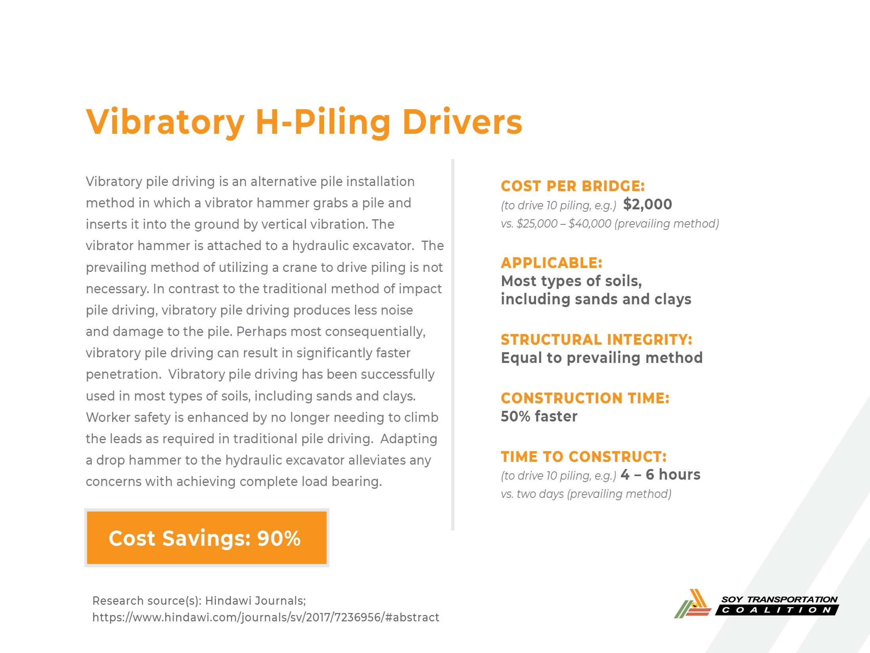

Slide 25
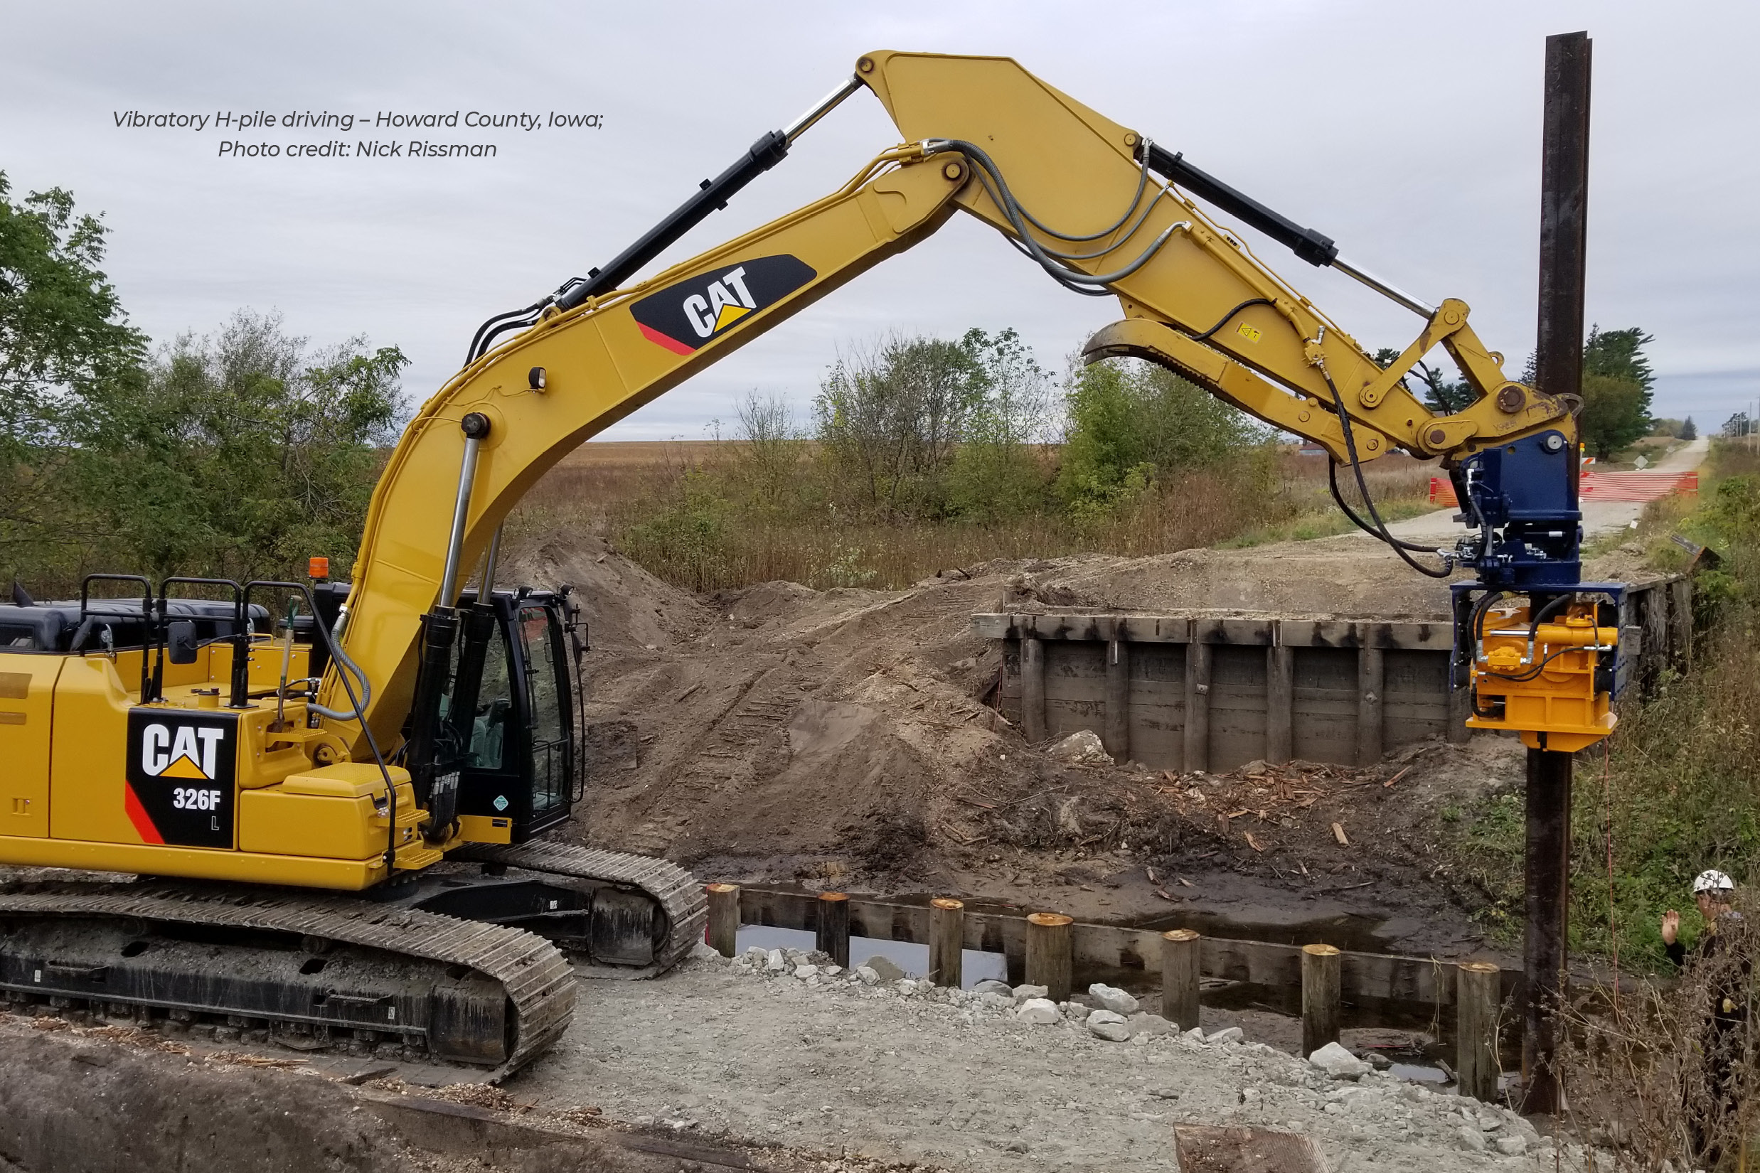
Vibratory H-Piling Drivers

Slide 26
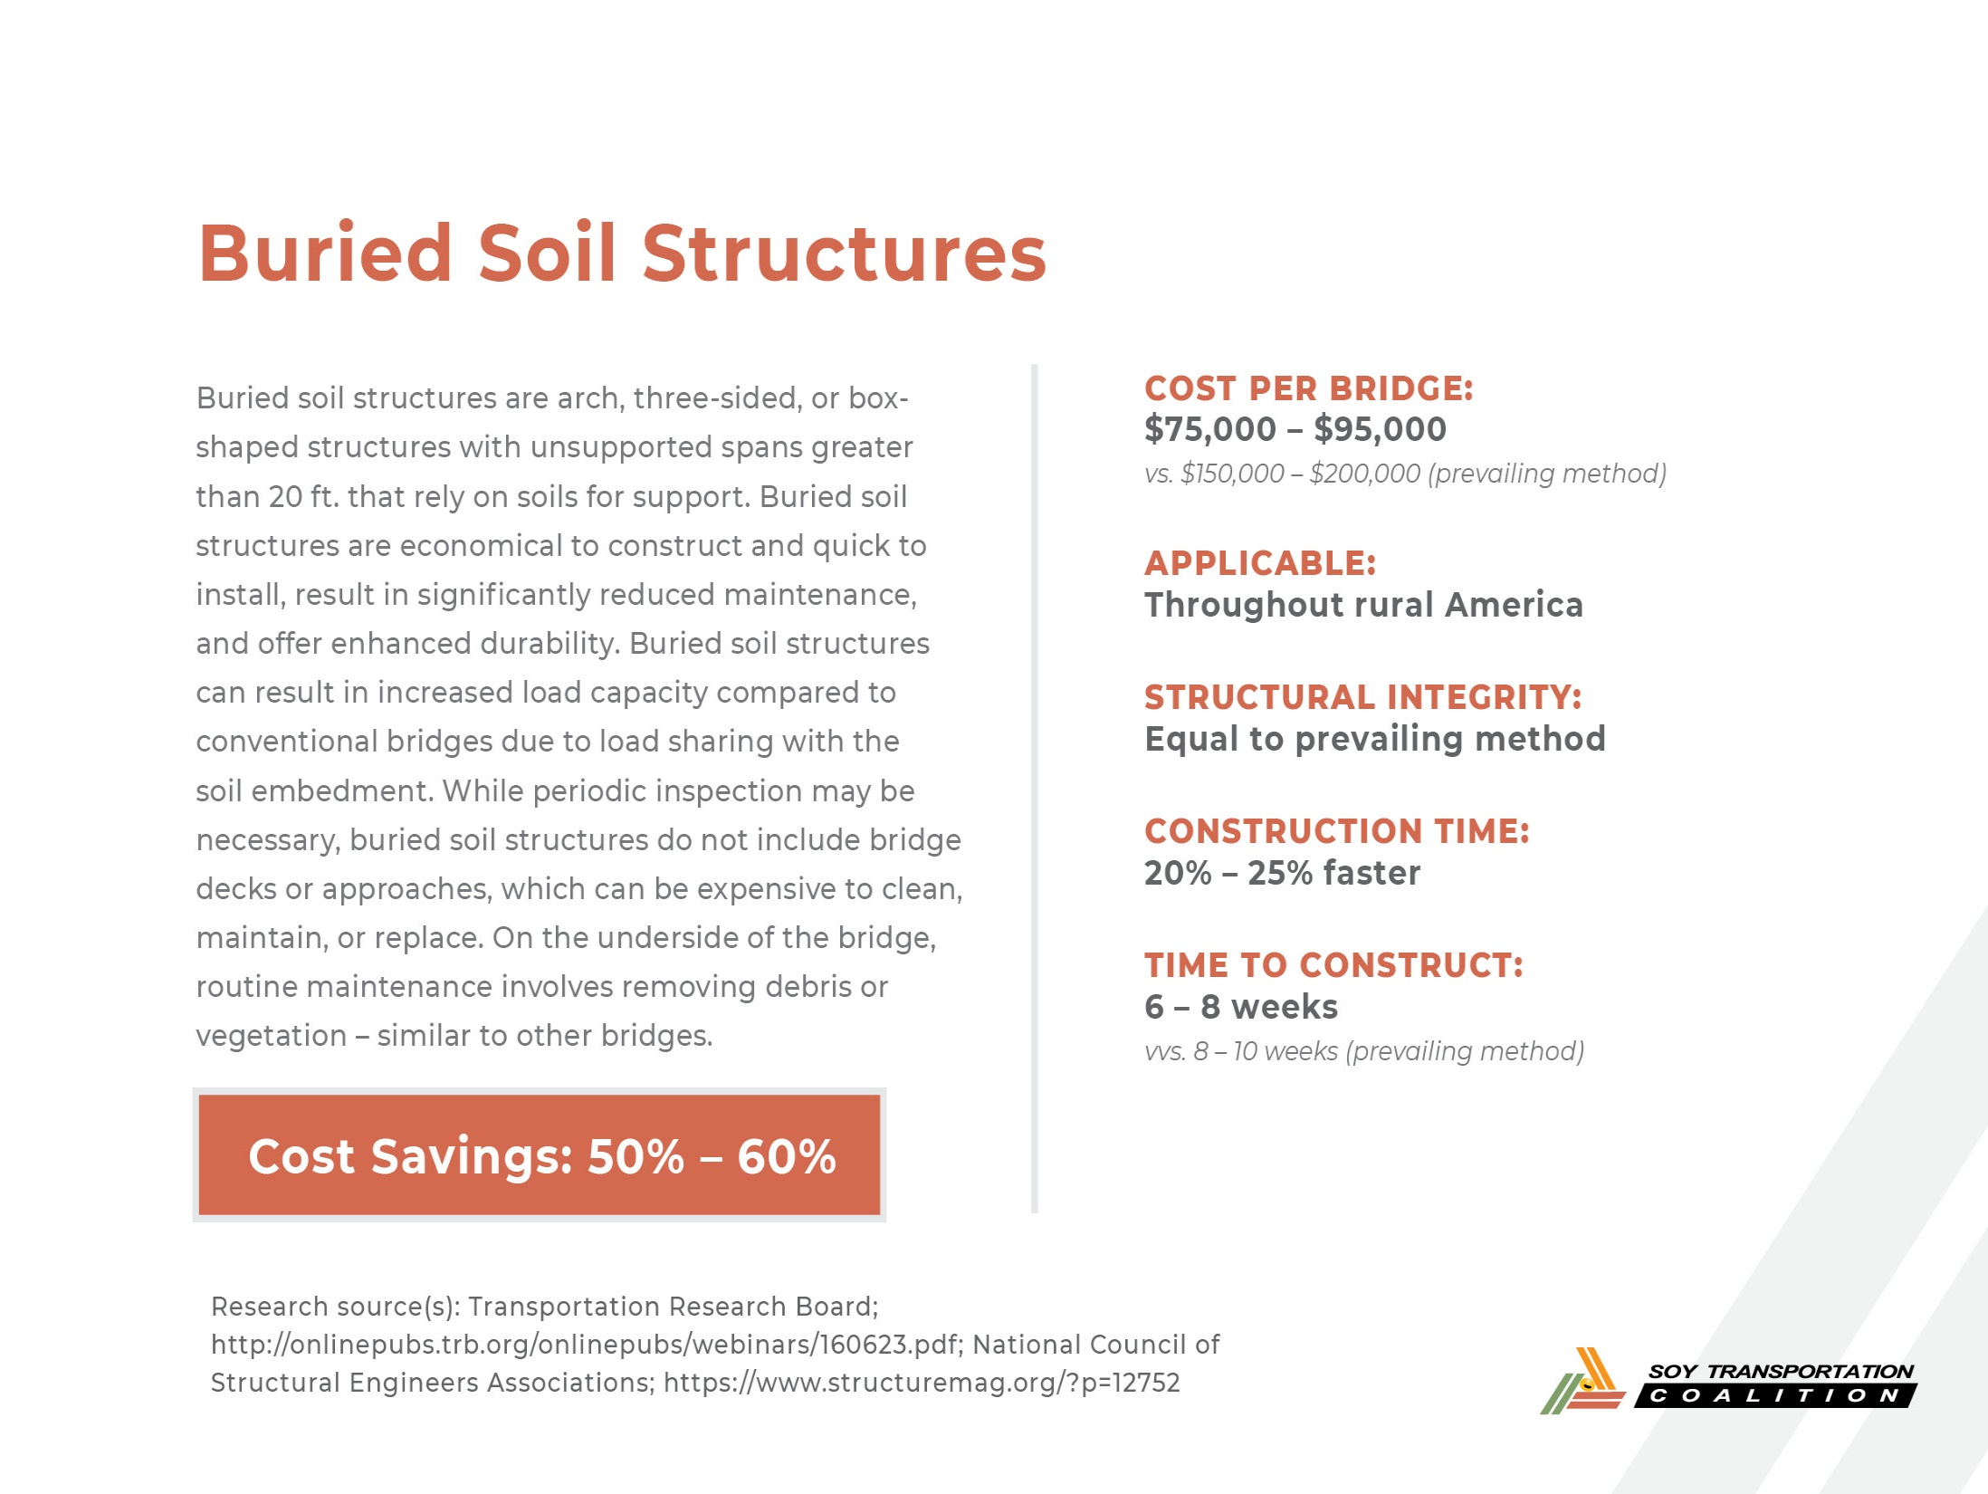

Slide 27
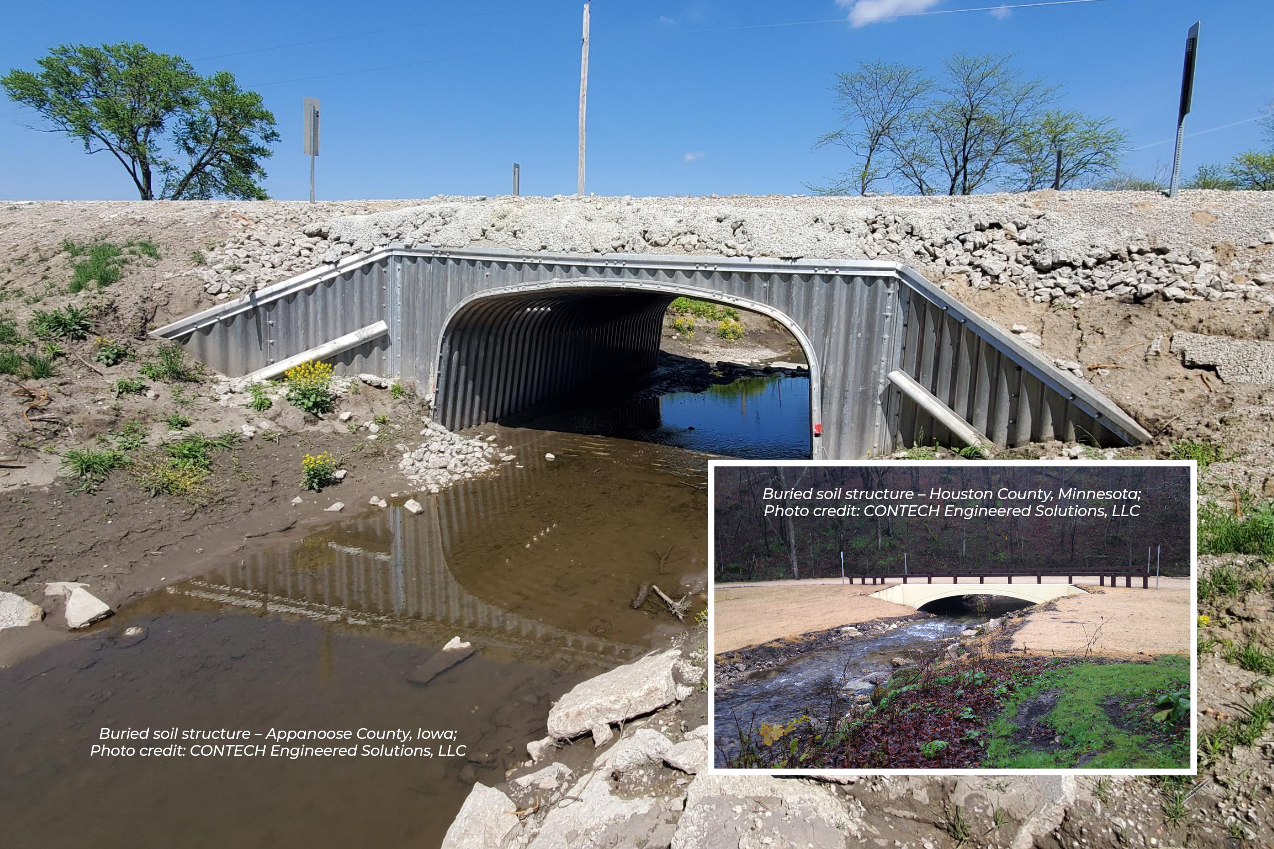
Buried Soil Structures

Slide 28
Bridge Load Testing Initiative
Working with local government, state government, engineering firms, &/or universities to promote rural areas having greater access to load testing technology. The greater utilization of this technology will:
  Reduce the likelihood of rural bridges being unnecessarily load restricted
  Increase the likelihood of taxpayer funding being allocated more strategically to those bridges in greatest need of repair or replacement
STC has authorized $10,000 to facilitate bridge load testing projects in each of the 13 states that comprise the organization. Total funding allocated: $130,000. Tested bridges must be located in rural areas in which soybeans are transported.
Bridge load testing is not the solution to all our problems, but it is an effective tool in the toolbox that should be more accessible – especially in rural areas.

Slide 29
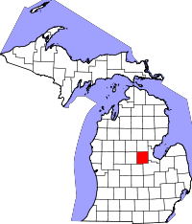
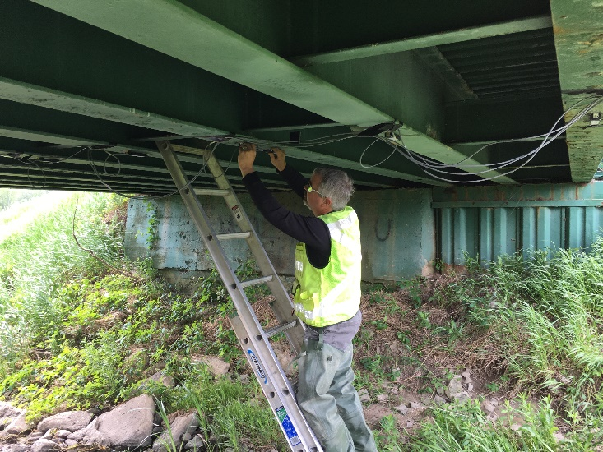
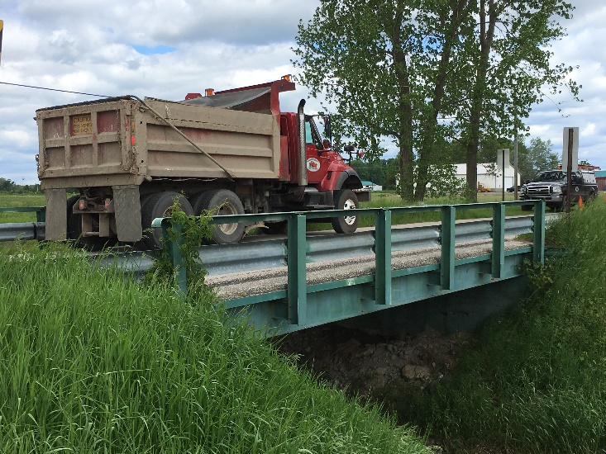
Bridge Load Testing Initiative: Midland County, Michigan
Project agreed to with Midland County Road Commission; Contract signed; Lifespan Technologies traveled to Midland County to conduct training on the equipment
Total up front cost of the project: $22,000 (approximately $23,000 currently)
  Sensor kit with covers, training manuals, & shipping
  On site training (approximately 6 hours)
  Calibration spreadsheet
$22,000 - $10,000 (STC contribution) = $12,000 total up front cost to Midland County (approximately $13,000 currently)

Slide 30
Bridge Load Testing Initiative: Midland County, Michigan
3 bridges tested summer – fall of 2017; Bridge #1: 10% increase; Bridge #2: 30% increase; Bridge #3: 30% increase; Load postings on all three bridges were removed
“The objective of load testing is to remove much of the subjectivity from the traditional visual inspection approach. In doing this project, it is our goal to highlight to Michigan counties and municipalities that this technology can be a cost-effective tool when managing and maintaining their bridge inventory.” Terry Palmer (retired), County Engineer, Midland County, Michigan

Slide 31
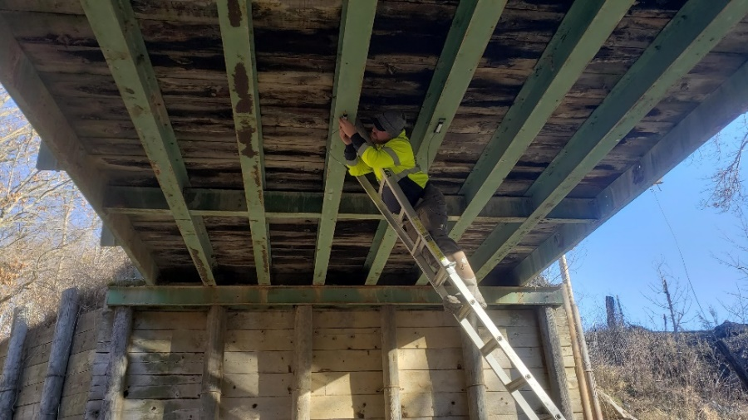
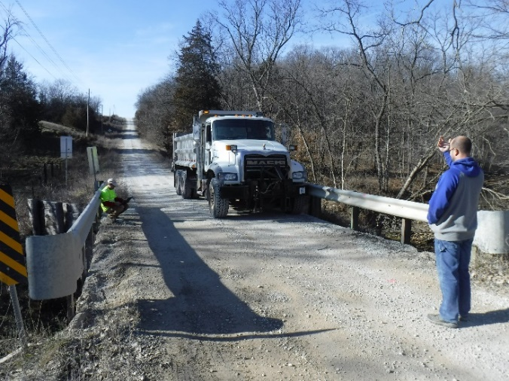
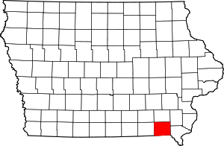
Bridge Load Testing Initiative: Van Buren County
Project agreed to with Kirkham Michael (engineering firm); Contract signed; Lifespan Technologies traveled to Iowa to conduct training on the equipment
3 bridges tested in Van Buren County on 12-10-20; Bridge #1: 25 tons → No load limits; Bridge #2: 7 tons → 17 tons; Bridge #3: 11 tons → 24 tons; Additional bridges to be tested in Van Buren County and other Iowa counties in 2021
“In my role as a county engineer, I seek to improve the utility and efficiency of the secondary road system without sacrificing the safety of the traveling public. I was very pleased with the results of the recent bridge load testing since they provided a thorough, objective assessment of the capabilities of the bridges. As a result, we are able to maintain safety while enhancing access to the road and bridge network Van Buren County residents have paid for.” Ryne Thornburg, County Engineer, Van Buren County

Slide 32
Collaboration Challenges
People care more about saying they are doing something vs. actually doing something.
The easiest next step is to commission a study or schedule another meeting.
Meetings can often become no more than a sequence of infomercials (a glorified “show & tell”) or multiple restatements of the problem.

Slide 33
Thank You
Soy Transportation Coalition
1255 SW Prairie Trail Parkway
Ankeny, Iowa 50023
515-727-0665
www.soytransportation.org
Mike Steenhoek, Executive Director
msteenhoek@soytransportation.org

